Slide 1
www.nasa.gov

Slide 2
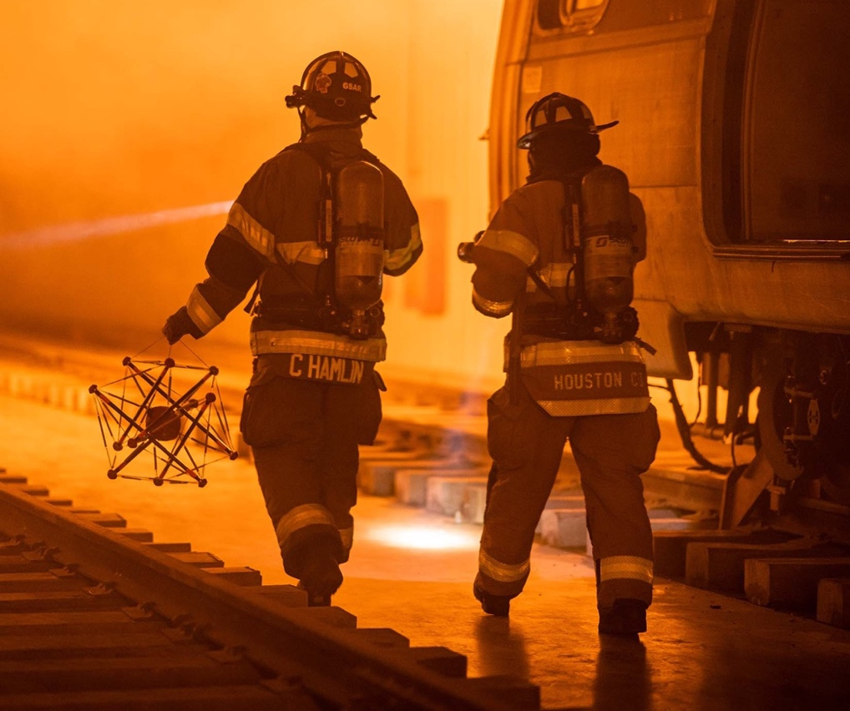
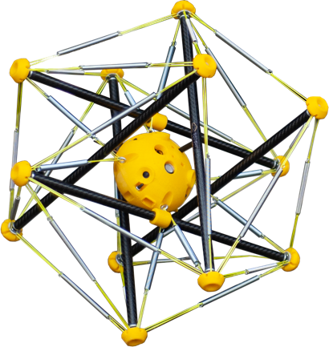
Spherical Robots to the Rescue
Scouting robots designed for space warn first responders of gas leaks, other dangers
Ames Research Center
Squishy Robotics: Berkeley, CA
Dr. Alice Agogino cofounded Berkeley, California-based Squishy Robotics after realizing spherical robots she was designing with NASA Early Stage Innovations funding to comb planetary and lunar surfaces could help first responders assess disaster scenes on Earth.

Slide 3
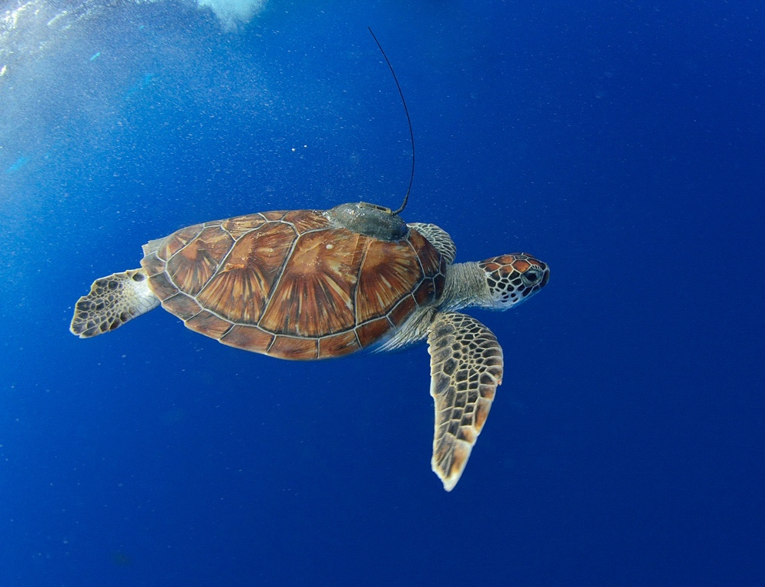
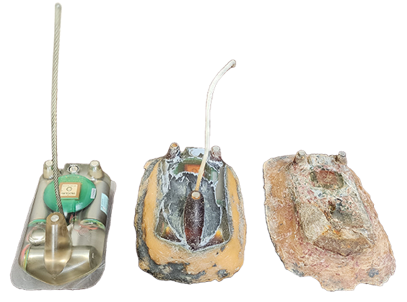
Satellites ‘See’ Sea Turtles, Ocean Threats
A tracking system in low-Earth orbit locates turtles, boats, birds, oil slicks, and more
Goddard Space Flight Center
CLS Group: Ramonville-Saint-Agne, France
Created under a former international partnership with NASA, Argos satellite technology is used for wildlife tracking. Now operated by CLS Group in Ramonville-Saint-Agne, France, the privately operated service tracks location and sensor data for tagged birds, oceangoing ships, stationary marine assets, and more.

Slide 4
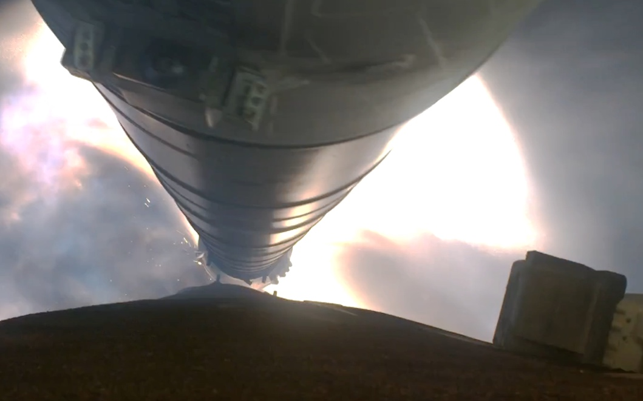
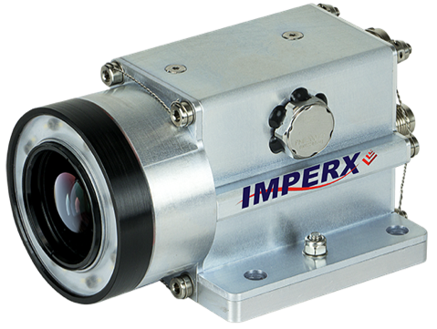
Redefining the ‘Rugged’ Video Camera
A new rocket-riding camera is tough enough for Earth
Marshall Space Flight Center
Imperx: Boca Raton, FL
A ruggedized video camera that captured footage of the Space Launch System rocket during launch and in the extreme temperatures of space is available in a commercial version, created by Boca Raton, Florida-based Imperx with a NASA license and expertise.

Slide 5
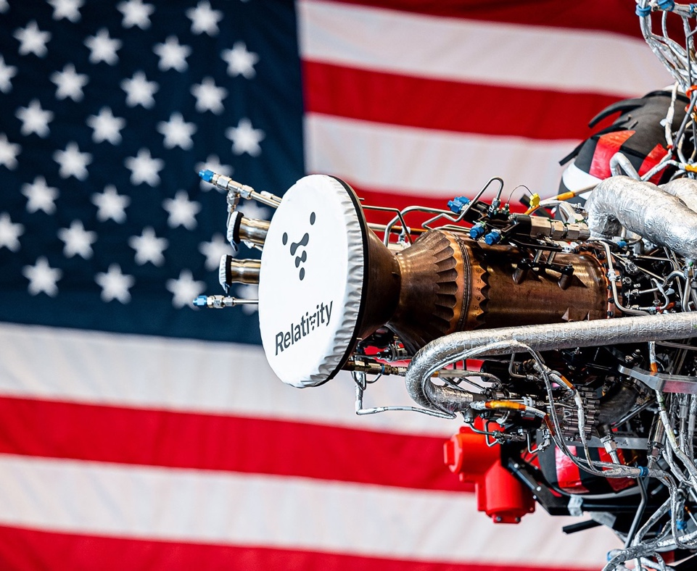
Additive Manufacturing Subtracts from Rocket Build Time
NASA teamwork on 3D printing and testing engines makes company’s launch services more affordable
Marshall Space Flight Center
Relativity Space: Long Beach, CA
Several Space Act Agreements helped Relativity Space of Long Beach, California, 3D print rocket engines using a NASA-invented alloy, and the company leases agency facilities to test the engines.

Slide 6
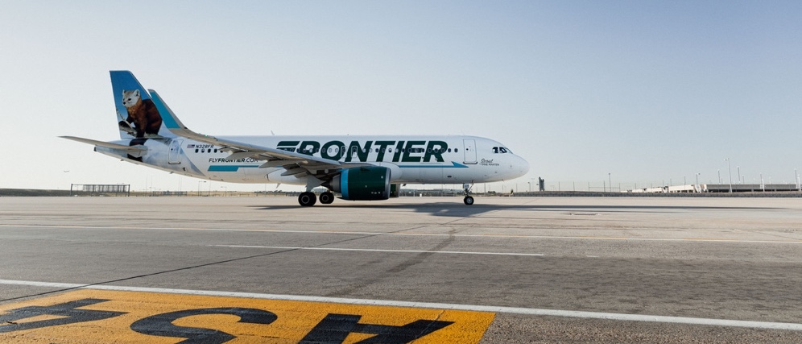
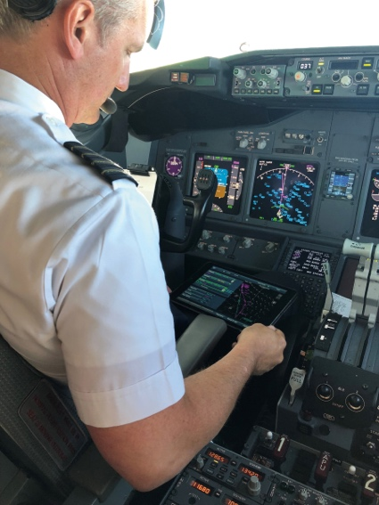
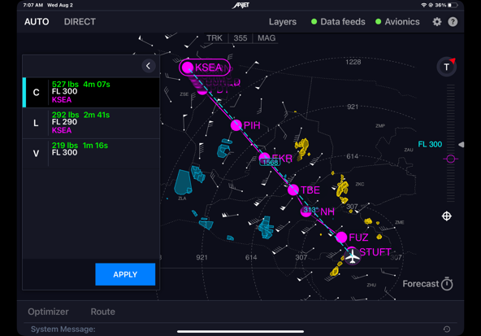
‘Digital Winglets’ for Real-Time Flight Paths
NASA-developed routing technology leads to fuel savings and smoother flights
Langley Research Center
APiJET: Seattle, WA
Through a NASA licensing agreement, APiJET of Seattle developed the Traffic Aware Strategic Aircrew Requests (TASAR) software into a commercial plane-routing technology that helps airlines save both time and fuel.

Slide 7
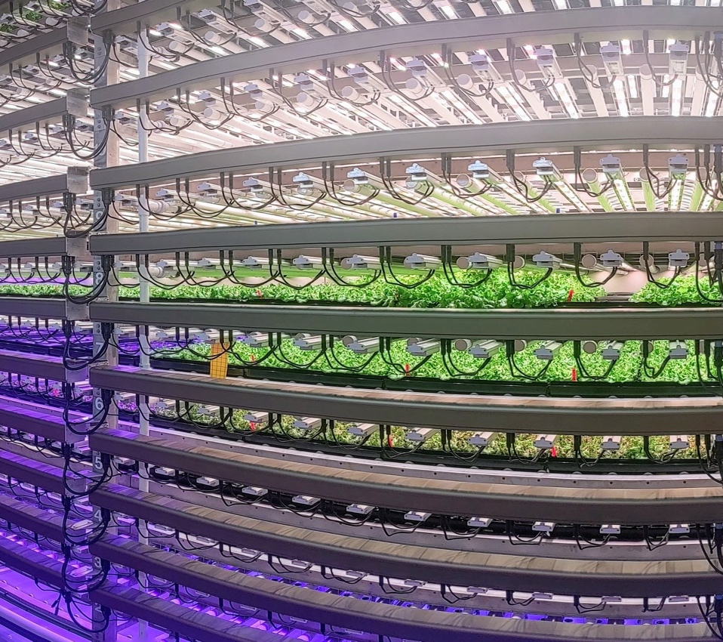
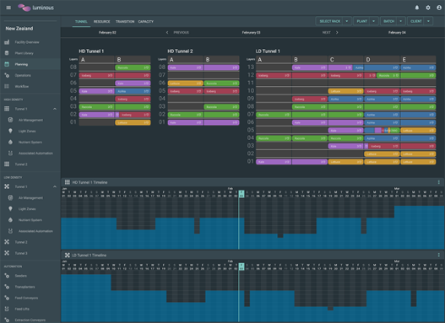
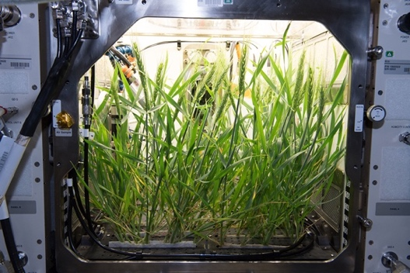
Next-Level Farming
NASA data and expertise help controlled environment agriculture reach new heights
Kennedy Space Center
IntraVision: Oslo, Norway
Closed-environment plant-growth data and expertise developed by NASA to feed astronauts on long-duration missions helped Oslo, Norway-based IntraVision Group develop complete indoor vertical growing systems and LED lighting to grow food on Earth.

Slide 8
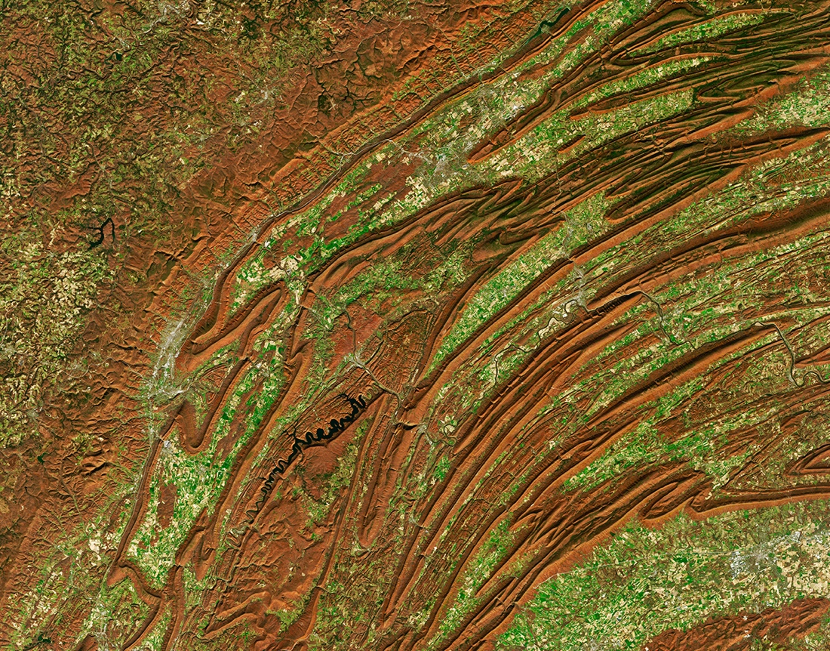
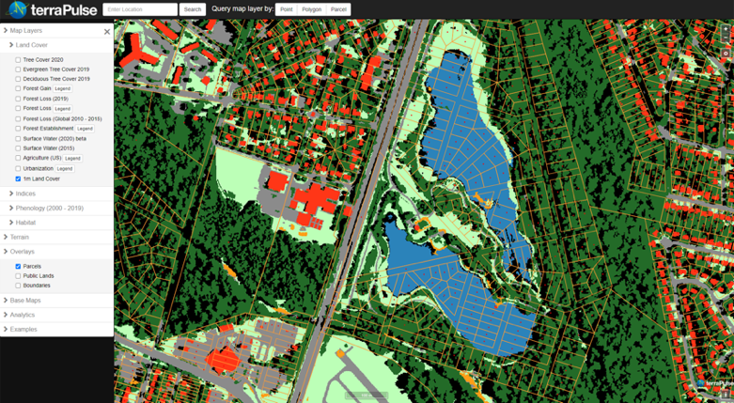
Taking the Pulse of Earth
Applying AI to Earth data reveals sustainable options for farming, reforestation, land management
Goddard Space Flight Center
terraPulse: North Potomac, MD
NASA satellite data and imagery combined with artificial intelligence developed by terraPulse enables customers of the North Potomac, Maryland-based company to monitor changes to Earth’s surface now and over the past 40 years.

Slide 9
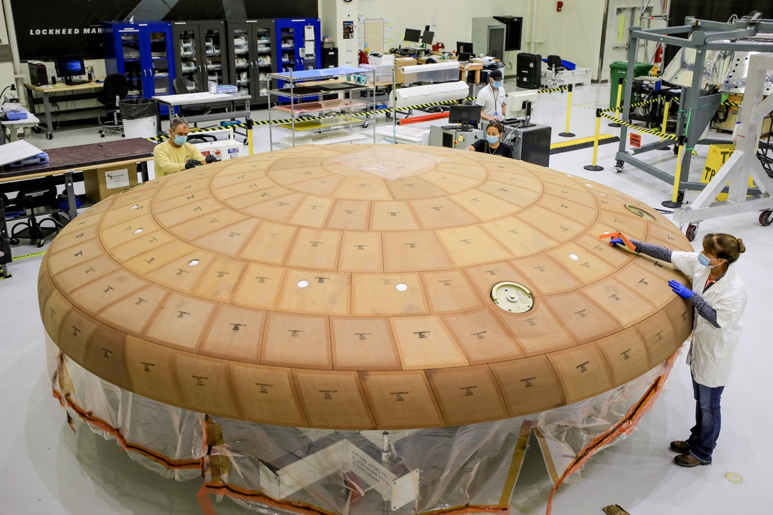
Ultrasonic Inspections Protect Astronauts, Boat Owners
Technology for inspecting Orion heat shield now checks integrity of composite materials in boats
Langley Research Center
ABS Group: Spring, TX
After NASA funded Aerospace Corporation’s development of an ultrasonic scanner that could detect defects inside the Orion spacecraft’s heat shield, ABS Group of Spring, Texas, adopted it for inspecting composite materials in boat hulls.

Slide 10
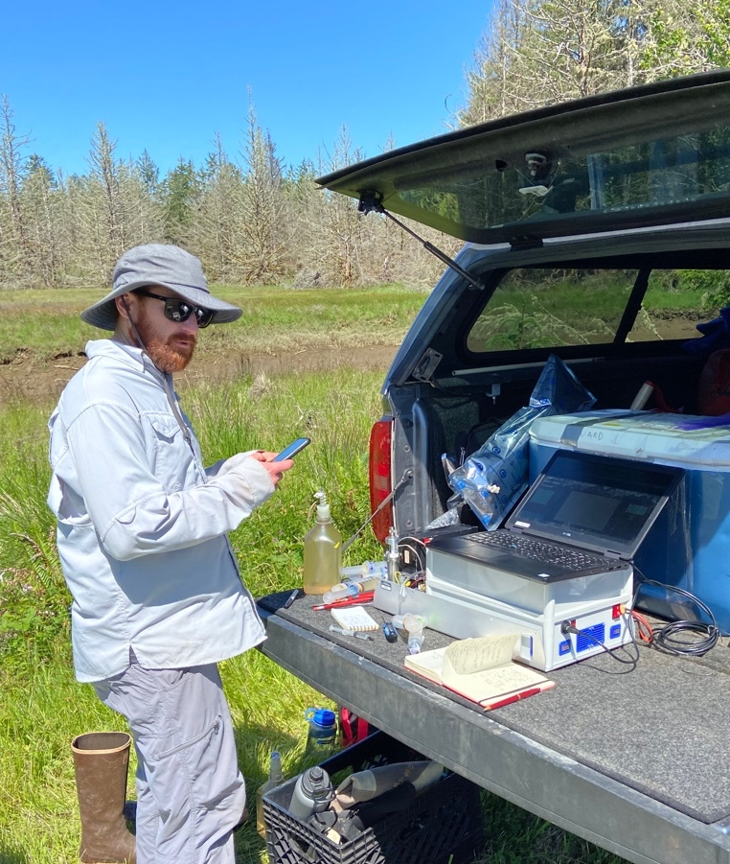
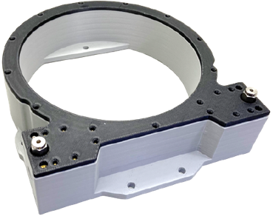
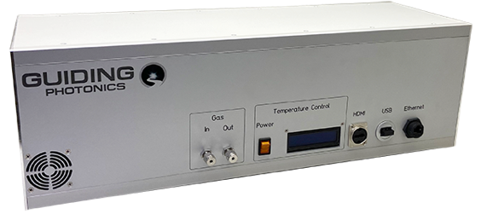
Oil Drillers, Environmentalists Agree on Small, Sensitive Spectrometer
Tiny tool to study water quality gets results anywhere
Jet Propulsion Laboratory
Guiding Photonics: Torrance, CA
NASA STTR funding and an agency scientist helped a company develop a small spectrometer capable of measuring trace gases and isotope ratios. Now Guiding Photonics of Torrance, California, offers the spectrometer to petroleum companies, conservationists, and others.

Slide 11
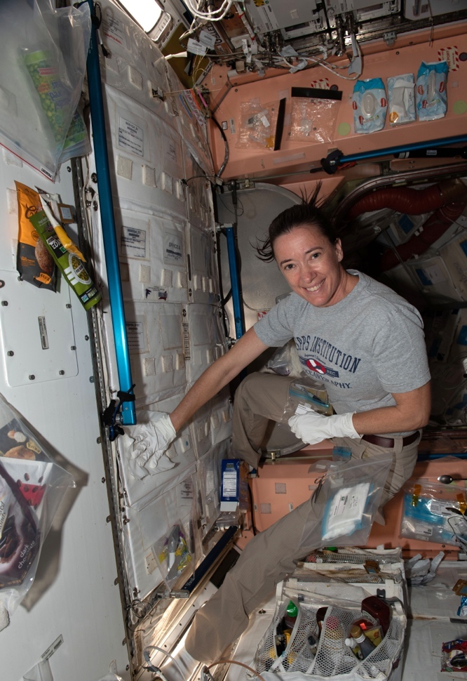
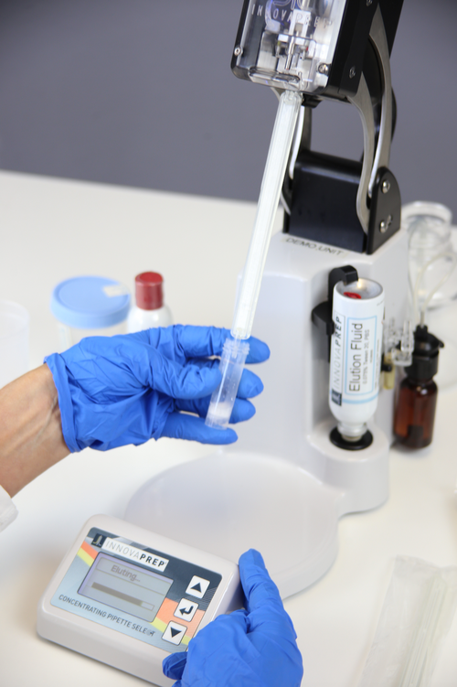
Concentrating on Microbes
Space station germ testing improves wastewater monitoring
Johnson Space Center
InnovaPrep: Drexel, MO
SBIR requirements and funding for testing water and air on the space station helped InnovaPrep of Drexel, Missouri, improve its commercial kits for testing water and air quality on Earth.

Slide 12
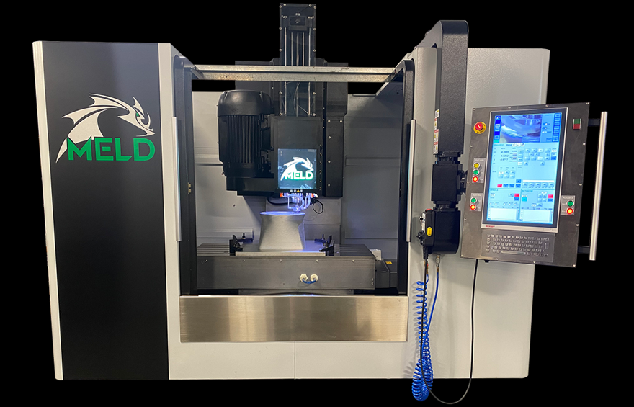
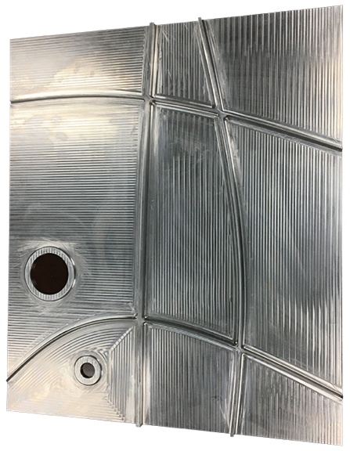
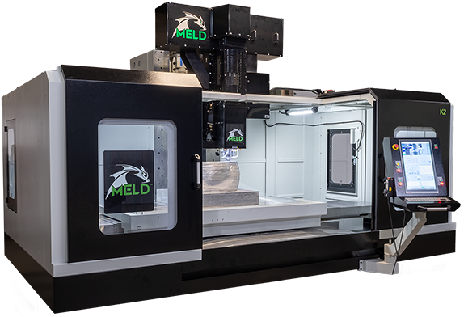
Rocket Manufacturing Meets Science Friction
Additive friction stir deposition builds bigger parts with more alloys
Langley Research Center
MELD Manufacturing: Christiansburg, VA
NASA SBIR funding helped prove a new metal 3D printing technique. Now MELD Manufacturing of Christiansburg, Virginia, sells 3D printers that can make huge parts with alloys that defy other additive manufacturing technologies.

Slide 13
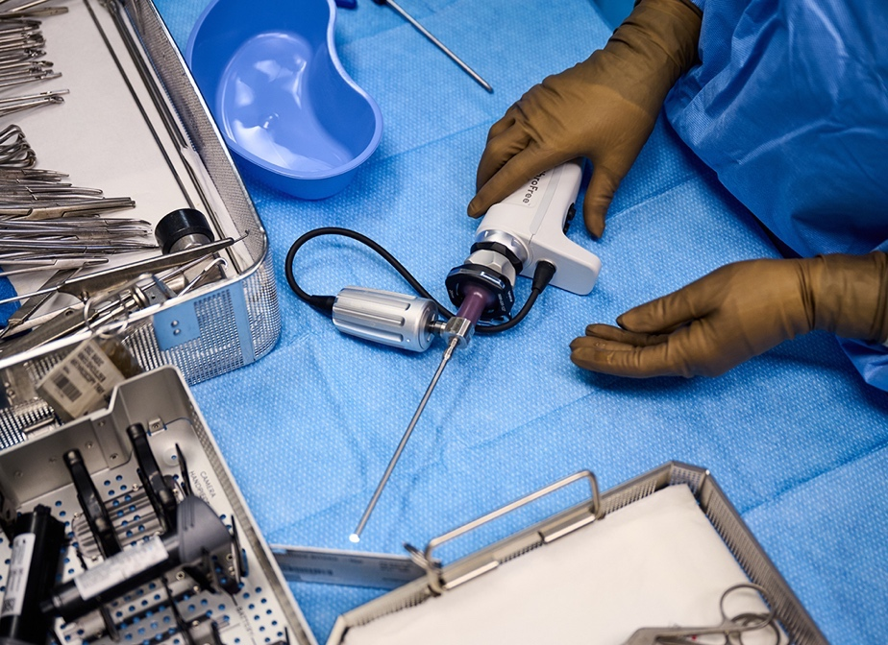
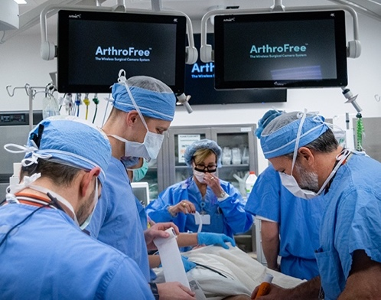
Cutting the Knee Surgery Cord
NASA experts offered early advice on first FDA-cleared wireless arthroscopic camera
Glenn Research Center
Lazurite: Cleveland, OH
The first FDA-cleared wireless arthroscopic camera – for knee surgeries and other orthopedic procedures – got early support from NASA through the Adopt a City program, which enabled agency engineers to consult with companies like Cleveland-based Lazurite, the device manufacturer.

Slide 14
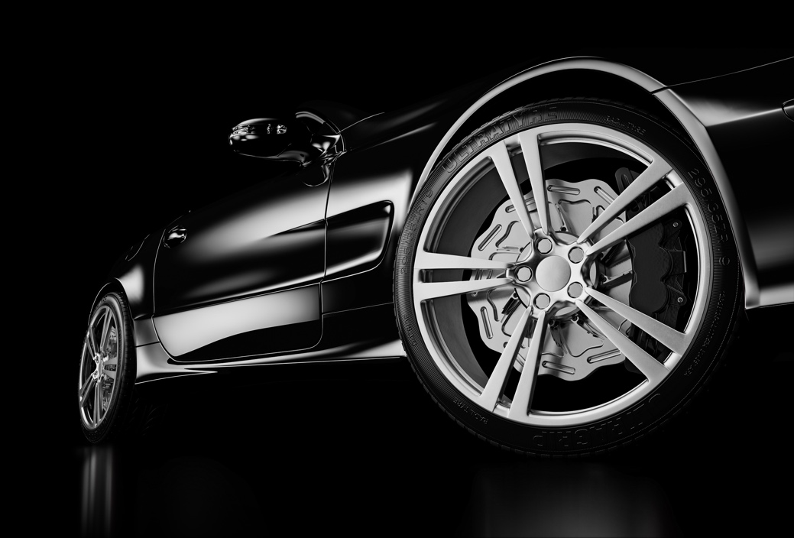
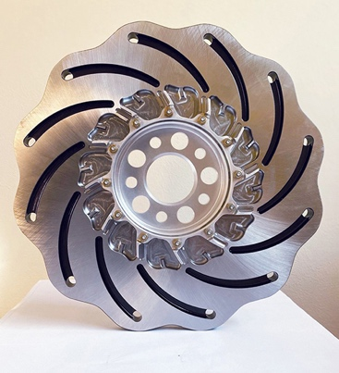
NASA Gives the World a Brake
Space agency invention puts a new spin on automotive brake rotors
Marshall Space Flight Center
Orbis Brakes: Santa Rosa, CA
The NextWave disc brake by Orbis Brakes of Santa Rosa, California, replaces existing disc rotors in high-performance cars thanks to exclusive licenses for NASA patents.

Slide 15
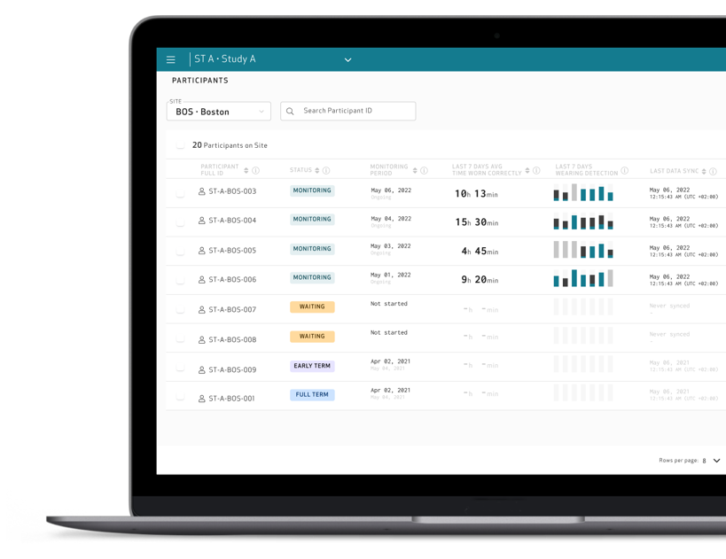
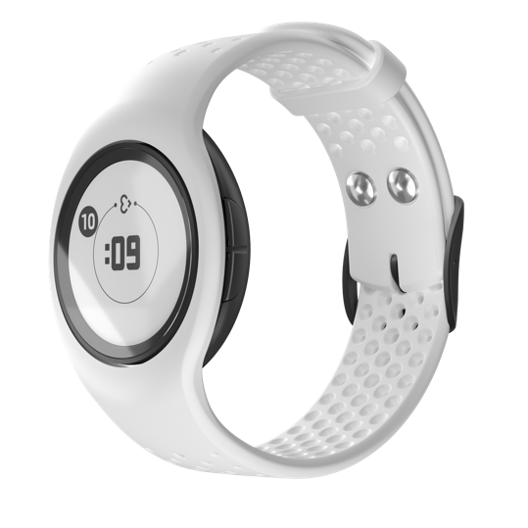
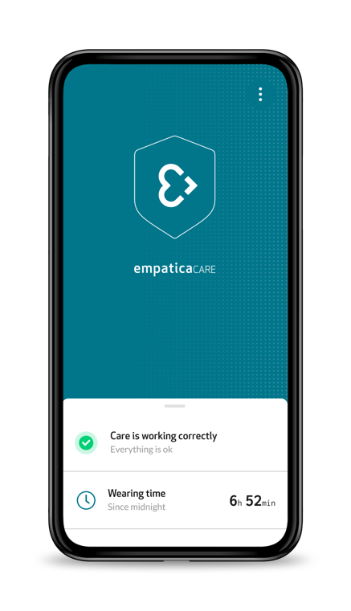
Medical-Grade Smartwatch Can Monitor Astronauts, Patients
NASA-backed consortium helped develop device for clinical trials, academic research, outpatient monitoring
Johnson Space Center
Empatica: Cambridge, MA
Empatica of Cambridge, Massachusetts, developed its EmbracePlus wearable device with funding from a NASA-backed research consortium. The smartwatch can monitor astronauts’ physiology, but it’s also being used in clinical trials and to observe outpatients.

Slide 16
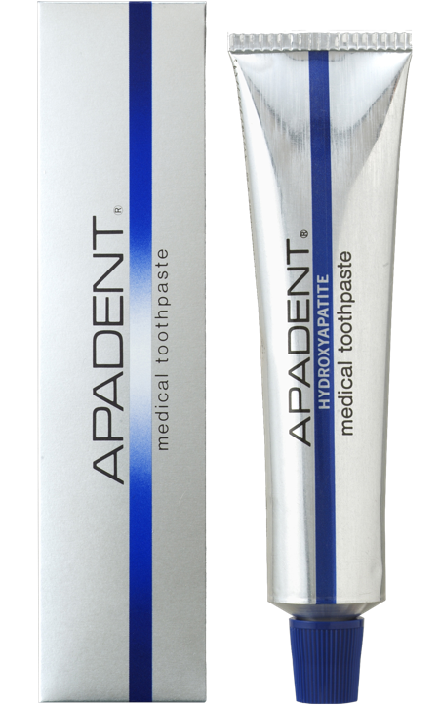
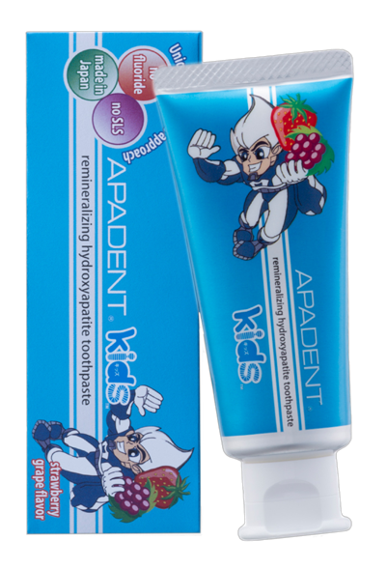
Semiconductor Research Leads to Revolution in Dental Care
Crystals grown for space electronics lead to profusion of remineralizing toothpastes
NASA Electronics Research Center
Sangi: Tokyo, Japan
Tokyo-based Sangi Co. acquired a NASA patent for repairing teeth by growing hydroxyapatite crystals, leading the company to develop the first hydroxyapatite-based remineralizing toothpastes in the 1980s. Hundreds of other companies have followed suit.

Slide 17
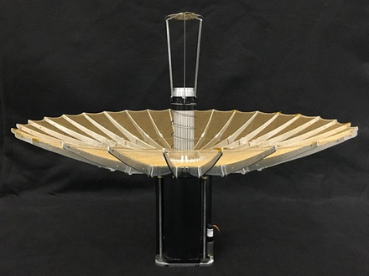
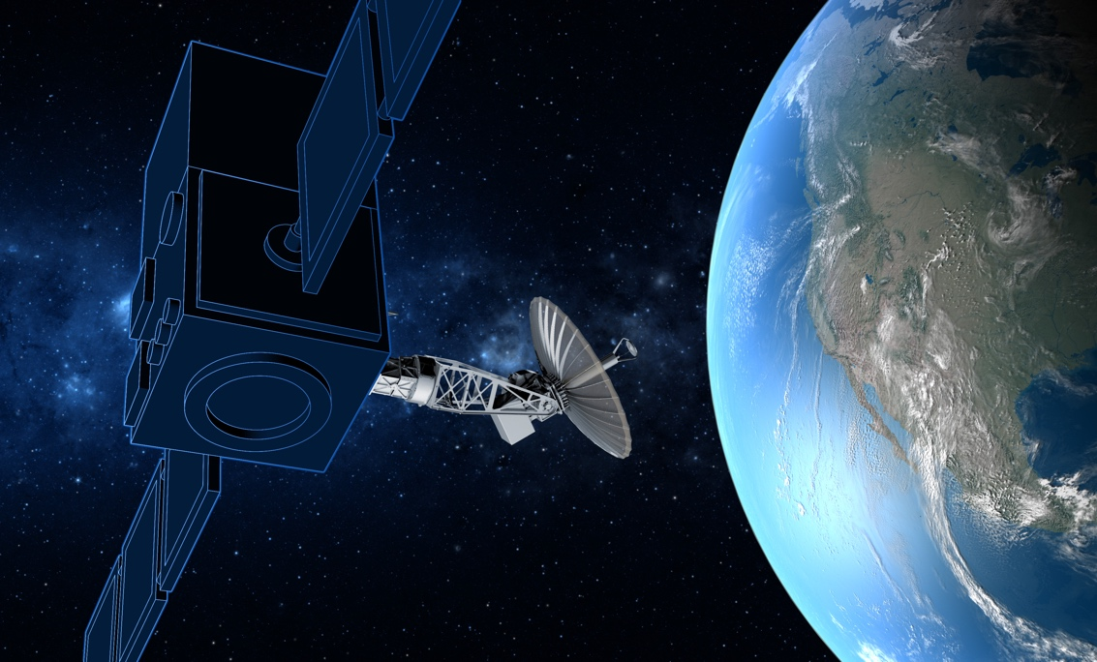
Unfurling Antennas Let Tiny Satellites Do Big Things
High-gain antennas for communication and imaging can now ride smaller, cheaper spacecraft
Jet Propulsion Laboratory
Tendeg: Louisville, CO
A contract to develop a NASA antenna, along with an agency license, SBIR funding, and a former NASA chief engineer, all helped Tendeg of Louisville, Colorado, develop high-performance antennas that collapse to fit into small satellites.

Slide 18
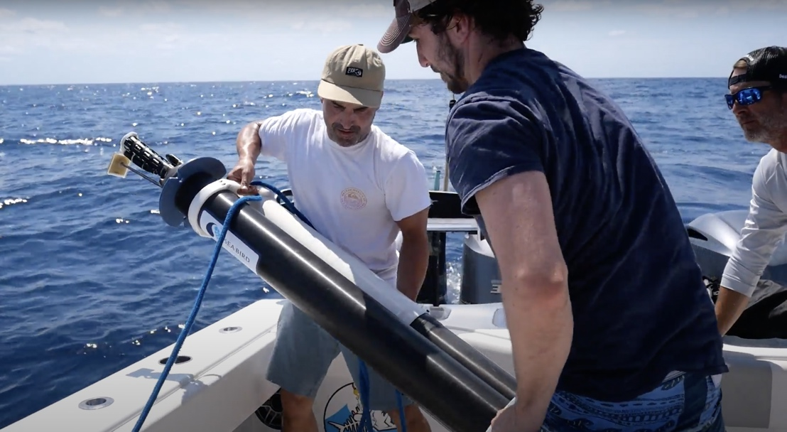
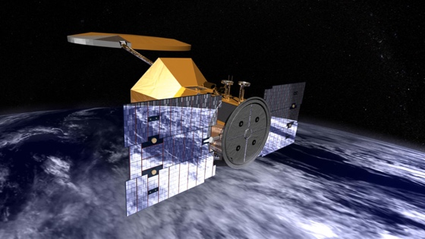
New Energy Source Powers Subsea Robots Indefinitely
Power modules driven by ocean temperatures save money, reduce pollution by living forever
Jet Propulsion Laboratory
Seatrec: Vista, CA
Seatrec of Vista, California, licenses technology its founder developed at NASA. Its modules generate energy to power robotic ocean floats when material inside them melts and expands as they rise into warmer waters.

Slide 19
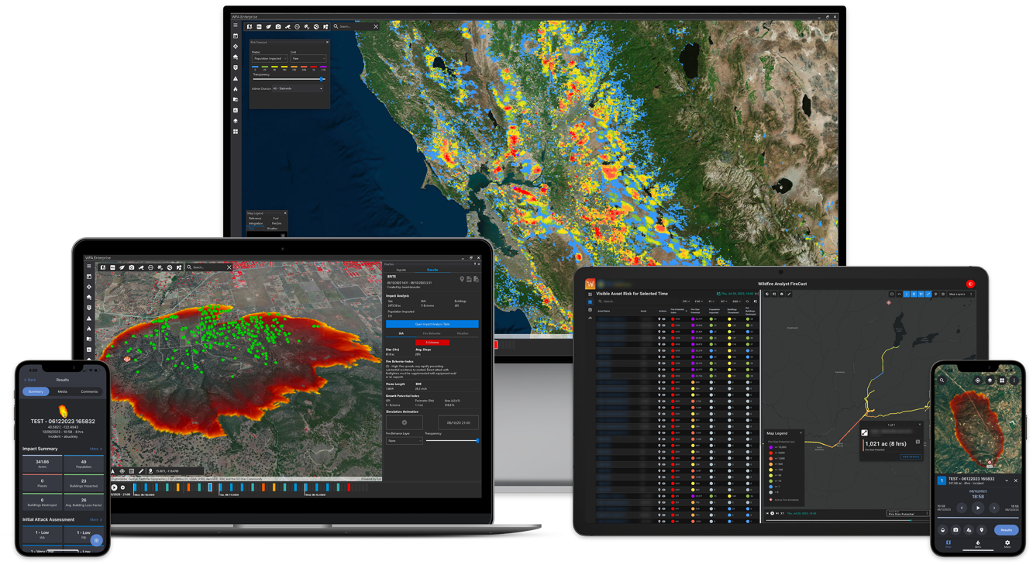
Where the Wildfires Are
Simulation, prediction, and response software helps businesses and communities cope with disaster
Ames Research Center
Technosylva: San Diego, CA
San Diego-based Technosylva’s wildfire monitoring service employs NASA Earth-observation data along with other wildfire resources, artificial intelligence, and machine learning to predict, monitor, and support post-fire recovery.

Slide 20
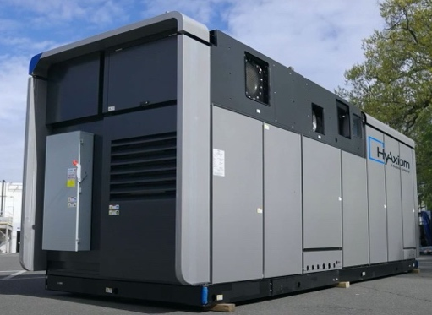
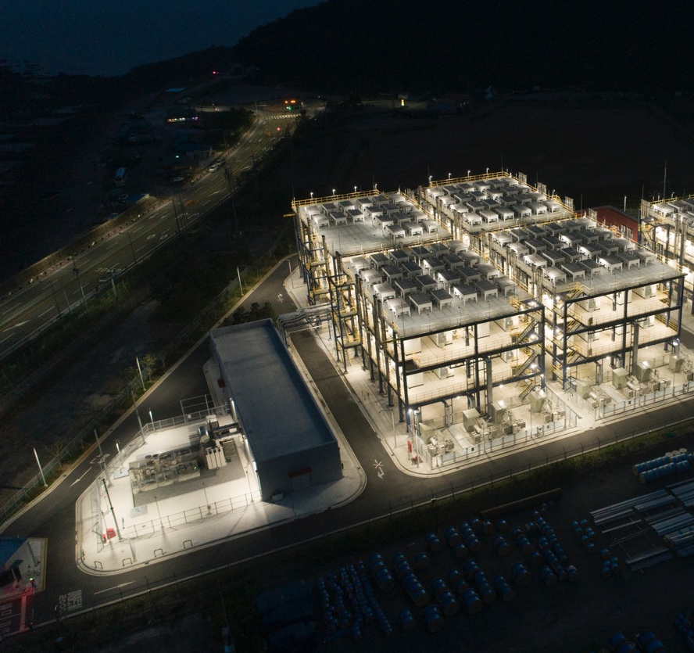
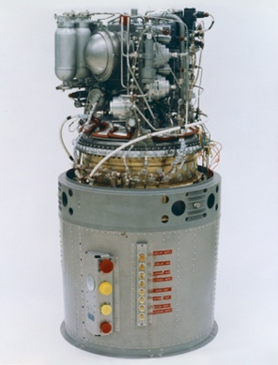
NASA’s Moon Shot Launched Commercial Fuel Cell Industry
Agency’s technology development prepared fuel cells for tomorrow’s renewable energy grids
Johnson Space Center
HyAxiom: South Windsor, CT
Fuel cells were first pioneered in preparation for NASA’s Apollo missions. The group that developed these and subsequent NASA fuel cells, now called HyAxiom, manufactures commercial fuel cells at the same facility in South Windsor, Connecticut.

Slide 21
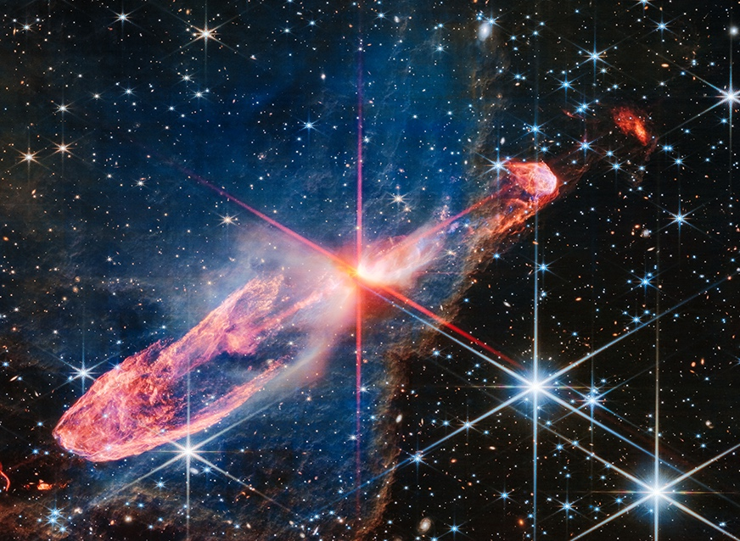
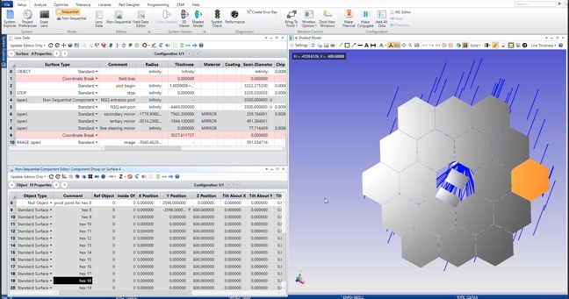
Webb Telescope Made Simulation Software Better
The observatory pushed optical modeling capabilities, driving advances in software used to design medical and augmented reality devices
Glenn Research Center
Ansys: Canonsburg, PA
Webb Telescope developers relied heavily on simulation software, helping to advance the whole field of integrated modeling, including OpticStudio, a suite that was used to develop the observatory and is now sold by Canonsburg, Pennsylvania-based Ansys.

Slide 22
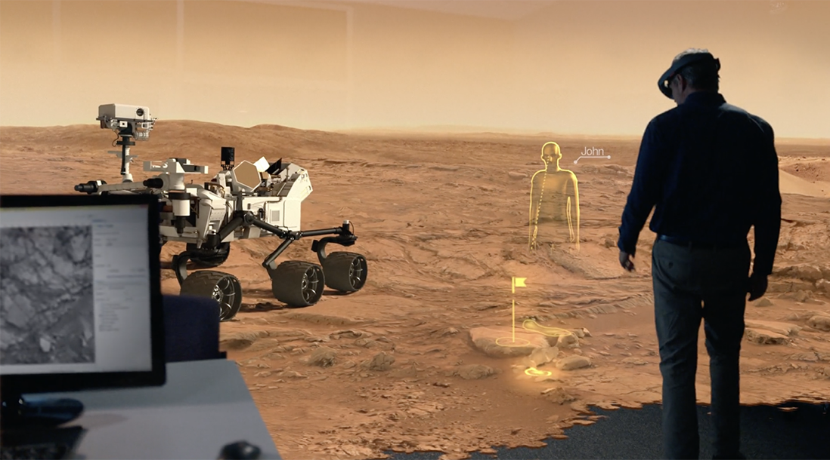
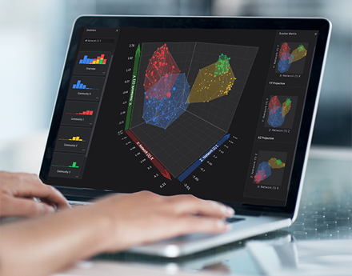
A Virtual World of Data
Experience gained with NASA helps one company engineer a variety of aviation resources
Jet Propulsion Laboratory
Virtualitics: Pasadena, CA
Using patented NASA technology, as well as the founders’ experience creating data visualization systems for the space agency, Virtualitics of Pasadena, California, developed software that analysts can use to examine statistics in three dimensions, from a spreadsheet to thousands of data points.

Slide 23
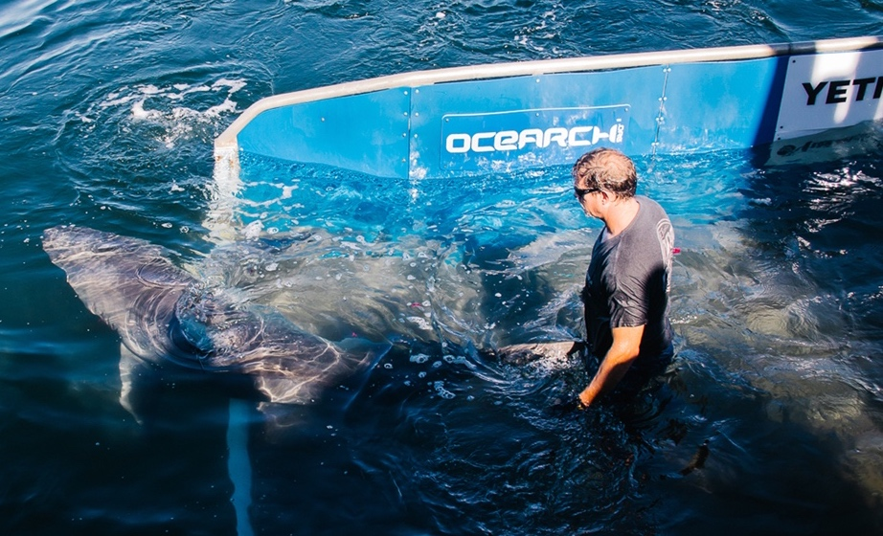
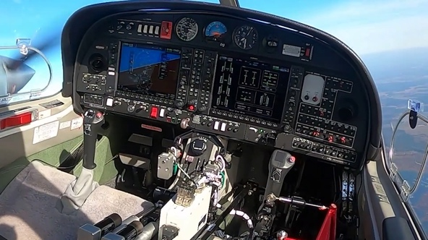
From Shark Searches to Space Tours
Experience gained with NASA helps one company engineer a variety of aviation resources
Armstrong Flight Research Center
Aurora Flight Sciences: Manassas, VA
Aurora Flight Sciences incorporates NASA expertise gained through multiple SBIR contracts to develop technology that enables remote piloting of conventional small planes. The Manassas, Virginia-based company also designs and tests remotely piloted vehicles, in addition to fabricating parts for drones and airplanes.

Slide 24
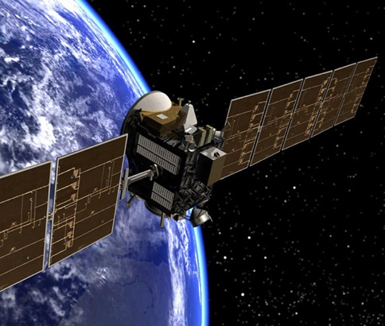
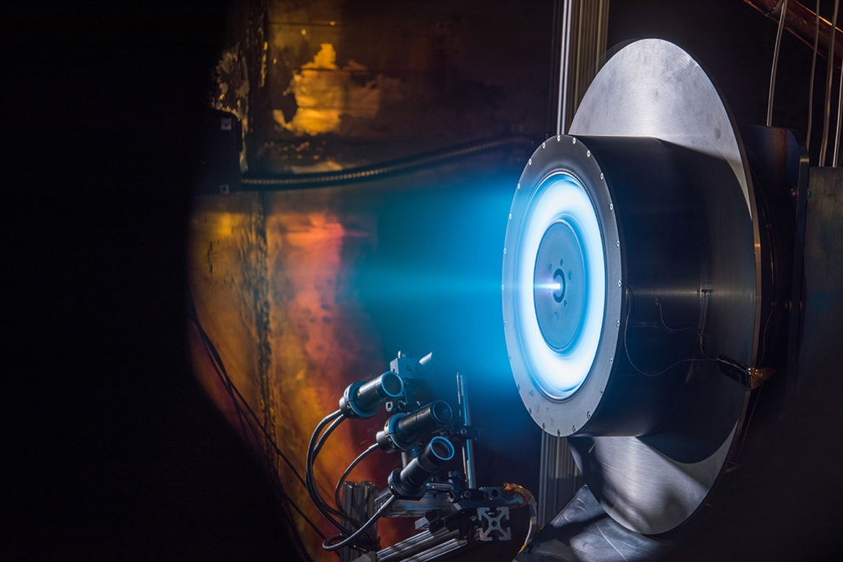
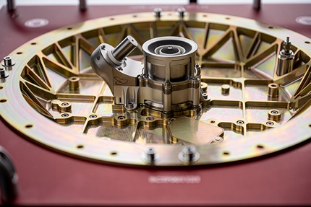
Ion Thrusters Keep Satellites Going and Going
NASA electric thruster expertise, data keep commercial satellites on the clock
Glenn Research Center
Orbion Space Technology: Houghton, MI
When Orbion Space Technology of Houghton, Michigan, wanted to bring high-efficiency ion thrusters to the commercial satellite industry, the company entered into agreements with NASA to receive guidance and data about how to build the perfect thrusters for small satellites.

Slide 25
Artificial Eyes Give Pilots a New Worldview
External vision system for supersonic test plane raises standard for flight camera video quality
Langley Research Center
WOLF Advanced Technology: Cleveland, OH
Combining ultra-high-definition video streams from multiple cameras on NASA’s X-59 Quiet SuperSonic Technology X-plane required new video cards to process the data. A NASA contract allowed WOLF Advanced Technology in Cleveland to develop its next-generation frame grabber, capable of supporting ultra-high-definition distributed video.

Slide 26
Ballooning Business for Shrinking Cameras
NASA-funded miniaturized technology offers better imagery than a satellite
Goddard Space Flight Center
Delsys: Natick, MA
Miniaturized sensors that fly on a zero-pressure balloon collect data and take pictures that are as expansive as satellite images but are more precise. Denver-based Urban Sky leveraged SBIR funding from NASA to create sensors lighter than off-the-shelf options.

Slide 27
Farmers Get Tools from Space
Service combines data from NASA sensors in orbit to determine current field conditions
Goddard Space Flight Center
IrriWatch: Wageningen, Netherlands
IrriWatch of Wageningen, Netherlands, uses streams of publicly available data from NASA-built instruments in orbit, including the Ecosystem Spaceborne Thermal Radiometer Experiment, to calculate plant stress and other factors important to agriculture for farmers’ fields all over the world. Farmers now buy the near-real-time information as a subscription-based service.

Slide 28
Commercial Space: NASA Has an App for That
Software two decades in the making helps private space companies save time, money
Goddard Space Flight Center
Red Canyon Software: Denver, CO
Commercial space vehicles, from satellites to lunar landers, need flight software. Red Canyon Software uses an open-source program developed by NASA to help businesses get to space faster and cheaper. Apps that the Denver-based company built off the software are quickly adapted to meet needs from collecting sensor data to descent and landing.

Slide 29
Keeping the Connection
NASA-proven radio enables satellite-to-satellite communication
Kennedy Space Center
NearSpace Launch: Upland, IN
After a NASA test-flight program proved the capability of a tiny radio that enables satellite-to-satellite communication, Upland, Indiana-based NearSpace Launch made it commercially available. Adding GPS made it possible for anyone to track a CubeSat in low-Earth orbit.

Slide 30
NASA Ingredients for Industrial Expedience
NASA funding enables large-scale inductive heating for food production
Johnson Space Center
Induction Food Systems: Durham, NC
When NASA wanted to explore ways of cooking food for long-term habitation in deep space, Induction Food Systems of Durham, North Carolina, received SBIR funding to develop induction heating for this application. The work led the company to a whole new market in industrial-scale induction heating.

Slide 31
Keeping Beds in the Goldilocks Zone
NASA experience inspires machine that keeps sleepers comfortable
Johnson Space Center
Bedjet: Newport, RI
Using his former experience as an engineer working on spacesuit environmental control systems, the founder of Bedjet LLC of Newport, Rhode Island, designed a cooling system to keep each side of the bed at its occupant’s ideal temperature.

Slide 32
Making the Most of Meticulous Measurements
Better space telescope testing makes waves in optics industry
Goddard Space Flight Center
4D Technology: Tucson, AZ
4D Technology of Tucson, Arizona, was contracted to develop measuring instruments that could ensure the James Webb Space Telescope could see distant galaxies. This equipment is now used to test precision optics of all kinds, from camera lenses to virtual reality headsets.

Slide 33
Pumping Out State-of-the-Art Design
Engineering expertise gained with NASA improves pump machinery design, analysis
Marshall Space Flight Center
Concepts NREC: White River Junction, VT
Decades of collaboration on multiple SBIR contracts gave Concepts NREC LLC extensive access to NASA rocket engine expertise. The White River Junction, Vermont-based company incorporates Marshall Space Flight Center know-how into its commercial software, engineering, and manufacturing services to help improve commercial rocket engines, pump machinery, and numerous industrial applications.

Slide 34
Super Insulation Requires Super Materials
NASA researchers helped create an insulation coating that blocks heat and sunlight
Marshall Space Flight Center
SPI: Shawnee, KS
When developing a new coating to protect buildings from heat buildup, Superior Products International II of Shawnee, Kansas, reached out to experts at a NASA materials lab for help finding a ceramic compound that could be incorporated into a heat-resistant spray insulation.

Slide 35
From Magnetic Rocket Fuel to Semiconductors
A South Korean company offers ferrofluids for a variety of applications
Glenn Research Center
MAGRON: Ansan, South Korea
A liquid with magnetic properties developed by NASA in the 1960s is the basis for ferrofluids now sold by MAGRON, a company in Ansan, South Korea, whose customers use them in semiconductor manufacturing, fishing rods, and other consumer products. NASA researchers originally considered the technology as a way to move fuel to rocket thrusters in zero gravity.

Slide 36
A Huge Development for Tiny Satellites
A South Korean company offers ferrofluids for a variety of applications
Goddard Space Flight Center
Thermal Management Technologies: Logan, UT
To fit tiny satellites into tinier spaces on launch vehicles, Goddard Space Flight Center developed a new equipment-deployment system that’s more reliable than previous solutions. Thermal Management Technologies LLC of Logan, Utah, later licensed this technology for use on commercial satellites.

Slide 37
Connections Made in Air and Space
Industry benefits from networking hardware designed for Orion
Johnson Space Center
DornerWorks: Grand Rapids, MI
When Johnson Space Center needed an Ethernet switch on the Orion capsule to manage data the spacecraft beams back to Earth, DornerWorks Ltd. of Grand Rapids, Michigan, was subcontracted to construct a spaceworthy piece of hardware. The company now licenses this switching technology to other firms for applications such as self-driving cars.

Slide 38
Synthetic DNA Diagnoses COVID, Cancer
NASA-funded molecular research enables better disease detection
NASA Headquarters
Firebird Diagnostics: Alachua, FL
Synthetic DNA used to diagnose diseases such as COVID, hepatitis, and cancer was developed by Firebird Diagnostics of Alachua, Florida, with research funded in part by the NASA Astrobiology Program. The technology could also help find life on other planets or moons by identifying DNA characteristics that might be Earth-specific and looking beyond them.

Slide 39
Fixing ‘Thermal Incompatibility’ in the Bedroom
Temperature-regulating bedding based on NASA-funded research keeps people comfy at bedtime
Johnson Space Center
Slumber Cloud: Arvada, CO
In the 1980s, NASA explored using phase-change materials to regulate temperatures in spacesuits. Funding from an SBIR contract resulted in a commercial textile product called Outlast. Global Web Horizons of Arvada, Colorado, doing business as Slumber Cloud, now incorporates this material into various kinds of bedding and loungewear.

Slide 40
Aqua Solutions for Terra Firma
NASA satellite imagery supports weather app for farmers in drought-stricken regions of India
Goddard Space Flight Center
ilika Geospatial: Edison, NJ
To provide weather information to underserved farming communities in India, ilika Geospatial of Edison, New Jersey, developed a weather app that uses data from the Aqua and Terra satellites operated by NASA to provide accurate forecasts in the Indian subcontinent. The company also uses this satellite data for its wider geospatial intelligence business.

Slide 41
From Space to Your Face
Radiation-resistant microbe studied in space leads to fewer wrinkles, less sun damage on Earth
Jet Propulsion Laboratory
Delavie Sciences: Worcester, MA
A bacterium that survived NASA sanitization efforts as well as 18 months in space is now the basis for an SPF-boosting sunscreen additive developed by Delavie Sciences of Worcester, Massachusetts, which licensed the organism patented by NASA researchers.

Slide 42
Eco-Friendly Bio Breaks
NASA-derived superabsorbent polymer helps relieve hikers, reduce pollution
Johnson Space Center
Cleanwaste: Oceanside, CA
American Innotek took a polymer utilized in astronaut undergarments to manage human waste on spacewalks and incorporated it into bags for use on the go. Sold under the brand Cleanwaste, these products allow campers and hikers to use the restroom anywhere, preventing pollution in campgrounds and national parks.

Slide 43
Space-Saving Exploration
Space habitat expertise drives recreational vehicle design
Johnson Space Center
Taxa Outdoors: Houston, TX
Putting the “fun” into functional campers is what Taxa Outdoors of Houston does using the know-how of a former NASA employee. Design principles developed for living quarters in space helped the company design five trailers that maximize space to include everything a camper could need.

Slide 44
Air Treatment Systems Break Down Pollutants, Germs
Technology pioneered for space plant-growth chambers cleans indoor air
Marshall Space Flight Center
Fresh-Aire UV: Jupiter, FL
Fresh-Aire UV of Jupiter, Florida, developed air purifiers that break down organic contaminants with a process called photocatalytic oxidation (PCO). The company gets one of its key ingredients from a company that employs the researcher who invented PCO with NASA funding in the 1990s.

Slide 45
Temperature-Regulating Clothing Additive Heats Up
Materials for coating spaceplanes maintain comfort in outerwear, sports uniforms, jeans
Ames Research Center
Trizar Technology: North Naples, FL
A highly emissive coating that NASA invented to protect the heat shield on a planned spaceplane in the 1990s was licensed and turned into the Emisshield product line. Now it’s been incorporated into textiles by Clean Textile Technology of North Naples, Florida, under the brand name Trizar and improves temperature regulation in various outdoor gear and other apparel.

