Slide 2
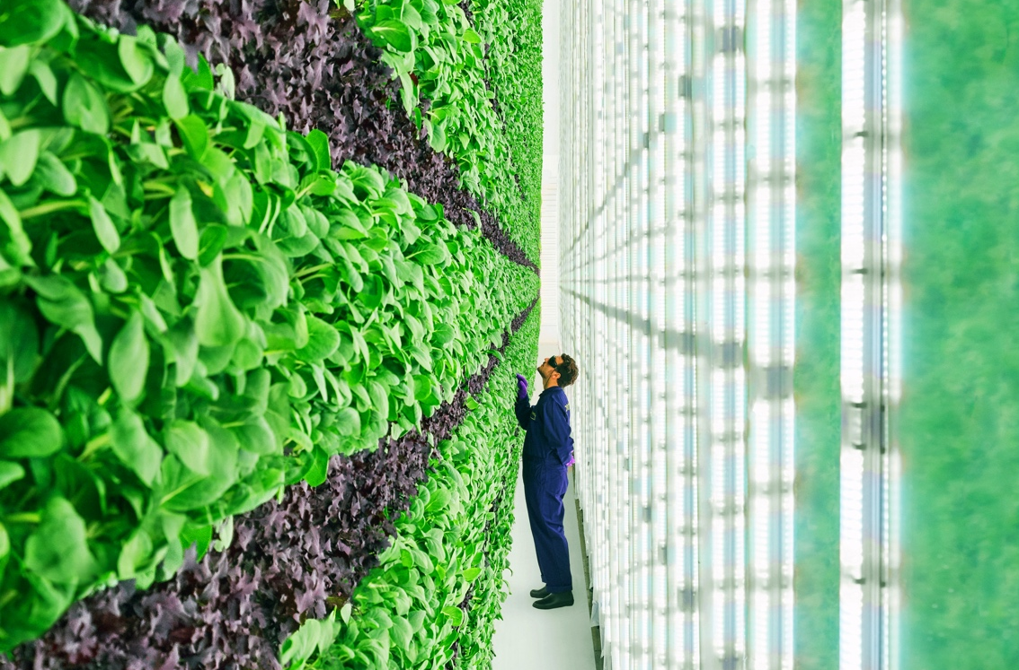
A Moveable Feast: Plant Research for Space Advances Earth Agriculture
NASA’s vertical farm, the first in the country, provided a foundation for expanding the controlled environment agriculture industry
Spinoff Theme
NASA’s vertical farming techniques, developed to feed astronauts on long missions, are enabling sustainable, high-yield crop growth with a small footprint.

Slide 3
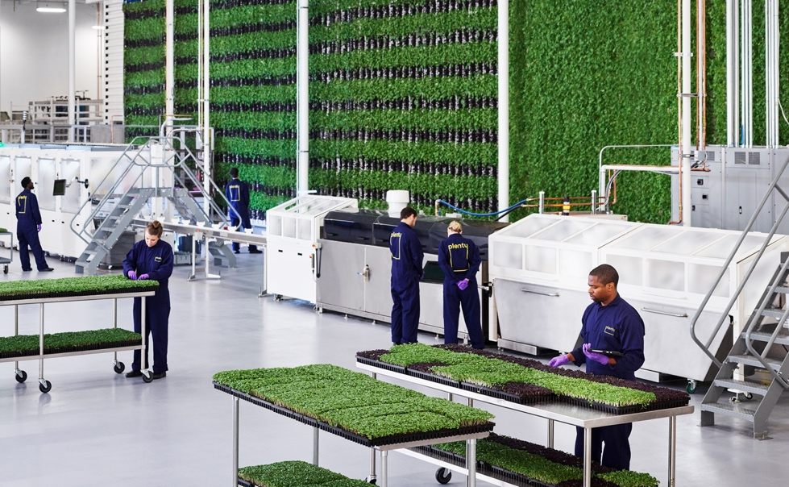
Space Inspired Farming
Kennedy Space Center
Plenty Unlimited: San Francisco, CA
Plenty Unlimited Inc. relied on data published by NASA about the first controlled-environment, vertical farm in the U.S. to design and build a highly automated urban farm that uses 1% of the water traditional agriculture requires.

Slide 4
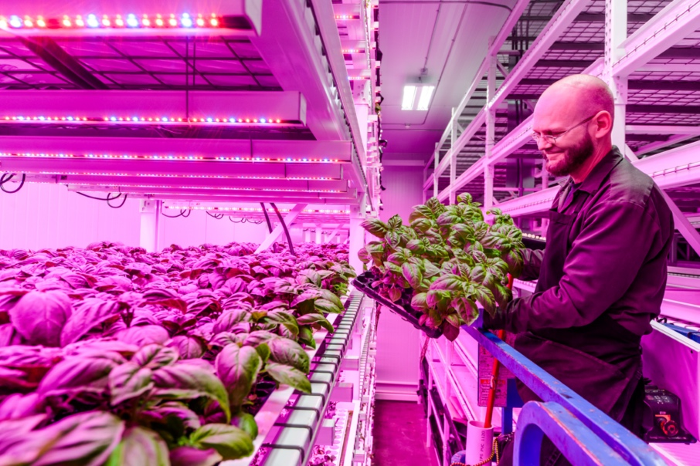
Plant-Growth R&D
Kennedy Space Center
Green Sense Farm Holdings: Portage, IN
Building on plant data from NASA growth experiments, Green Sense Farm Holdings Inc. develops and automates optimal growing conditions for plant varieties for Earth-bound indoor farmers.

Slide 5
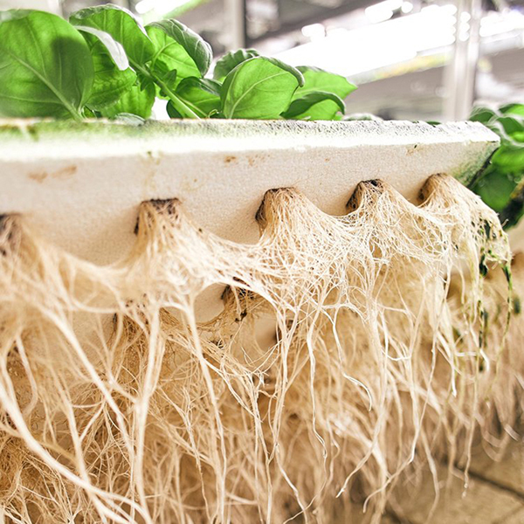
Redefining ‘Data Farm’
Kennedy Space Center
Bowery Farming: New York, NY
To convert existing buildings into indoor farms, Bowery Farming Inc. is leveraging the vertical farm structure NASA originated, along with the expertise of employees who participated in NASA-funded plant-growth research projects.

Slide 6
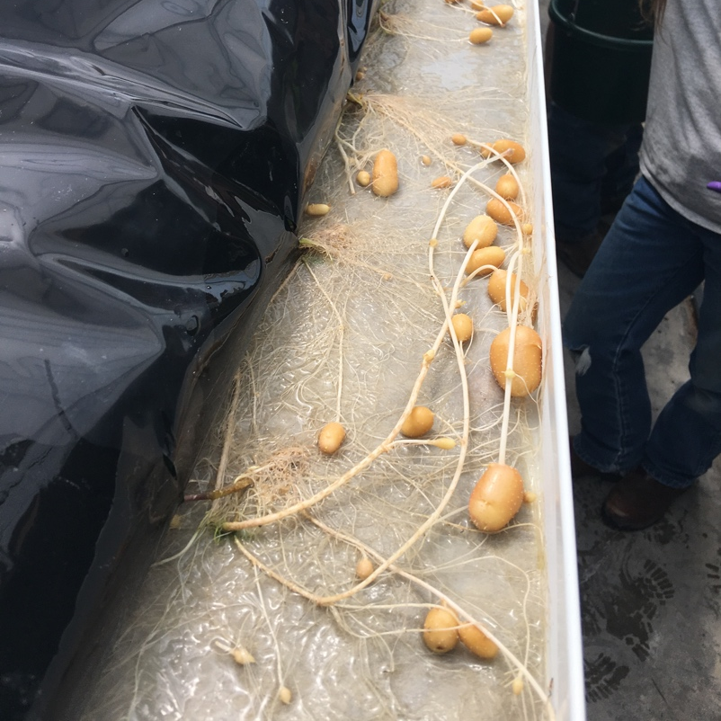
Specialized Spuds
Kennedy Space Center
CSS Farms: Watertown, SD
Dramatic greenhouse yields at CSS Farms LLC are the result of a NASA-developed hydroponic growing method specifically for root vegetables such as potatoes.

Slide 7
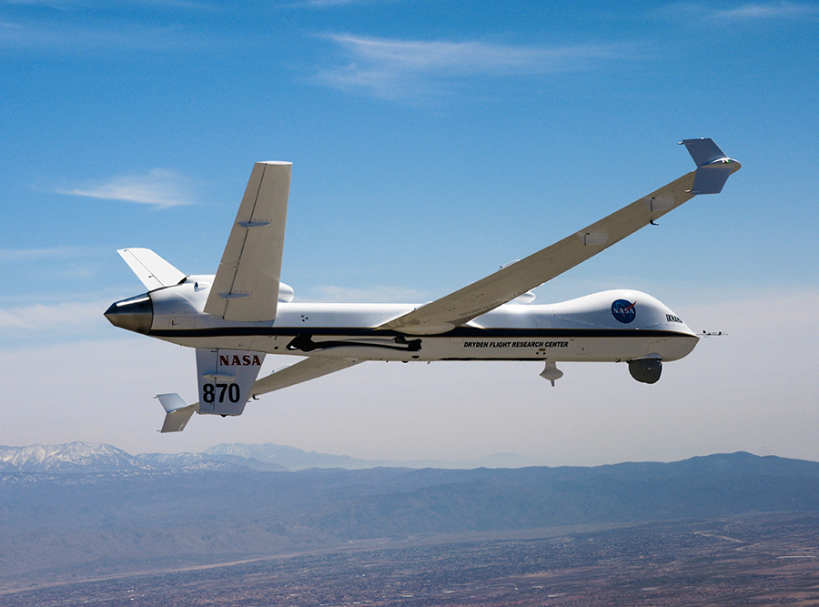
NASA Helps Drones Take Flight
The agency has helped develop the foundational technology and systems that are enabling remotely piloted aircraft to fill our skies
Spinoff Theme
Software, research, and testing environments provided by NASA are providing the critical groundwork to help drones navigate better and avoid accidents.

Slide 8
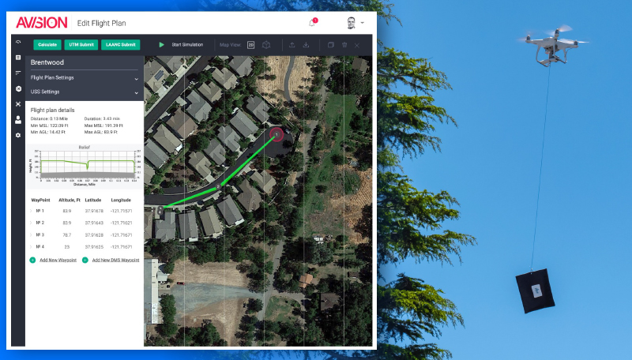
Flying Your Own Drone
Ames Research Center
Avision: Santa Monica, CA
After working with engineers at NASA under a Space Act Agreement, Santa Monica, California-based Avision developed its own drone management app to help pilots navigate small drones in low-altitude airspace.

Slide 9
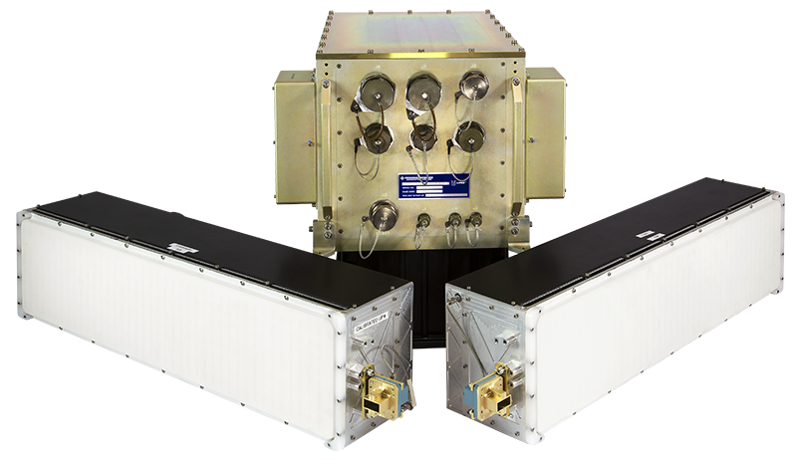
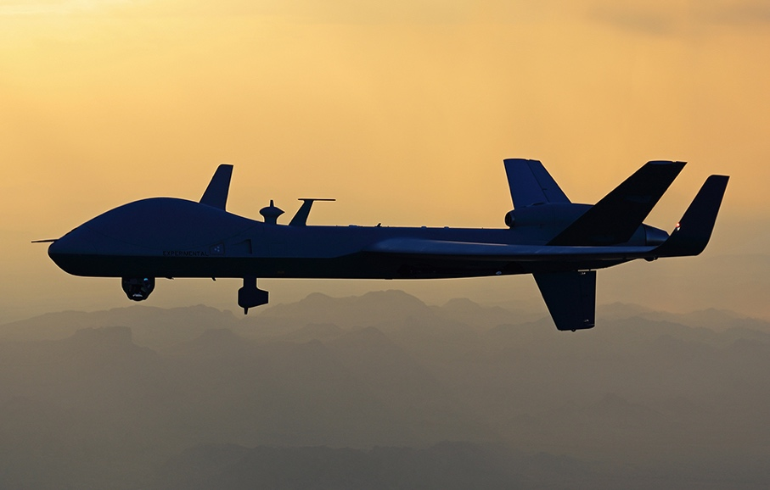
Remotely Piloted and Global
Langley Research Center
General Atomics: San Diego, CA
While helping NASA develop detect-and-avoid algorithms that eventually validated new safety standards, San Diego-based General Atomics developed its own system to help aircraft, including drones, avoid collisions.

Slide 10
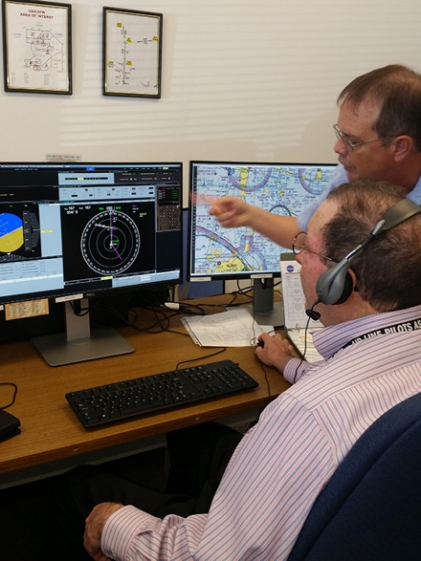
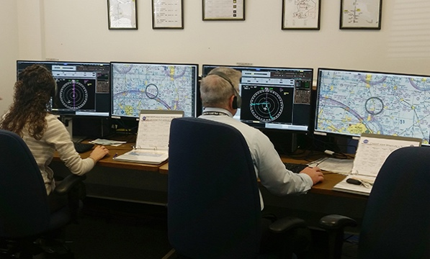
On the Ground and in the Cloud
Langley Research Center
Cal Analytics: Beavercreek, OH
Beavercreek, Ohio-based Cal Analytics’ commercially available detect-and-avoid system for drones was informed by the company’s work testing an Air Force detect-and-avoid system against NASA algorithms.

Slide 11
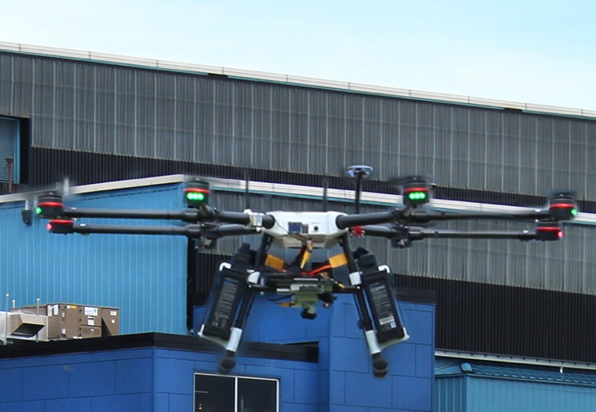
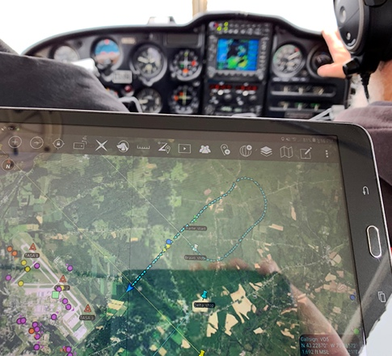
Simulations, Live Flights, and Flight Simulators
Langley Research Center
AX Enterprize: Yorkville, NY
After helping NASA develop a drone flight testing environment that incorporates both live and virtual aircraft, Yorkville, New York-based AX Enterprize continued to enhance the system so that its own customers could continue to use it.

Slide 12
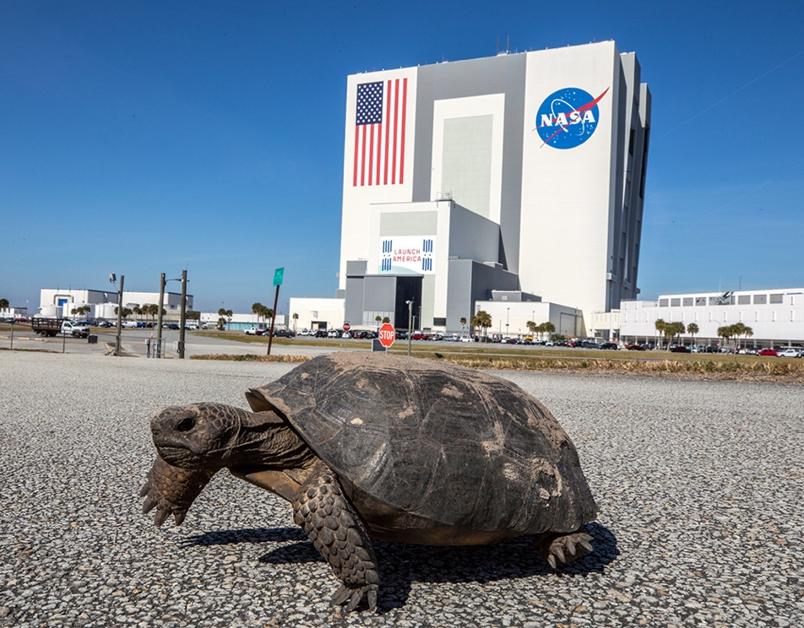
Safely Detoxifying Soil and Groundwater with NASA Technology
Revolutionary iron emulsion created an eco-friendly
alternative to costly site decontamination
Spinoff Theme
A groundwater remediation technique developed for launch sites at Kennedy Space Center is being used to clean industrial contamination around the country.

Slide 13
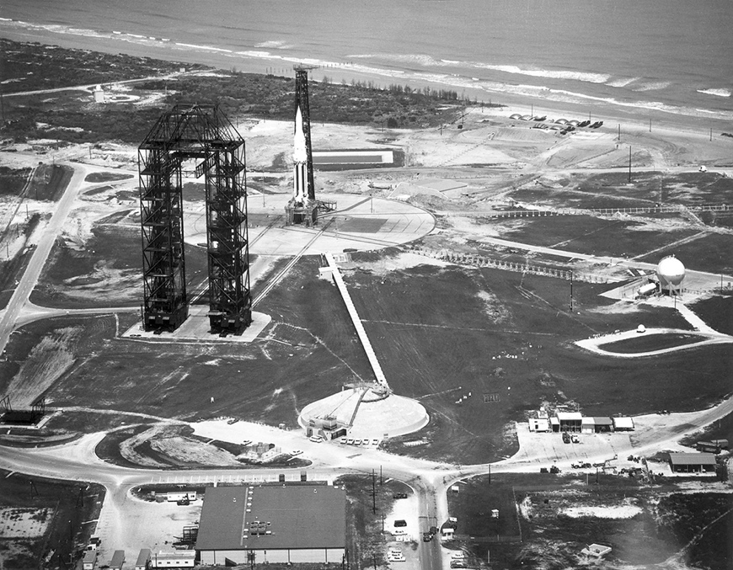
Cheaper, Faster, More Effective Brownfield Cleanup
Kennedy Space Center
TEA: Miramar Beach, FL
Toxicological and Environmental Associates Inc. of Miramar Beach, Florida, developed SourceKill using a non-exclusive license for NASA’s eco-friendly EZVI technology to reduce on-site chemicals to their harmless components.

Slide 14
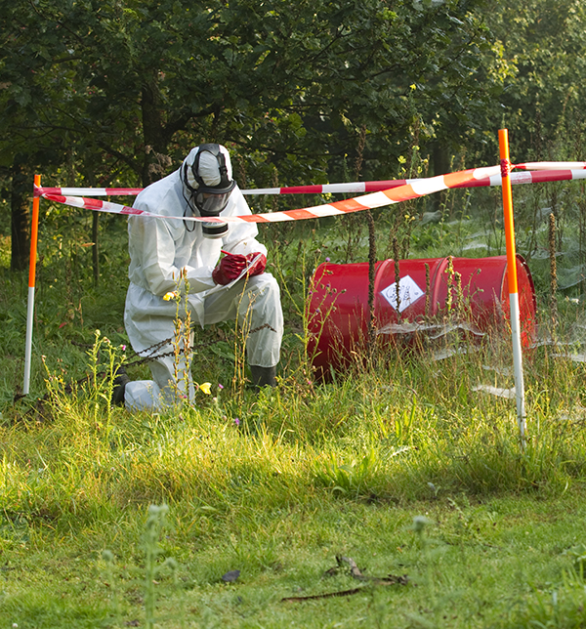
Improving Toxic Site Remediation
Kennedy Space Center
Provectus Environmental Products: Freeport, IL
Freeport, Illinois-based Provectus manufactures EZVI for its clients and other remediation companies using a non-exclusive patent license to support the safe removal of chlorinated hydrocarbon compounds from soil and water.

Slide 15
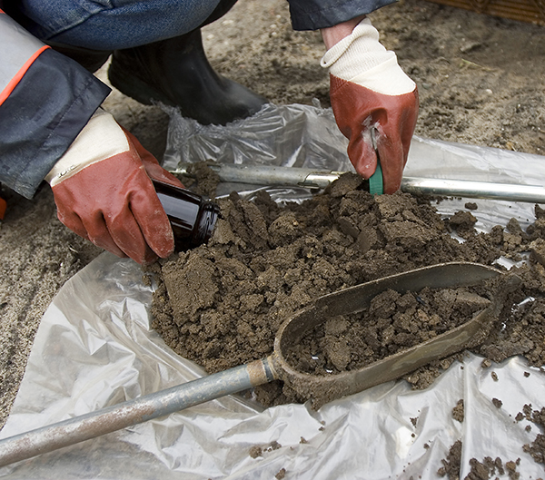
Tackling Worldwide Environmental Cleanup
Kennedy Space Center
Terra Systems: Claymont, DE
Terra Systems Inc. of Claymont, Delaware, uses a non-exclusive license for EZVI to clean up brownfield sites in the United States and overseas.

Slide 16
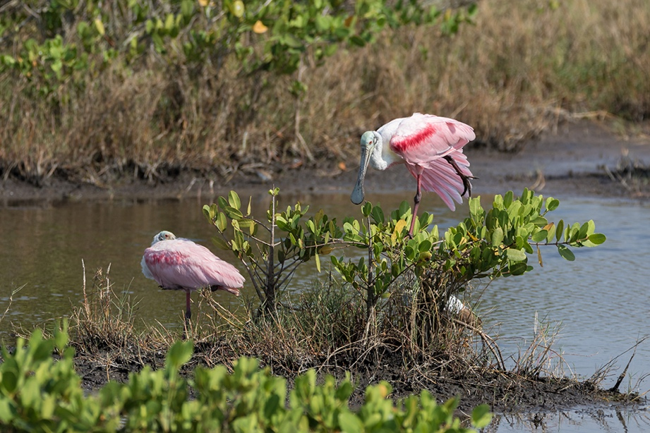
Eliminating Persistent Chemicals from Soil and Groundwater
Kennedy Space Center
Woodard & Curran: Portland, ME
A non-exclusive license for patented NASA technology that safely removes toxins at a spill site enables Woodard & Curran of Portland, Maine, to help companies mitigate damage and comply with EPA standards.

Slide 17
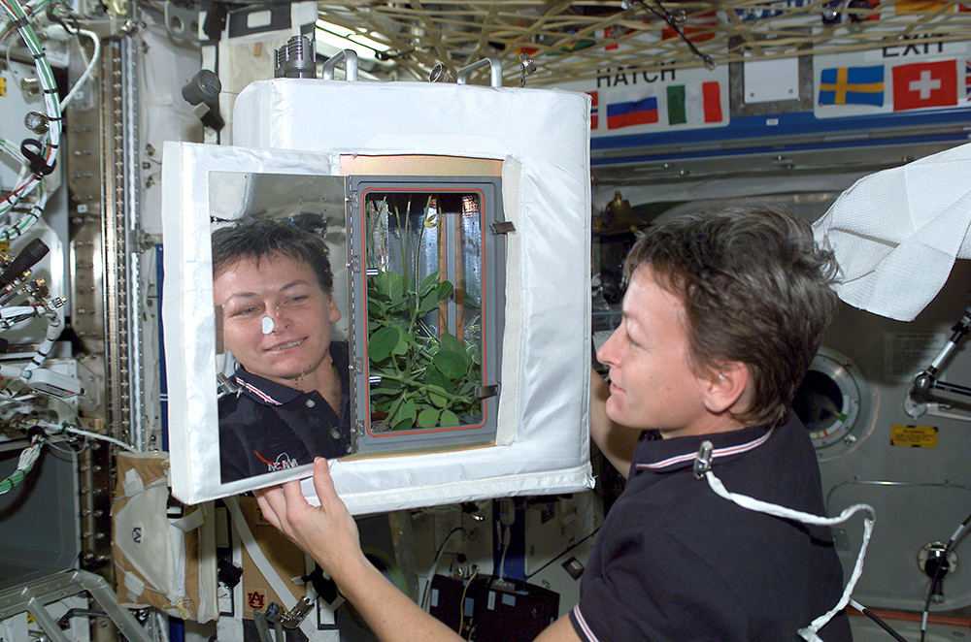
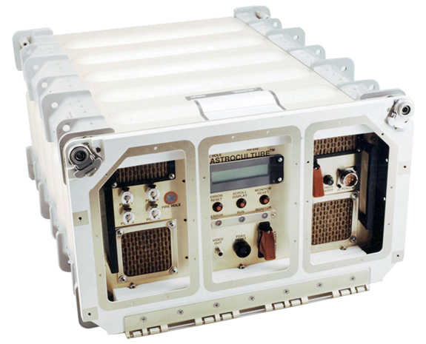
Clean Air Tech for Spacecraft
Helps Fight Pandemic
Clean air, always a priority in space, gained importance on Earth in slowing virus spread
Spinoff Theme
Air sensing and purifying technologies developed for use on the International Space Station are now slowing virus spread here on Earth.

Slide 18
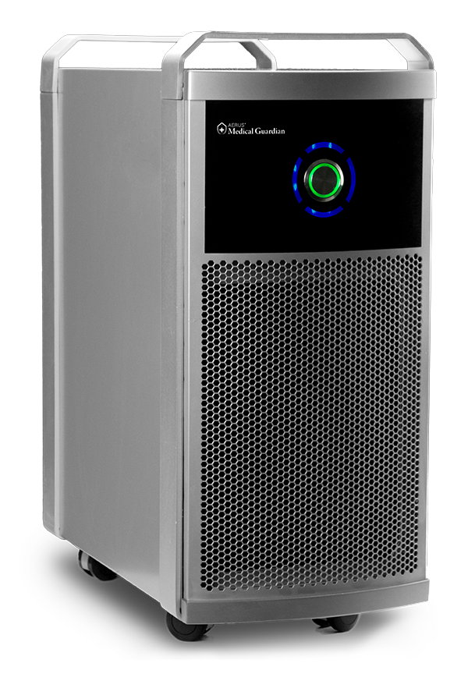
From Plants in Space to the Human Race
Marshall Space Flight Center
ActivePure Technology: Dallas, TX
Air purifiers made by ActivePure Technology, based in Dallas, proved able to eliminate the SARS-CoV-2 virus, and the company had a model approved for medical use in 2020. The devices use photocatalytic oxidation, pioneered under funding from NASA in the 1990s as a way to improve plant growth in spacecraft.

Slide 19
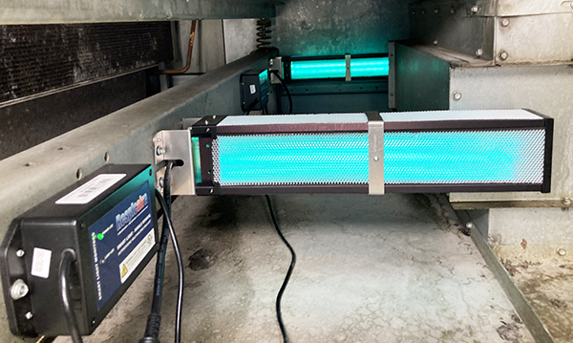
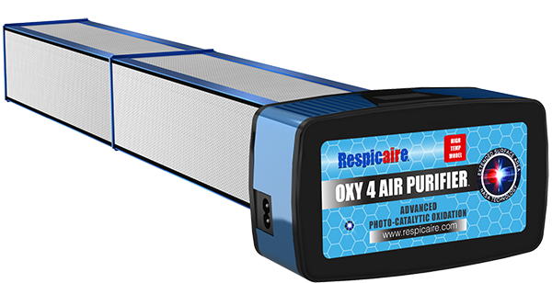
Spacecraft: The Ultimate Indoor Environment
Marshall Space Flight Center
TFI Environmental: Toronto, Canada
TFI Environmental Inc. of Toronto based several of its Respicaire air purifiers on Marshall Space Flight Center-funded research into the use of photocatalytic oxidation to scrub the air in a spaceborne plant growth chamber. TFI’s devices proved able to kill the novel coronavirus and found widespread demand during the pandemic.

Slide 20
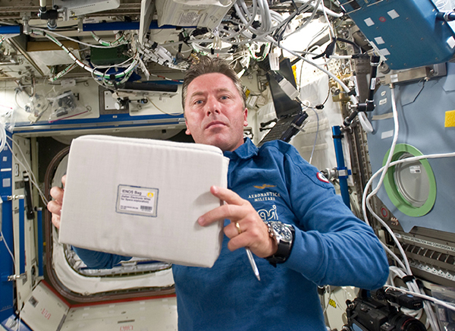
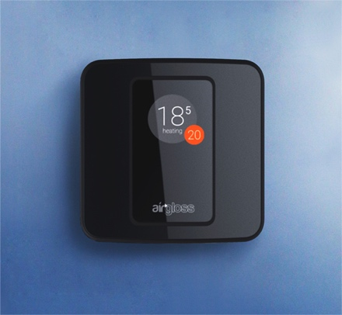
‘Electronic Nose’ Smells Trouble
Kennedy Space Center
Airgloss: Rome, Italy
After Kennedy Space Center and the Italian Space Agency sent an “electronic nose” for testing on the space station, its inventors founded Airgloss in Rome and incorporated the technology into an air-quality sensor, which can also calculate the risk of COVID-19 spread in an indoor space.

Slide 21
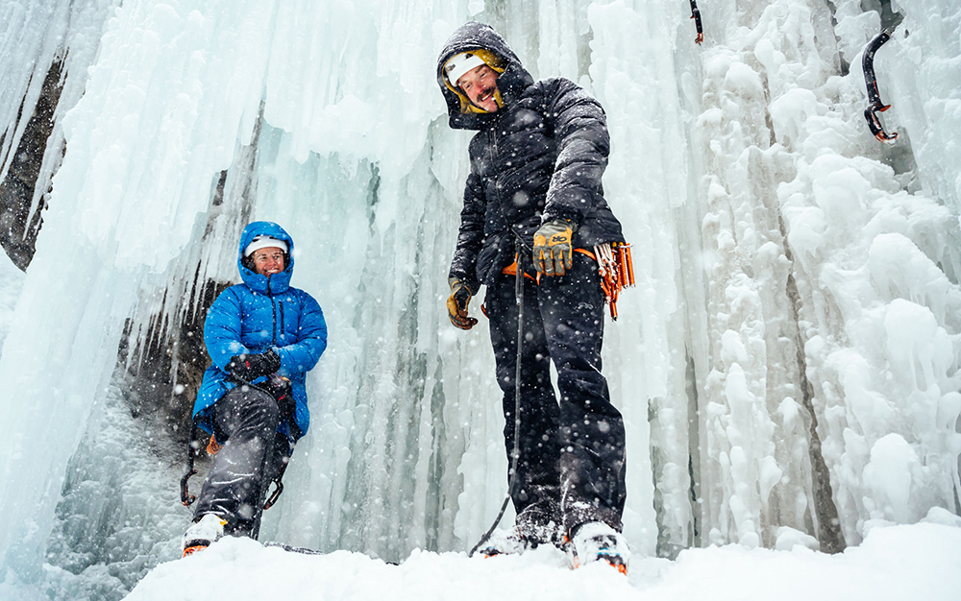
Keeping Warmer in the Great Outdoors
A longtime apparel insulator develops its own takes on popular NASA spinoff material
Spinoff Theme
Aerogels, first used at NASA
to insulate cryogenic rocket fuel, are being incorporated into products such as winter coats and phone cases that can withstand frigid temperatures without the bulk.

Slide 22
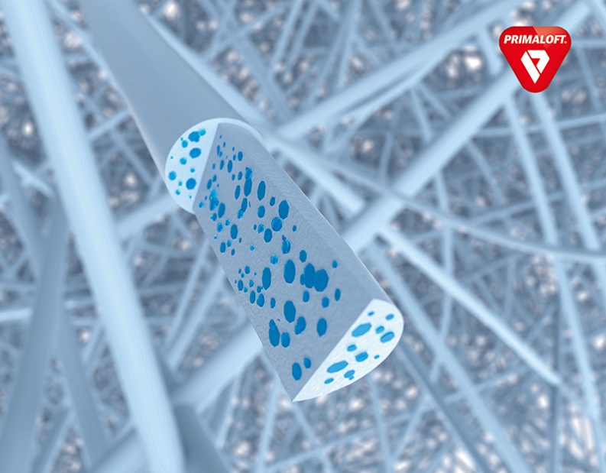
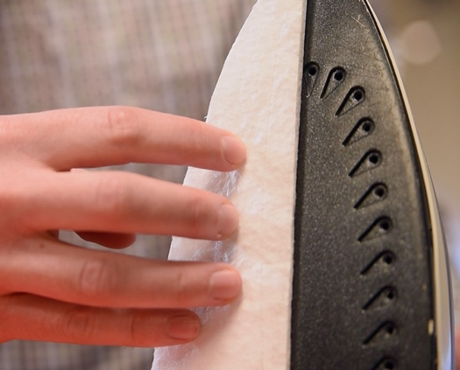
New Twist on a Classic Insulator
Kennedy Space Center
Primaloft: Latham, NY
The first aerogel insulations were developed under SBIR contracts from NASA, which was looking to better store cryogenic liquids. Now PrimaLoft of Latham, New York, is building on the technology to bring two new lines to the outdoor apparel market, resulting in products for the coldest conditions.

Slide 23
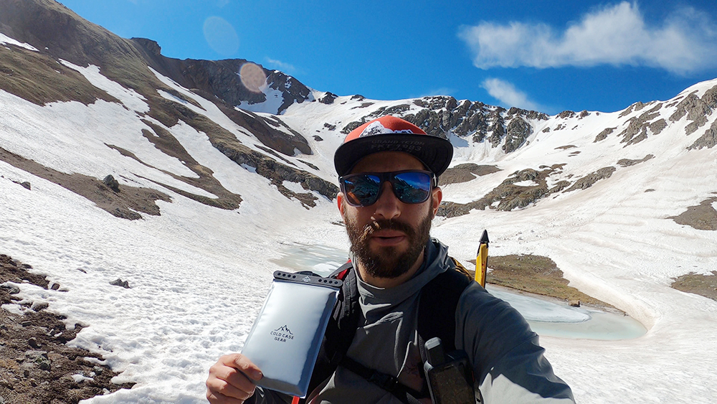
Going for Gold
Kennedy Space Center
Cold Case Gear: Pagosa Springs, CO
An outdoorsman couldn’t find small, well-insulated pouches to carry little items like batteries in extreme cold, so he founded Cold Case Gear in Pagosa Springs, Colorado, and released a smartphone case this year. The products rely on aerogel insulation first created under NASA SBIR contracts.

Slide 24
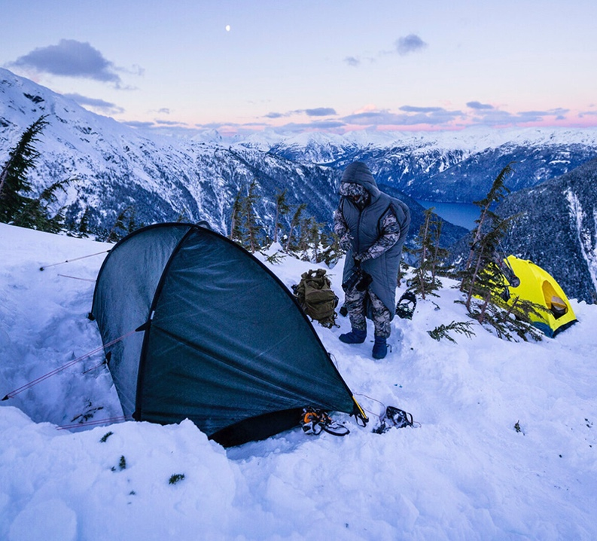
On the Hunt for Better Insulation
Kennedy Space Center
SITKA Gear: Bozeman, MN
Hunting gear brand SITKA of Bozeman, Montana, improved the performance of some of its warmest products by incorporating a new type of insulation, building on a technique pioneered under NASA SBIR funding for infusing blankets with aerogel.

Slide 25
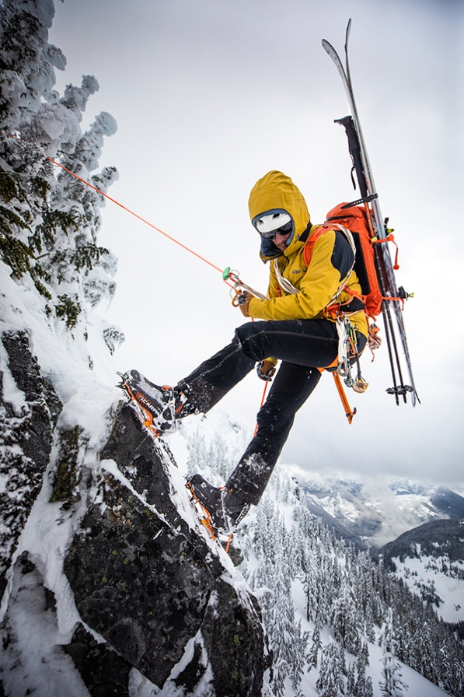
Aerogel Keeps On Climbing
Kennedy Space Center
Outdoor Research: Seattle, WA
Outdoor Research of Seattle now uses aerogel insulation, first developed with SBIR funding from NASA, as a thin temperature barrier in its signature footwear and specialized gloves, all designed to withstand the most extreme mountaineering expeditions.

Slide 26
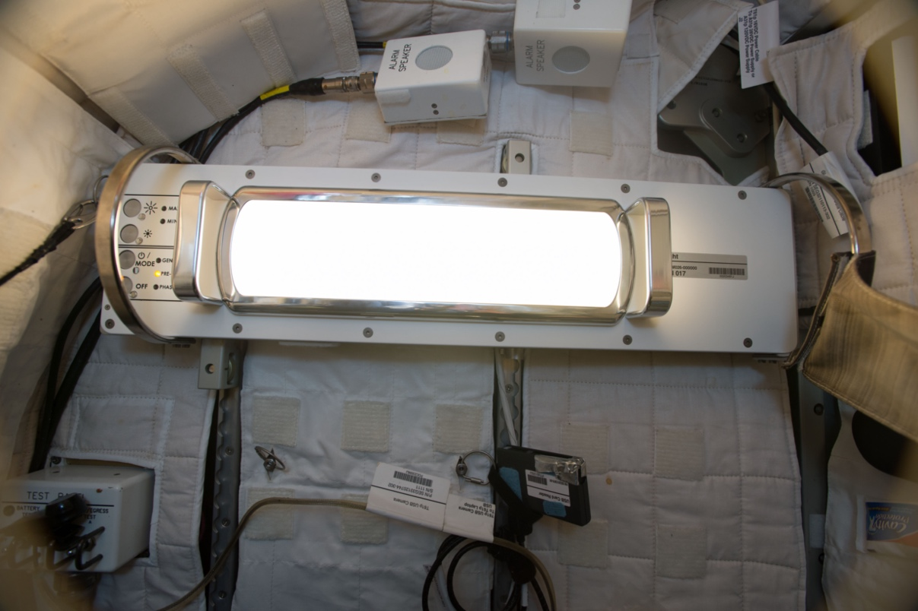
Lighting in a Bottle
NASA’s lighting research gives people on Earth better rest and helps plants grow
Spinoff Theme
NASA’s lighting research to regulate astronauts’ circadian rhythms and grow plants in space is being used to create LED lamps that can help people get better rest and plants grow indoors.

Slide 27

LED Lights for Sleep and Sanitizing
Johnson Space Center
Healthe: Orlando, FL
Healthe Inc. of Orlando, Florida, based on experience designing spacecraft lighting for NASA and using NASA-funded circadian research, developed automated LED bulbs to promote healthy sleep-wake cycles. They further developed the technology into a method of sanitizing air with ultraviolet light.

Slide 28
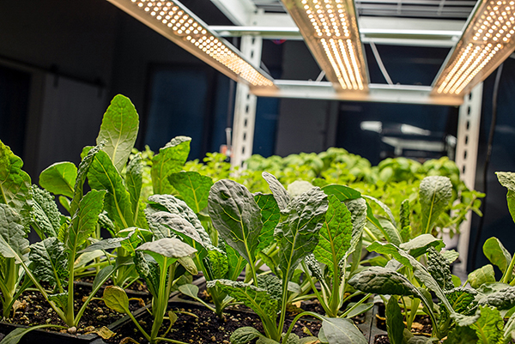
LEDs: They’ve Got What Plants Crave
Kennedy Space Center
VividGro: Chicago, IL
Built with experience from working on circadian and grow lamps for NASA , VividGro of Chicago, Illinois, developed solid-state LED technology into more efficient grow lights for indoor agriculture.

Slide 29

Spinoff Features
We are always advancing technology to enable exploration of our home planet and beyond. The following slides give a glimpse of some more ways this technology improves life
on the ground.

Slide 30
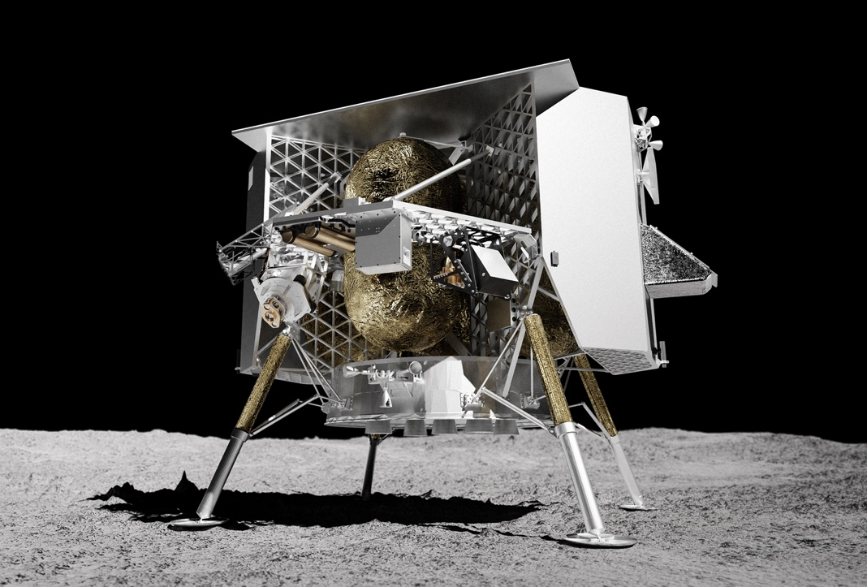
NASA Helps Private Lander Shoot for the Moon
Astrobotic’s lunar landing program, launching in 2022, carries NASA and commercial payloads
Jet Propulsion Laboratory
Astrobotic: Pittsburgh, PA
Astrobotic of Pittsburgh leveraged NASA expertise to develop one of the first commercial lunar landers, planned to deliver agency science and technology payloads in 2022. Private organizations and individuals are also sending payloads as space exploration becomes more accessible to everyone.

Slide 31
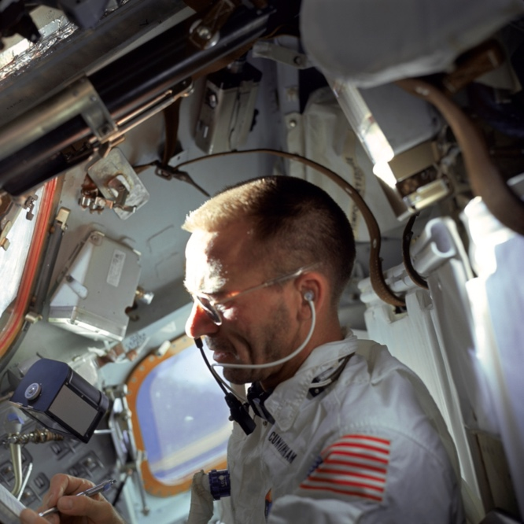
Space Pens, Pencils, and How NASA Takes Notes in Space
The real story behind the iconic Space Pen and how NASA testing helped it soar
Johnson Space Center
Astrobotic: Boulder City, NV
Boulder City, Nevada-based Fisher Pen Company was already developing a pressurized ballpoint pen when NASA decided to stop using pencils in space. Traditional pens wouldn’t work without gravity. The company accelerated development, and NASA tested the resulting pen rigorously. The Space Pen, capable of writing in zero gravity, extreme temperatures, and underwater, has flown on every crewed mission since Apollo 7 and become a popular gift item on Earth.

Slide 32
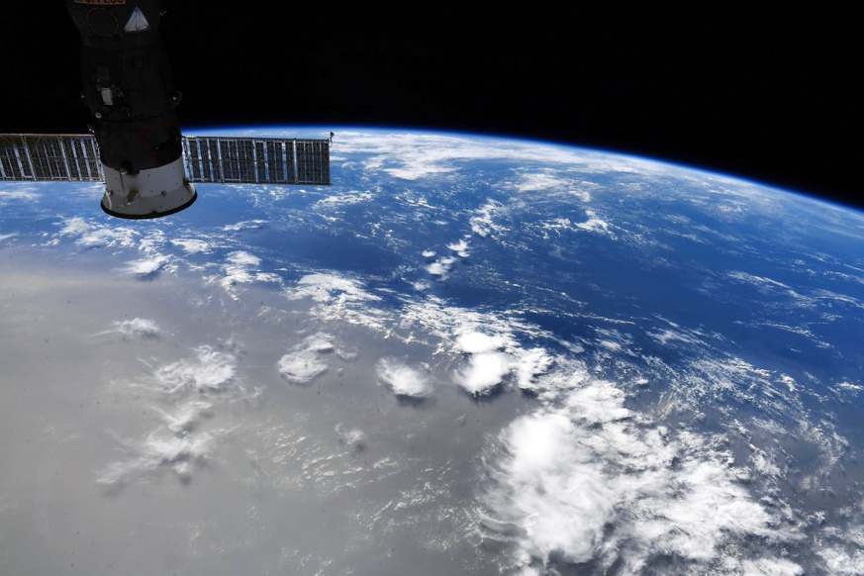
Forecasting Saharan Dust to Minimize Health Risks
NASA-funded system uses satellite data to predict timing and severity of African dust storms in the Caribbean
NASA Headquarters
University of Puerto Rico: San Juan Puerto Rico
NASA-funded researchers at the University of Puerto Rico use satellite data to track dust and other aerosols traveling across the Atlantic Ocean from the Saharan Desert. They alert local and federal governments, and the public in advance of poor air quality.

Slide 33
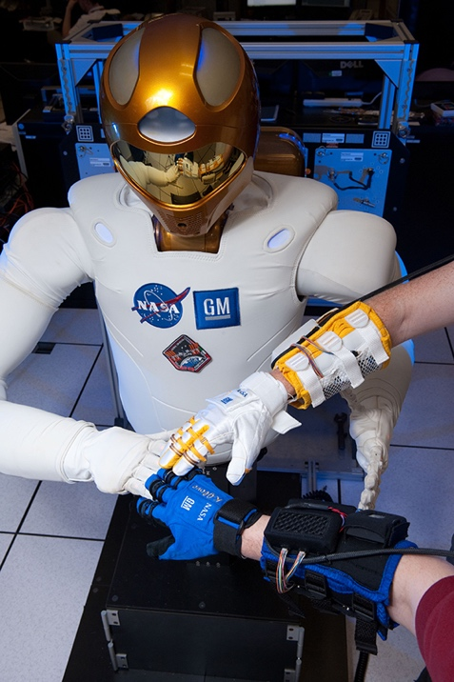
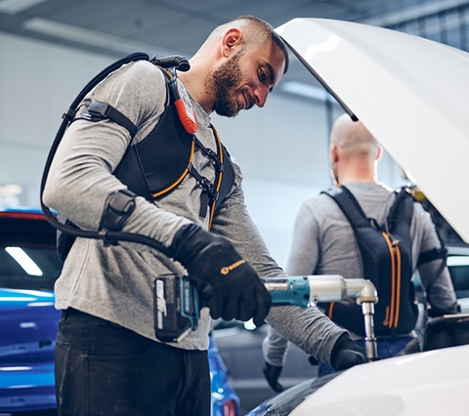
NASA’s Robotic Glove Finds Commercial Handhold
Grip-strengthening glove based on robotic astronaut assistant aims to reduce workplace stress injuries
Johnson Space Center
Bioservo Technologies: Stockholm, Sweden
NASA and General Motors joined forces to build Robonaut 2. The work led to a suite of robotic glove patents, now licensed and commercialized by Bioservo Technologies of Stockholm, Sweden, for industrial workplaces.

Slide 34

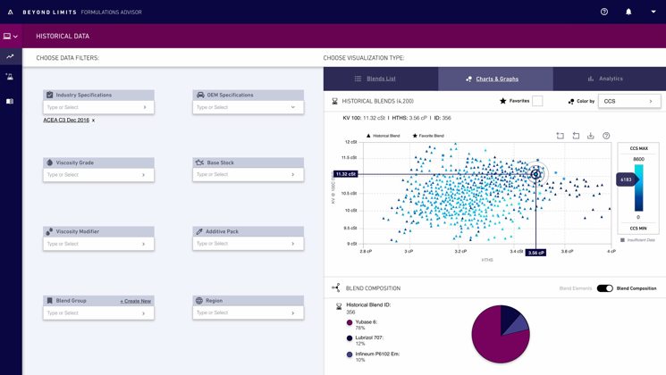
Expertise Flows from Computer Cognition
NASA-grown AI technology enables energy industry innovations
Jet Propulsion Laboratory
Beyond Limits: Glendale, CA
Artificial intelligence systems to monitor performance of space systems and suggest solutions to issues led Beyond Limits of Glendale, California to use software derived from those programs in energy production across the entire process.

Slide 35
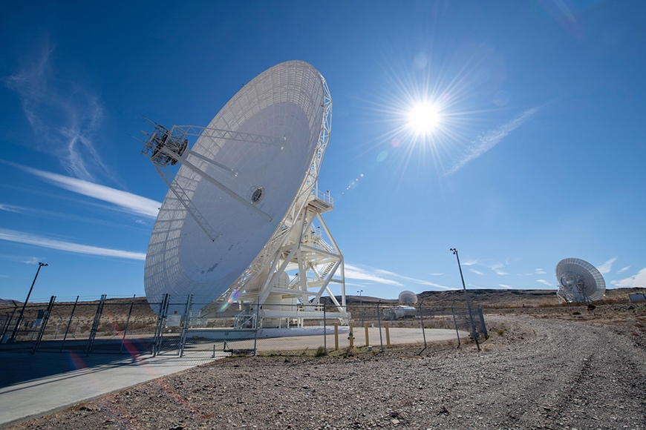
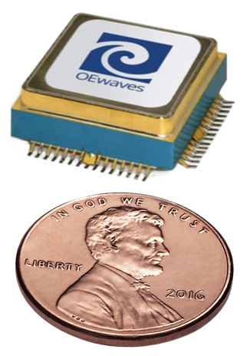
High-Performance Lasers Make Waves in Self-Driving Cars, Quantum Devices
JPL photonics inventions improve lasers and oscillators for autonomous vehicles, next-generation communications, and quantum computing
Jet Propulsion Laboratory
OEwaves: Pasadena, CA
The optoelectronic oscillator and whispering gallery mode optical resonator, created at NASA and licensed to their inventor at OEwaves of Pasadena, California, have gained widespread popularity and enable high-performance lasers and communication devices for emerging fields.

Slide 36
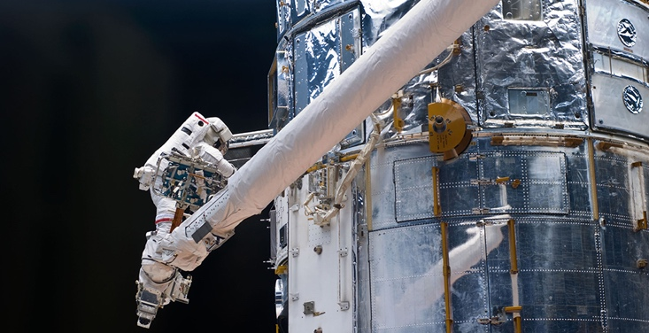
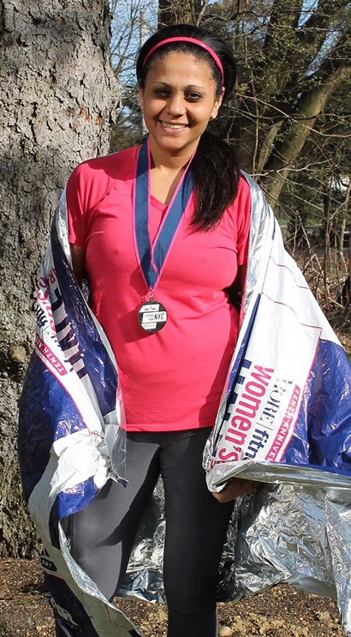
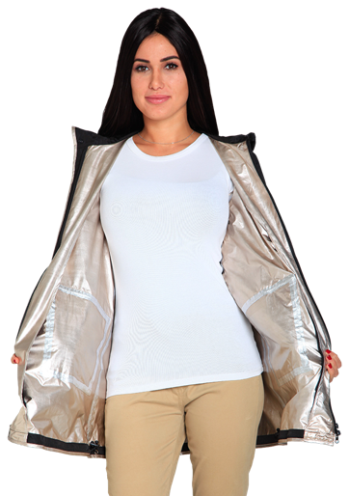
‘Reflecting’ on Life’s Daily Challenges
Fabric spun off from reflective space insulation lines lightweight rain jackets
Marshall Space Flight Center
13-One: Larchmont, NY
Inspired by the “space blankets” at her first post-surgery race, a runner founded 13-One in Larchmont, New York, to turn a fabric based on NASA’s radiant barrier insulation into a line of warm, portable, weatherproof jackets.

Slide 37
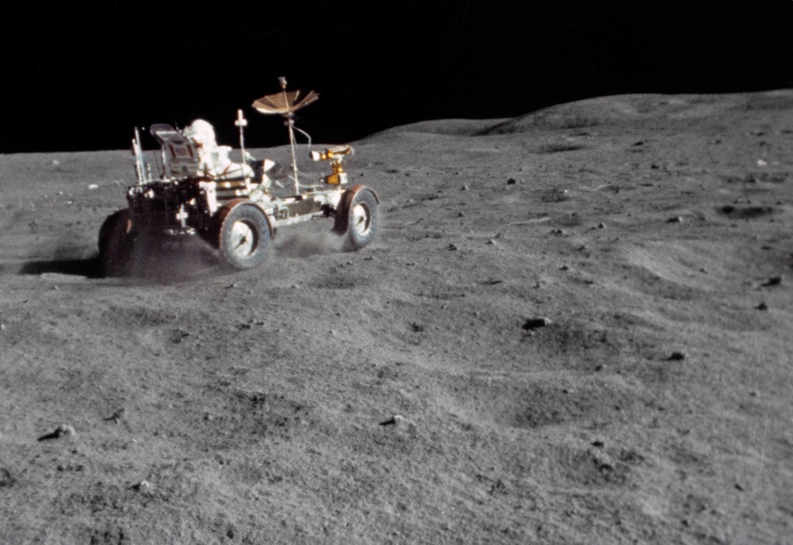
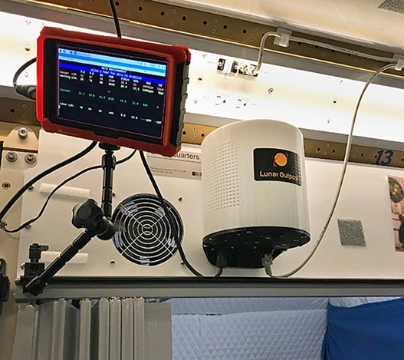
Measuring Moon Dust to Fight Air Pollution
NASA’s need to contain hazardous lunar dust led to technology that senses other pollutants
Kennedy Space Center
Lunar Outpost: Golden, CO
Working as a contributor on a NASA NextSTEP lunar habitat project, Lunar Outpost Inc. developed an air-quality sensor system to detect and measure the amount of lunar soil in the air that also detects pollutant on Earth.

Slide 38
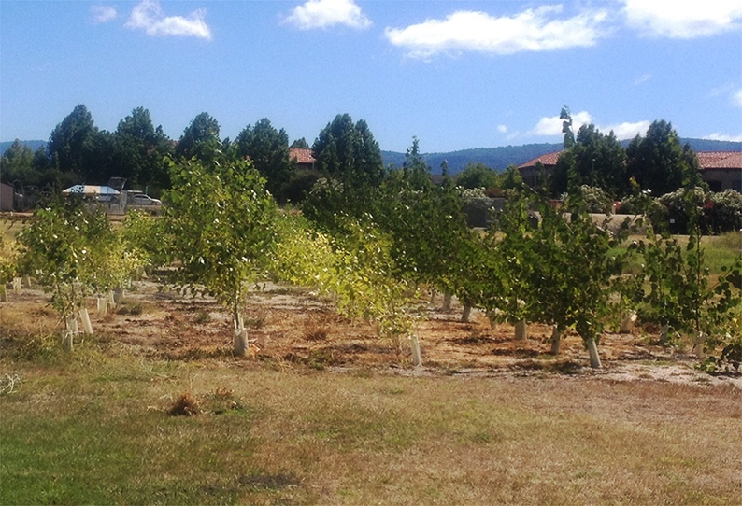
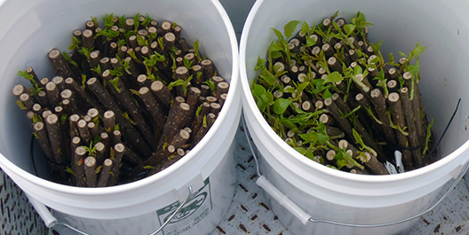
Microbes Help Trees Clean Up Pollution
Bacteria-fortified trees now eliminating pollution were first field-proven with help from NASA
Ames Research Center
Intrinsyx Environmental: Moffett Field, CA
The use of symbiotic bacteria to help trees eliminate environmental contaminants got its first field test at a NASA center, leading to the formation of Moffett Field, California-based Intrinsyx Environmental.
The company’s trees are now cleaning up pollution across the country.

Slide 39
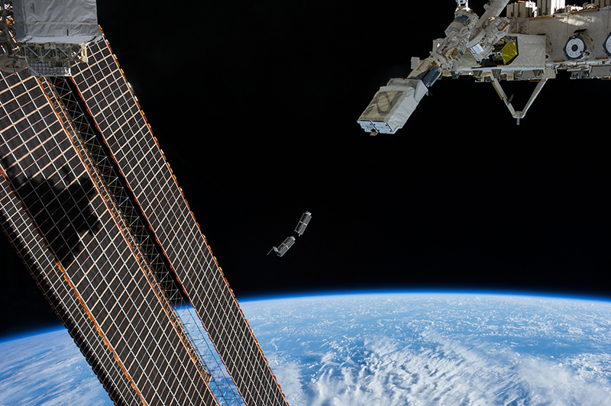
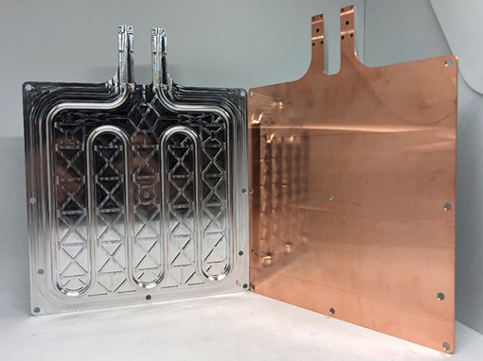
Ultrasonic Welding Makes Parts for NASA Missions, Commercial Industry
Combine metals and embed sensors with this novel additive manufacturing technique
Jet Propulsion Laboratory
Fabrisonic: Columbus, OH
Fabrisonic LLC used NASA SBIR funding for materials development to refine ultrasonic welding practices that provide the agency and commercial industry with lightweight parts that can be made with disparate metals and embedded sensors.

Slide 40


Water Purification Anywhere on Earth
Company puts NASA-enhanced filter in consumer water bottles, looks to expand to developing world
Johnson Space Center
nkd LIFE: West Palm Beach, FL
The company nkd LIFE Ltd., whose U.S. office is in West Palm Beach, Florida, makes bottles for purifying water on the go, using a filtration medium developed with the help of NASA SBIR funding. The company is now working to make drinking water more accessible in the developing world.

Slide 41



Plasma Improves 3D Electronics Printing
Space Foundry’s plasma jet printer makes it easier to build electronics components on Earth and in space
Ames Research Center
Space Foundry: San Jose, CA
A new method of 3D printing electronics uses plasma to fine-tune the electronic properties of the print materials, or inks. It was developed by San Jose, California-based Space Foundry with NASA funding and help.

Slide 42


Computers Tough Enough for Space
NASA collaboration with industry and academia resulted in a reliable computer for CubeSats
Goddard Space Flight Center
Space Micro: San Diego, CA
As a member of a collaborative endeavor, NASA Goddard helped develop a more resilient computer to use in CubeSats and SmallSats. Space Micro of San Diego now markets a derivative of this original processor to interested customers in academia and research institutions, plus industry and other NASA centers.

Slide 43


NASA-born Software Keeps Cloud Traffic Moving
Process scheduler software originally developed for NASA helps ensure optimal use of cloud computing resources
Ames Research Center
Altair Engineering: Troy, MI
When NASA Ames needed to keep their computers from traffic jams, they developed a tool that’s seen decades of continued development from Altair Engineering of Troy, Michigan, helping companies and researchers make the most of cloud computing.

Slide 44


Neurological Devices, Racecars, Antennas Benefit from NASA Heat Shield Material
An ultra-thin, flexible insulation finds diverse uses in the commercial sector
Armstrong Flight Research Center
Blueshift Materials: Spencer, MA
Advanced plastic aerogel insulation provides industry with durable, flexible material that insulates without blocking radio signals. Blueshift Materials Inc. licensed a polyimide aerogel formula from NASA and used the recipe to develop its own proprietary version, AeroZero, which improves the efficiency of electronics, vehicles, and more.

Slide 45


Test Rockets Prepare for Distant Landings
Rocket-powered vehicle for testing lander navigation systems supports space companies
Glenn Research Center
Masten Space Systems: Mojave, CA
Needing to test space landing systems on Earth, NASA funded a small startup, Masten Space Systems, based in Mojave, California, to develop a rocket-powered testing platform that now supports the aerospace industry.

Slide 46

Swinging the HAMR
NASA technology and experience bring hybrid aircraft to the skies
Langley Research Center
Advanced Aircraft Company: Hampton, VA
Founded by a former NASA engineer working with licensed technology he invented at Langley Research Center, Advanced Aircraft Company of Hampton, Virginia has built a hybrid-engine aircraft capable of outlasting battery powered drones.

Slide 47


Getting Water Out of Snow with NASA Technology
Sensors attached to an airplane measure snowpack in mountains to calculate the water it contains
Jet Propulsion Laboratory
Airborne Snow Observatories: Mammoth Lakes, CA
Calculating the amount of water in mountain snowpack is now possible with NASA-developed technology. Airborne Snow Observatories Inc. measures the depth and quality of snow to accurately calculate when and how much water will be available downstream.

Slide 48


Stay Safe with Battery Testing for Space
NASA battery safety exams influence commercial product testing
Johnson Space Center
Underwriters Laboratories: Northbrook, IL
Experience developing battery testing methods for human spaceflight at NASA was brought to Underwriters Laboratories Inc., headquartered in Northbrook, Illinois, helping reduce the risk of lithium-ion battery chemistries and ensuring that batteries in equipment and appliances are safer.

Slide 49


Metallic Glass Gears Up for ‘Cobots,’ Coatings, and More
Bulk metallic glass could slash prices of collaborative robots and lead to advanced 3D-printed metals
Jet Propulsion Laboratory
Amorphology: Pasadena, CA
Founded by JPL’s foremost pioneer of metallic glasses and metal 3D printing, Pasadena, California-based Amorphology Inc. aims to turn multiple NASA patents into cheaper robot gears and much more.

Slide 50


NASA-Born Software Helps Weather Forecasting Around the Globe
Satellite scheduling software helps to consolidate data acquisition and improve weather forecasting
Goddard Space Flight Center
Orbit Logic: Greenbelt, MD
Experience gained while working on NASA satellite systems helped Orbit Logic of Greenbelt, Maryland, make improvements to NOAA’s Earth-observing satellite scheduling capabilities, which will be used to get weather-tracking data down to Earth more efficiently.

Slide 51


From a Lightbox to Lamps
Wireless LED lamps keep people’s circadian rhythm in check
Johnson Space Center
Ario: Seattle, WA
When a lighting engineer wanted to make something new to help people get the rest they needed, NASA research allowed Ario of Seattle to create a wirelessly controlled LED lamp that is now seeing use in homes and hospitality.

Slide 52


‘Positive Energy’ Captures Contaminants
Aquaspace filters still build on research for Apollo, space shuttle water purification
Johnson Space Center
Western Water International: Forestville, MD
Decades ago, Western Water International of Forestville, Maryland, based its Aquaspace water filter compound in part on NASA technical reports. The business continues to grow after being selected by high-profile customers like the White House and D.C. schools.

Slide 53



From Spacesuits to Racing Suits
NASA-funded materials give race car drivers more comfort and better performance
Johnson Space Center
Walero: Mooresville, NC
Phase Change Materials originally developed for spacesuits under an SBIR with NASA’s Johnson Space Flight Center are now being used in specialized undergarments to help keep race car drivers cool in the cockpit.

Slide 54



Some Engineering Is Only Skin Deep
Ability to finish surfaces of 3D-printed superalloys improves performance for engines, industry
Johnson Space Center
REM Surface Engineering: Southington, CT
Additive manufacturing with superalloys promised cheaper, better rocket engines,
but rough surfaces reduced performance
of 3D printed parts. With NASA SBIR funding,
a company developed a solution.

