Slide 2
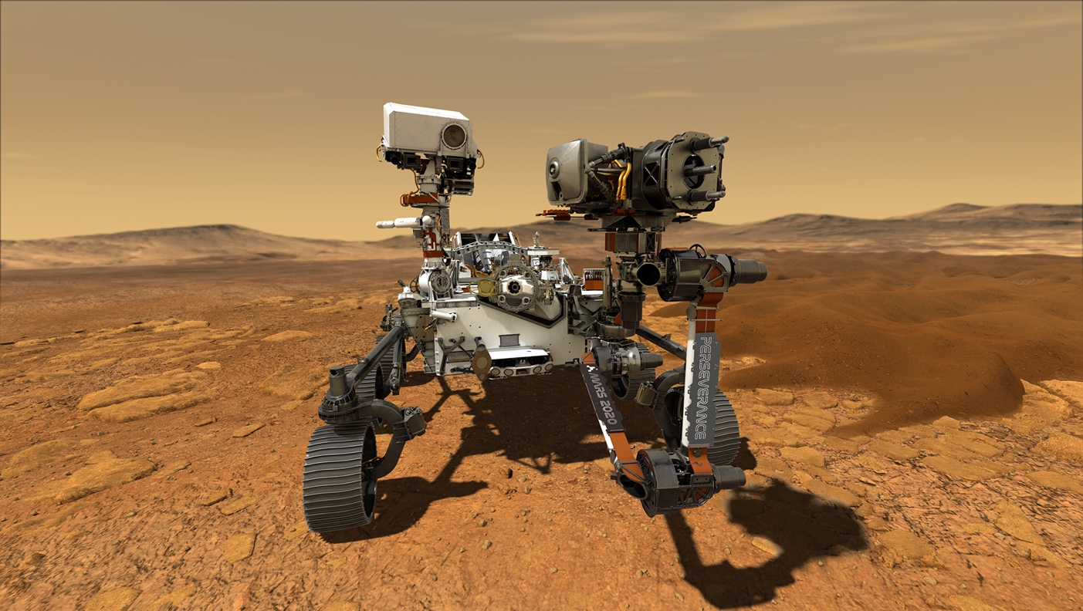
The Rewards of Perseverance
Even before the Perseverance rover gets to Mars, work that went into it is already paying off on Earth
Spinoff Theme
NASA is constantly working to create the technology needed for current and future missions to Mars. Read on for examples of some of the innovations created with that goal in mind that have found important uses here on Earth, too.

Slide 3

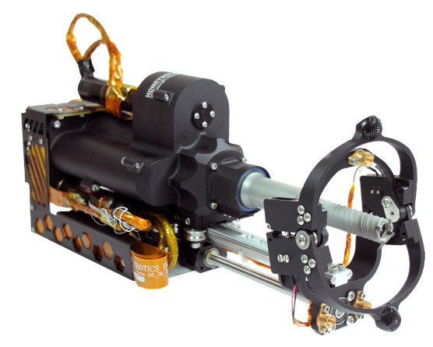
Giving Geologists a Break
Jet Propulsion Laboratory
Honeybee Robotics: Brooklyn, NY
Abstract:
With SBIR funding from JPL, Honeybee
Robotics developed coring drill bits that can
break off and retain rock samples. The bits
are flying for the first time on Perseverance
and are available to geologists on Earth.

Slide 4
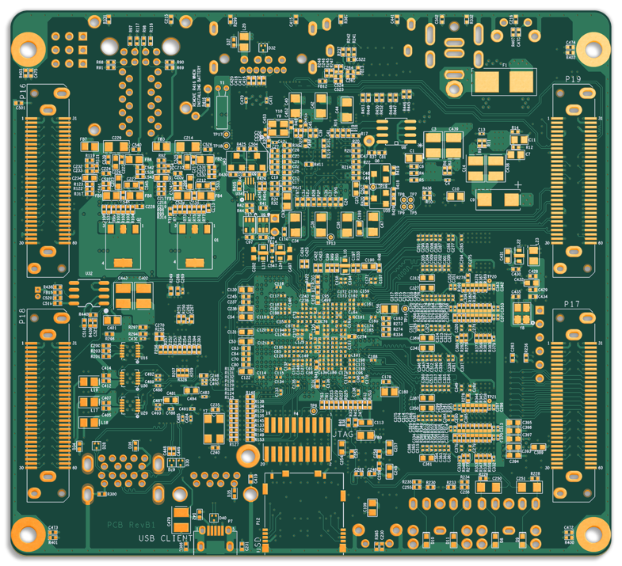
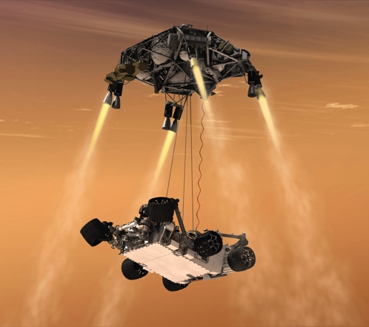
Home Videos from Mars
Jet Propulsion Laboratory
Tempo Automation: San Francisco, CA
Abstract:
As Tempo Automation built a circuit board for a Perseverance camera system, the company added new inspections and documentation to its production process and developed a novel preproduction tool. All these now benefit Tempo’s customers.

Slide 5
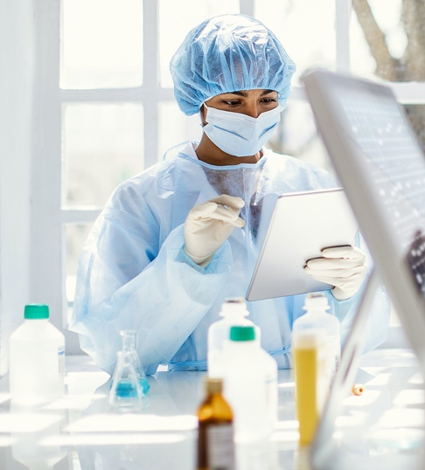
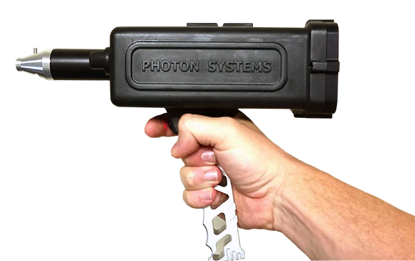
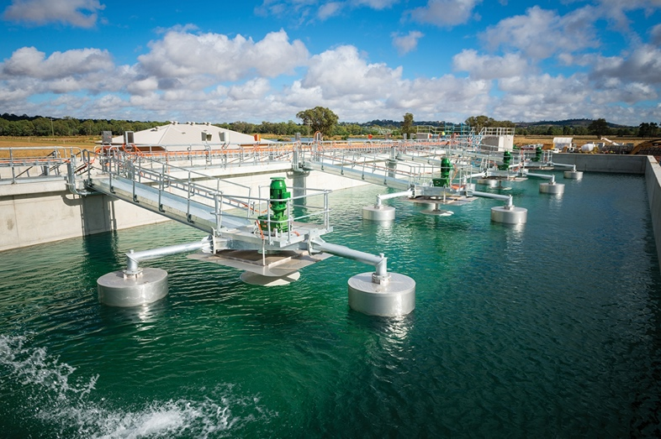
Ultraviolet Lasers Scan for Chemical Clues
Jet Propulsion Laboratory
Photon Systems: Covina, CA
Abstract:
NASA funding, including JPL SBIR contracts for
Mars exploration, helped Photon Systems make
small, inexpensive spectrometers in the deep-UV
range, where they’re so sensitive they can identify bacteria. They’re being used in pharmaceutical quality control, wastewater treatment, and more.

Slide 6

In the Right Hands, NASA Satellite
Data and Analysis Make Earth Better
NASA data and imagery aids humanitarian and environmental efforts
Spinoff Theme
The space agency makes its Earth-observation data freely available and provides additional tailored tools to help humanitarian and environmental efforts.

Slide 7
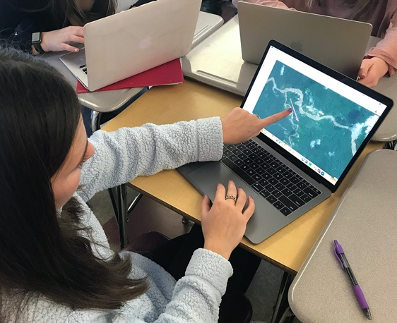
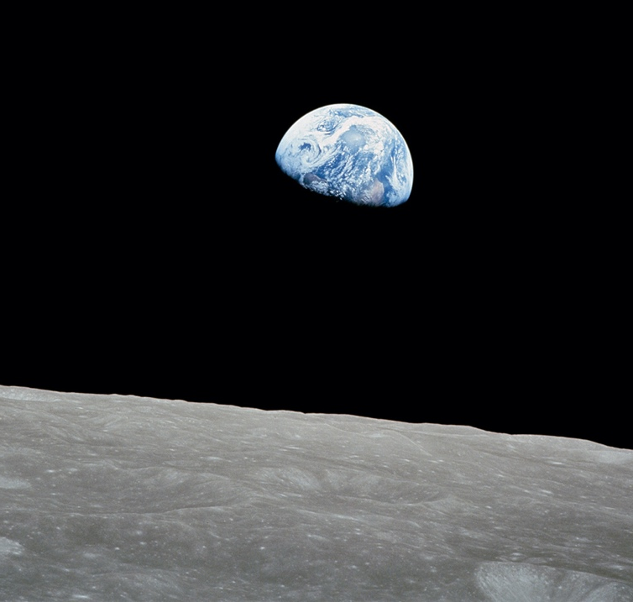
Self-Reflection
NASA Headquarters
Earthrise Alliance: Washington, DC
Abstract:
Founded by former NASA officials, Earthrise gave satellite data from NASA and other organizations to Massachusetts ninth graders, who used it to identify illegal gold mines in Brazil. The organization also helps conservationists and decision-makers use Earth imagery and data.

Slide 8
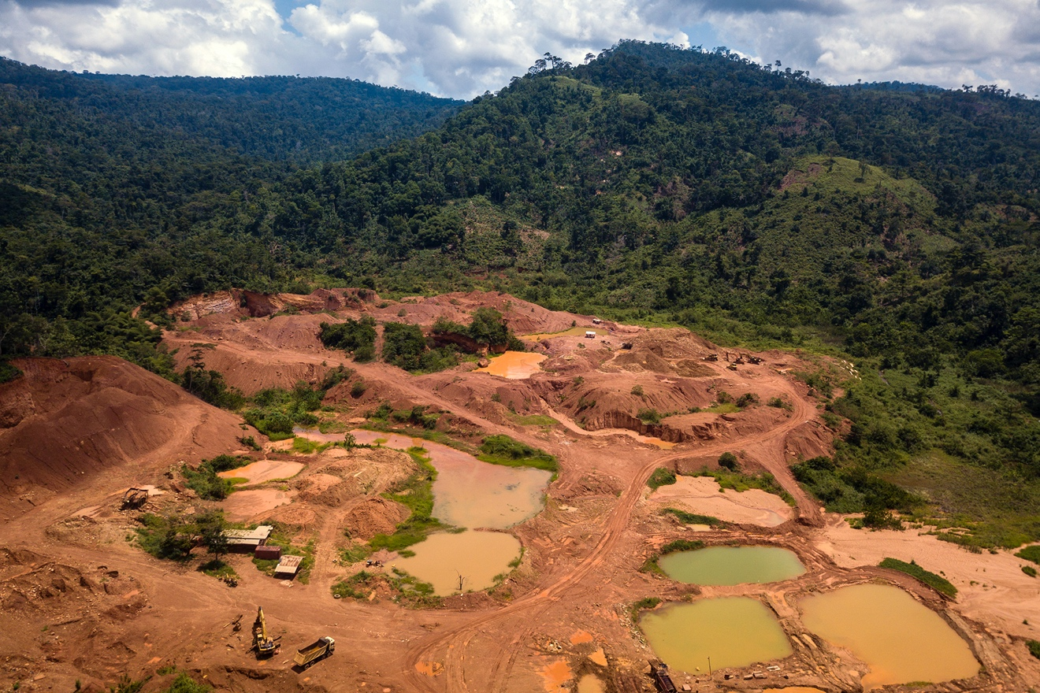
Striking Gold, Helping Farmers
Langley Research Center
Digital Earth Africa: Addis Ababa, Ethiopia
Abstract:
Officials in five African countries are using a NASA-developed satellite data tool to identify illegal gold mines and conditions on the ground for small farmers struggling with climate change. Parts of the program are expanding to cover more countries across Africa.

Slide 9
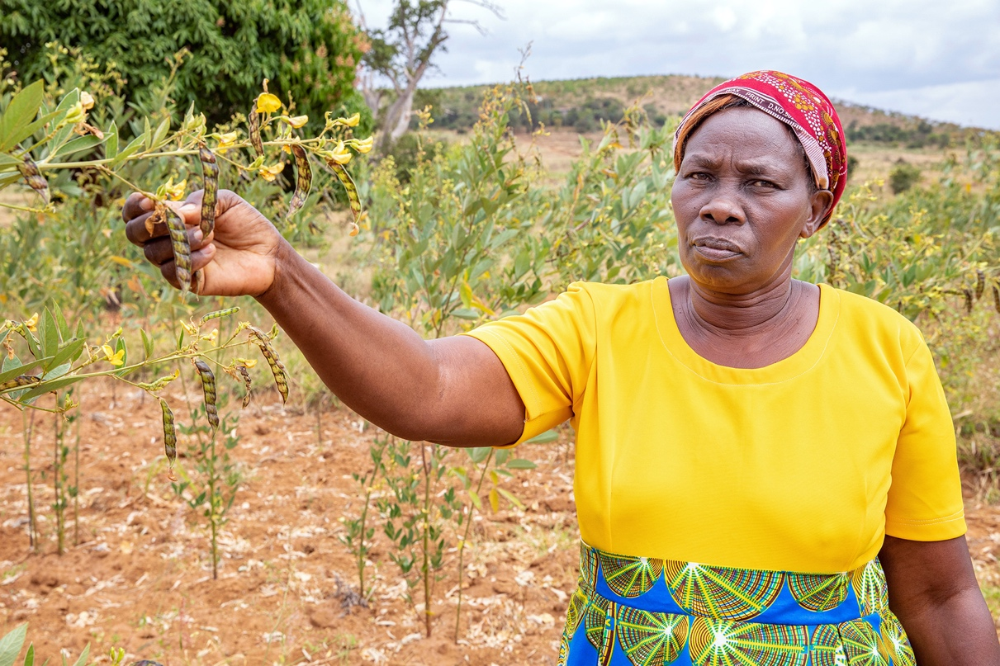
Informing Better Decision-Making
NASA Headquarters
Mercy Corps: Portland, OR
Abstract:
Mercy Corps is collaborating with NASA through a Space Act Agreement, using satellite data to inform its humanitarian aid work and to pass on relevant information – about weather patterns or groundwater, for example – directly to farmers in Africa.

Slide 10

Space-Age Water Conservation
NASA’s need to conserve water in space has long supported terrestrial water-purification techniques
Spinoff Theme
Few challenges are more pressing for the space agency than the need for clean water. These are just a few examples of NASA technology now cleaning water on Earth.

Slide 11
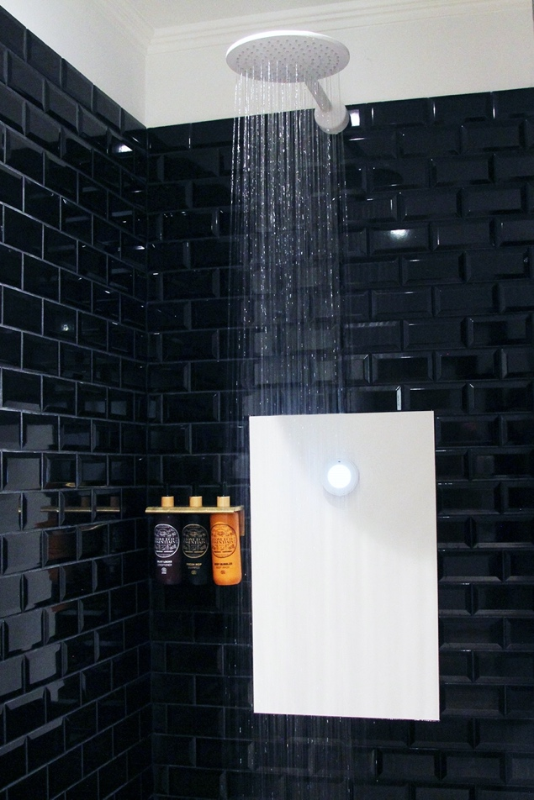
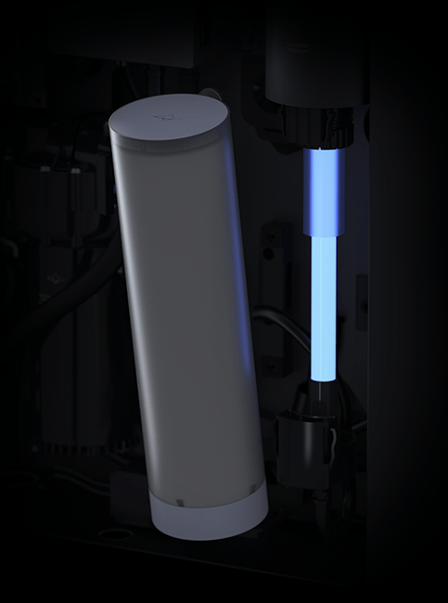
Shower like a Martian
Johnson Space Center
Orbital Systems: Malmö, Sweden
Abstract:
Inspired by a NASA design exercise, a Swedish inventor used filter material developed with help from NASA to create the first recirculating shower, saving water and energy.

Slide 12
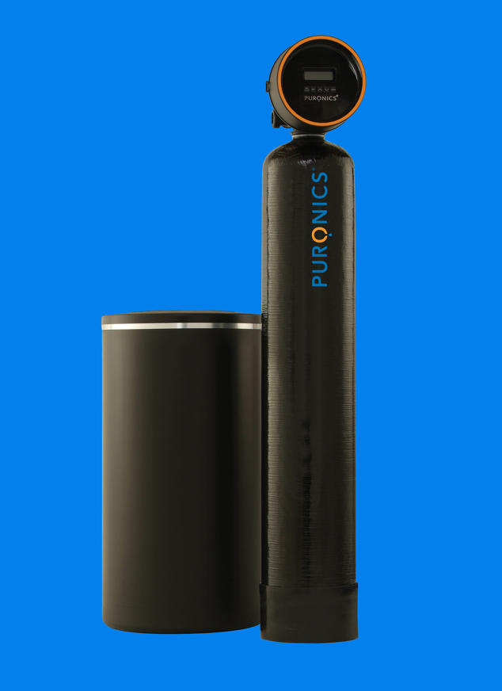
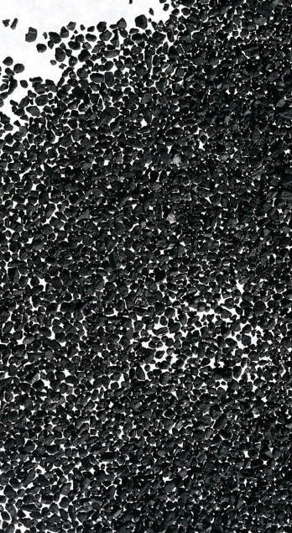
Ancient Technology Enters the Space Age
Johnson Space Center
Puronics: Livermore, CA
Abstract:
After helping another company implement silver-ion water purification technology from the space shuttle, Puronics has incorporated its SilverShield version into whole-house water conditioners to prevent bacterial growth in filters.

Slide 13
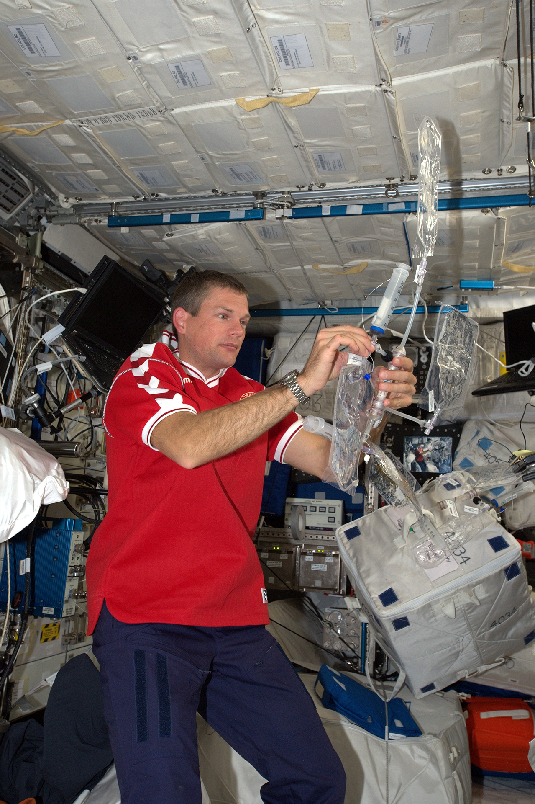
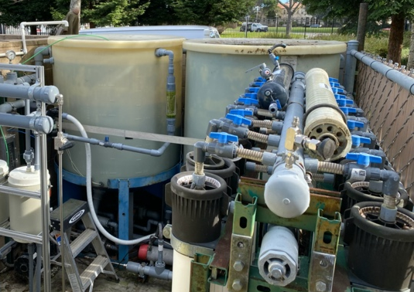
Using Nature’s R&D Lab
Ames Research Center
Aquaporin: Copenhagen, Denmark
Abstract:
With early NASA funding and testing,
a company incorporated nature’s water-filtering proteins into membranes. Now companies and researchers are trying them out for many applications, from wastewater treatment to dialysis.

Slide 14

A Case Made in Space
How NASA investment in small businesses helps both thrive
Spinoff Theme
The Small Business Innovation Research program funds early technology that shows promise for NASA missions and commercial markets.

Slide 15
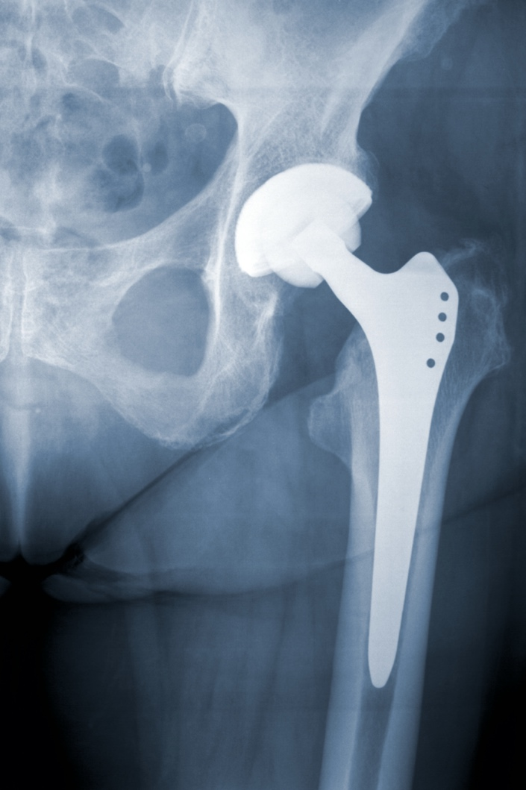
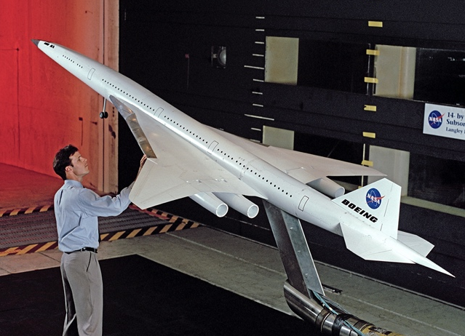
From Supersonic Jets to Medical Tech
Langley Research Center
Imitec: Schenectady, NY
Abstract:
NASA-backed research into durable materials for supersonic jets finds a second life in the medical industry, helping to make more durable implants.

Slide 16
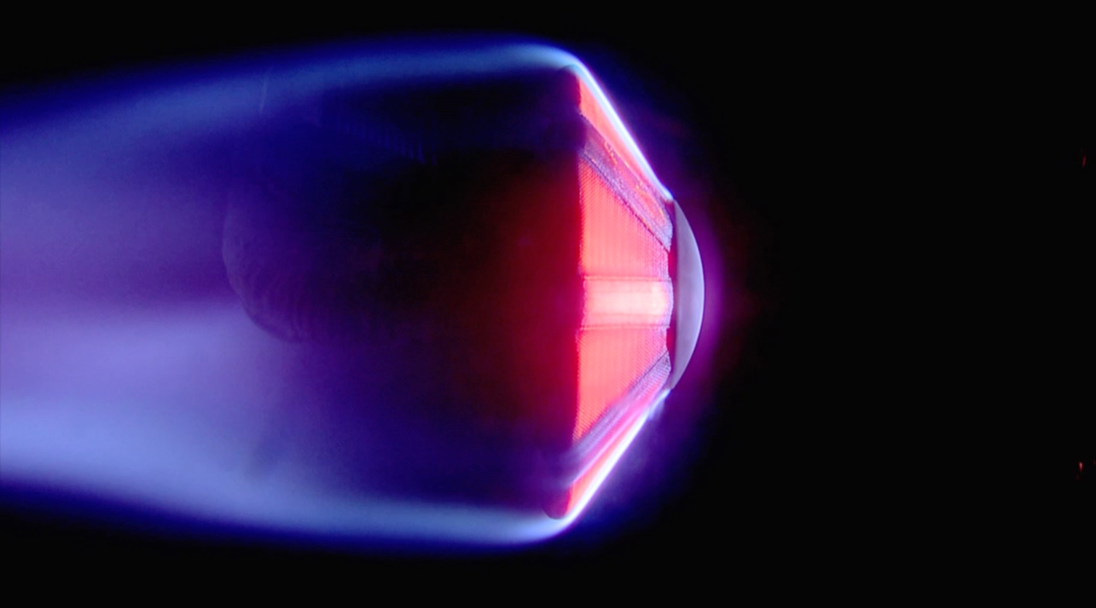
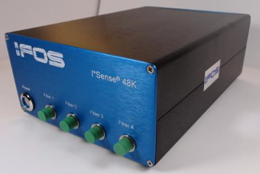
Fiber Optics Feel the Heat
Ames Research Center
Intelligent Fiber Optic Systems: San Jose, CA
Abstract:
Development of high-heat fiber optic temperature sensors for testing spacecraft heat shields shows promise for semiconductor manufacturing.

Slide 17
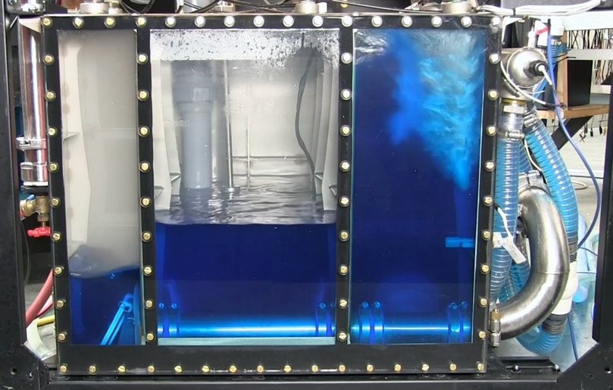
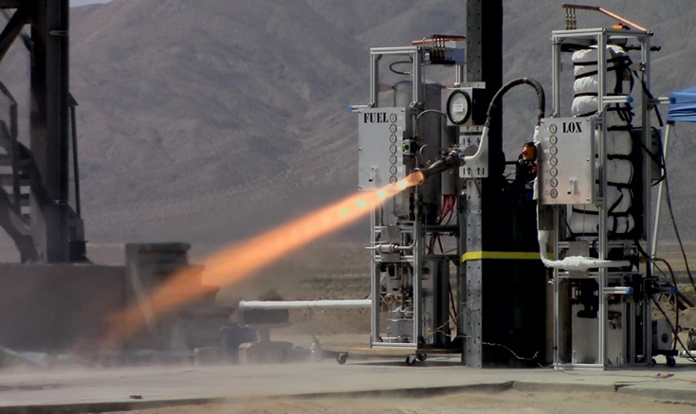
Engine Pump Helps Computers Chill Out
Glenn Research Center
Chilldyne: Carlsbad, CA
Abstract:
NASA-backed research to make a lighter, more reliable rocket engine pump led to a liquid cooling system for supercomputer processors and servers.

Slide 18
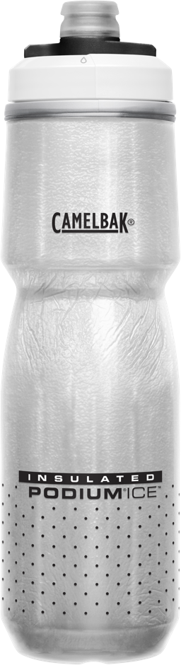
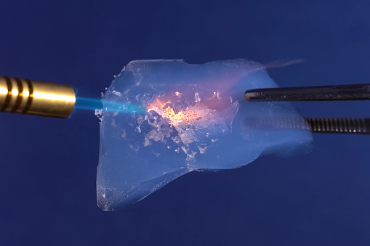
Cooling Rocket Fuel and Drinks Alike
Kennedy Space Center
CamelBak: Petaluma, CA
Abstract:
Aerogels designed to keep cryogenic fuels cold are seeing new life as insulation for water bottles. They make sure drinks stay at the desired temperature longer.

Slide 19
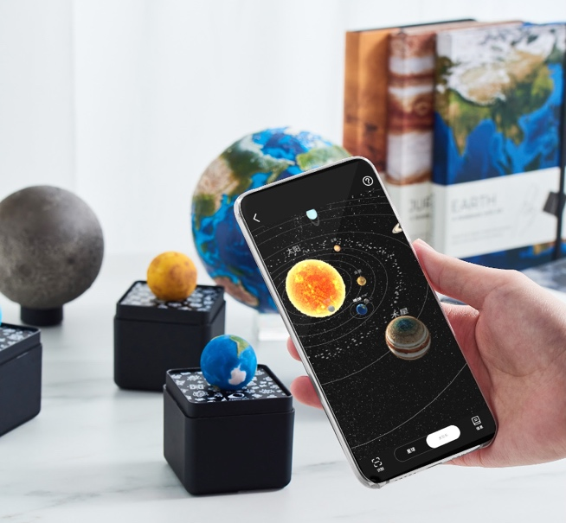
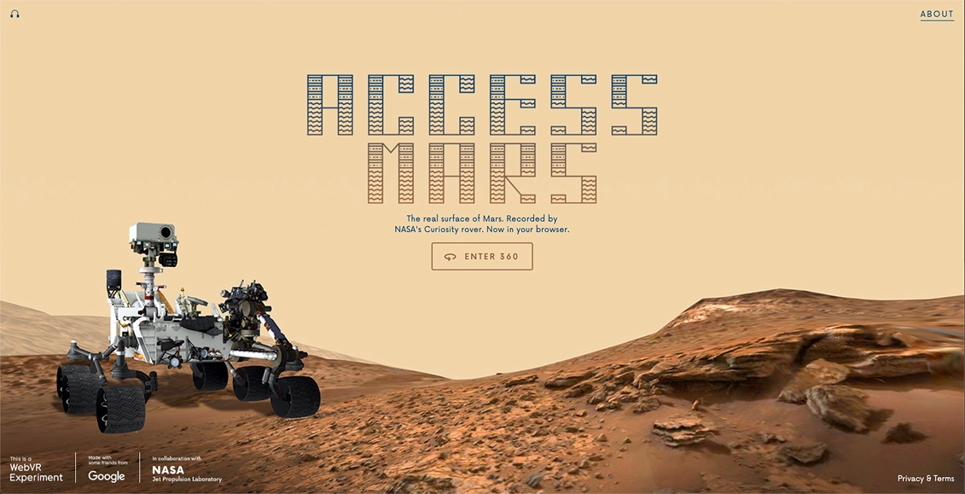
Planets Take Virtual Shape on Earth with NASA Knowledge and Imagery
Companies are creating virtual worlds with NASA’s planetary data and augmenting our own, enabling immersive experiences of space
Spinoff Theme
NASA archives make data from the space agency’s planetary missions – and tools to process and use it – freely available to the public, including makers of virtual and augmented reality products.

Slide 20
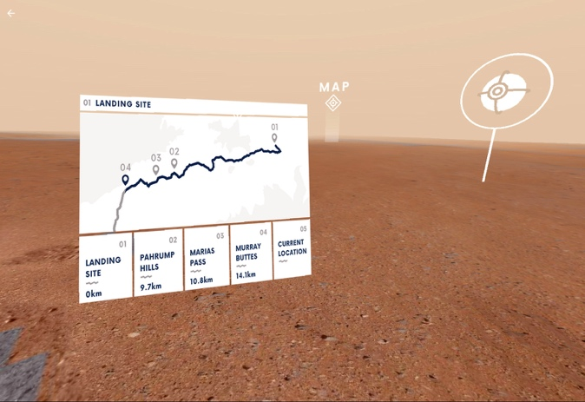
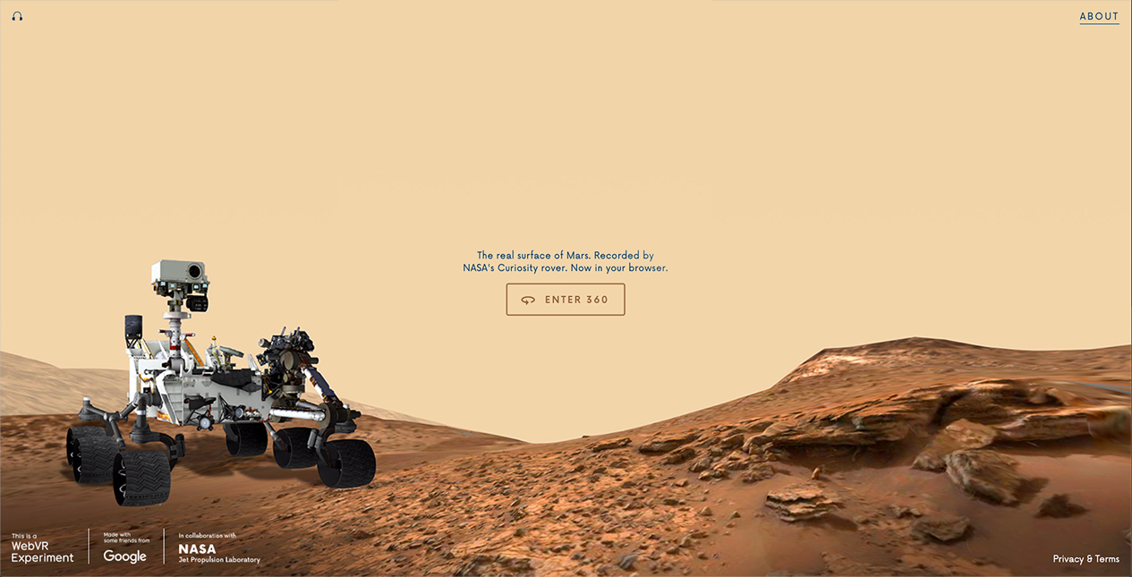
Navigating Curiosity’s Path
Jet Propulsion Laboratory
Google: Mountain View, CA
Abstract:
A Space Act Agreement enabled NASA and Google to collaborate on Access Mars, a virtual reality experience that allows anyone with an internet connection to explore the Red Planet.

Slide 21
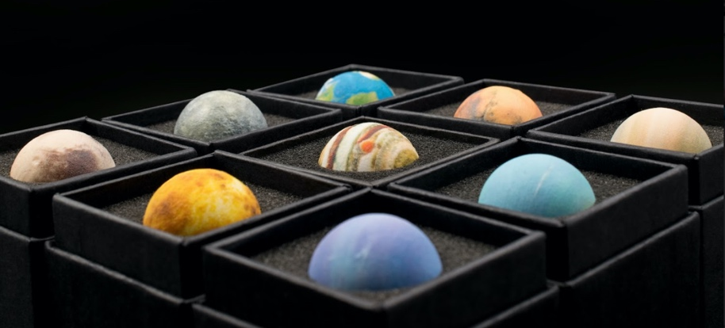
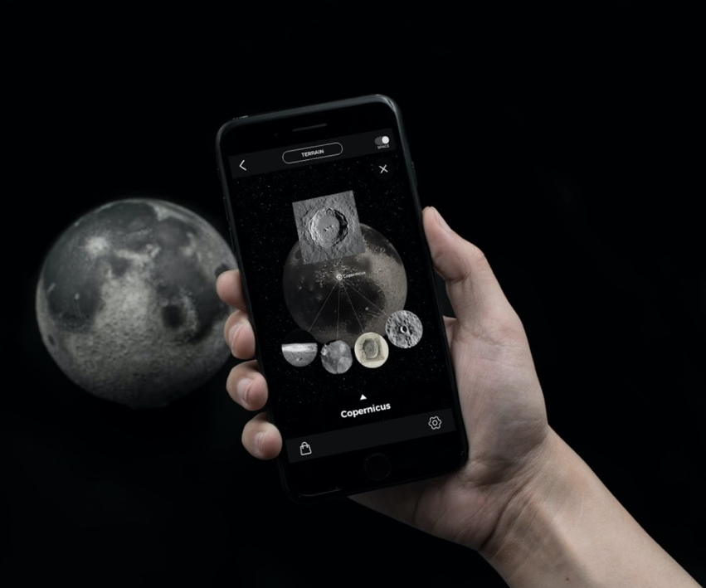
The World at Your Fingertips
Goddard Space Flight Center
Quantum AR Technologies: Cupertino, CA
Abstract:
AstroReality, a brand of Quantum AR, uses publicly available NASA data to create models of the
Moon and planets that pair with the
company’s apps, which provide
additional information about specific
lunar and planetary features.

Slide 22

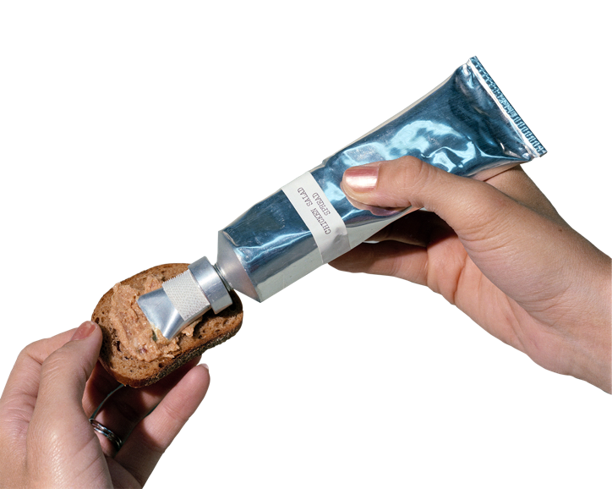
Food Safety Program for Space Has Taken Over on Earth
System created for Apollo astronaut food has become the global standard for hazard prevention
Spinoff Theme
Facing strict reliability requirements, NASA and Pillsbury personnel invented a system to prevent hazards from entering foods processed for the Apollo astronauts. Their approach now assures safe processed foods all over the world.

Slide 23


Safe Enough for Space
Johnson Space Center
Pillsbury/General Mills: Minneapolis, MN
Abstract:
The team tasked with supplying food for astronauts on the Apollo missions came up with a system to eliminate hazards from food processing. The Hazard Analysis and Critical Control Point (HACCP) system is now the global standard for food safety and regulation.

Slide 24

From Farm to Table
Johnson Space Center
Butterball: Garner, NC
Abstract:
A HACCP plan for turkey processing means monitoring crucial points such as those where any residual farm chemicals are removed, proper refrigeration must be maintained, and antimicrobial sprays or dip tanks are used. High-pressure processing has recently become popular for poultry and various other foods as a way to eliminate potential pathogens and extend shelf life.

Slide 25
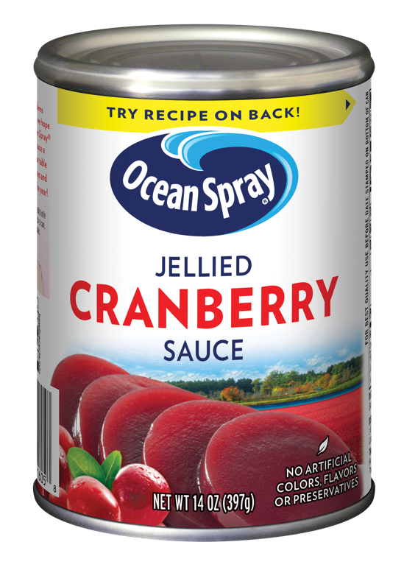
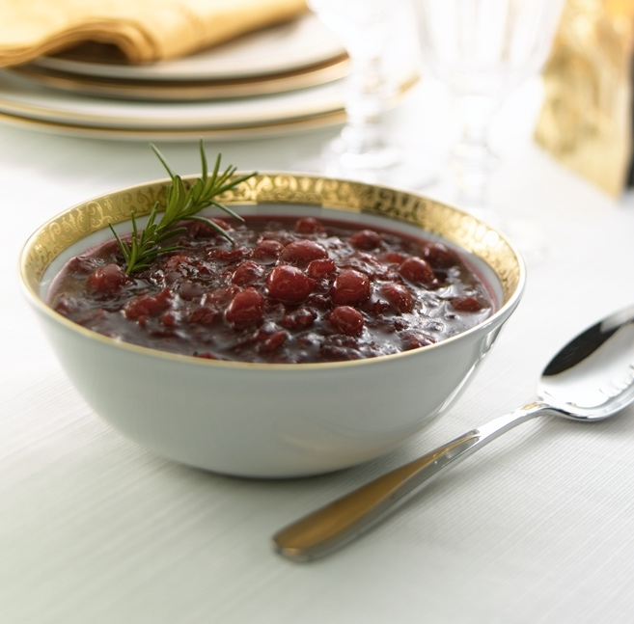
Contamination-Free Canning
Johnson Space Center
Ocean Spray: Lakeville-Middleboro, MA
Abstract:
Critical control points to monitor cranberry sauce production can include a washing station
for the berries, filtration and metal detection that ensure against foreign materials, heat treatment
for pasteurization, and checks of acidity levels, among others.

Slide 26
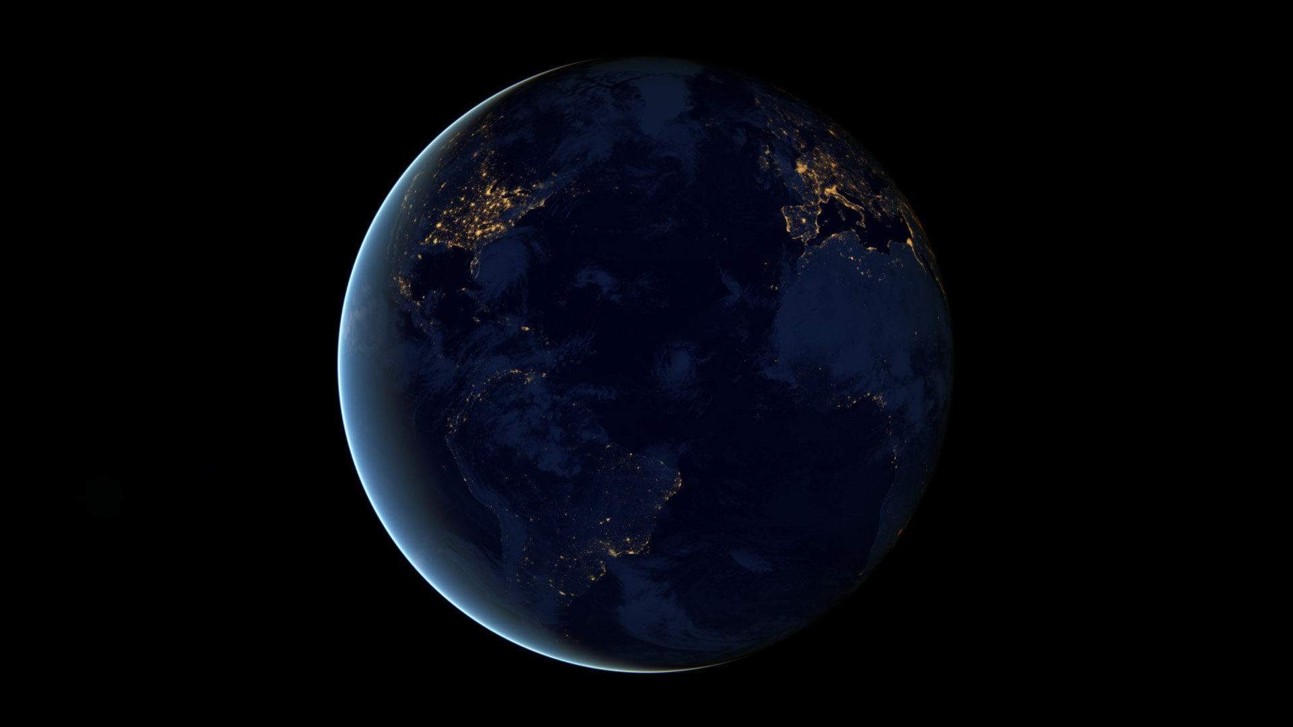
Spinoff Features
We are always advancing technology to enable exploration of our home planet and beyond. The following slides give a glimpse of some more ways this technology improves life
on the ground.

Slide 27

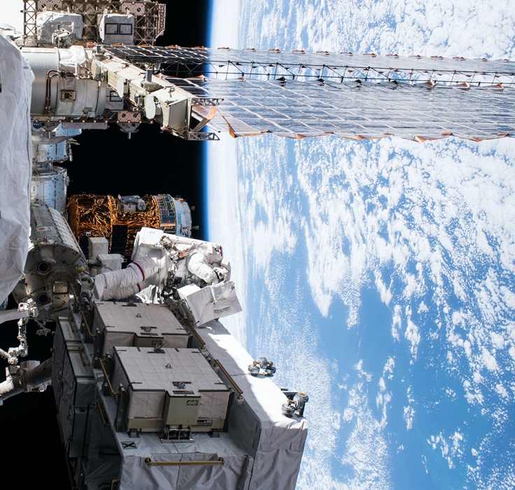
Medical Mission Control
Software that monitors astronaut health in space now monitors high-risk patients at home
Kennedy Space Center
Ejenta: San Francisco, CA
Abstract:
Custom software automated data collection from the space station, distributing it across NASA. Under exclusive license, that same program is now organizing and disseminating patient data for healthcare systems.

Slide 28
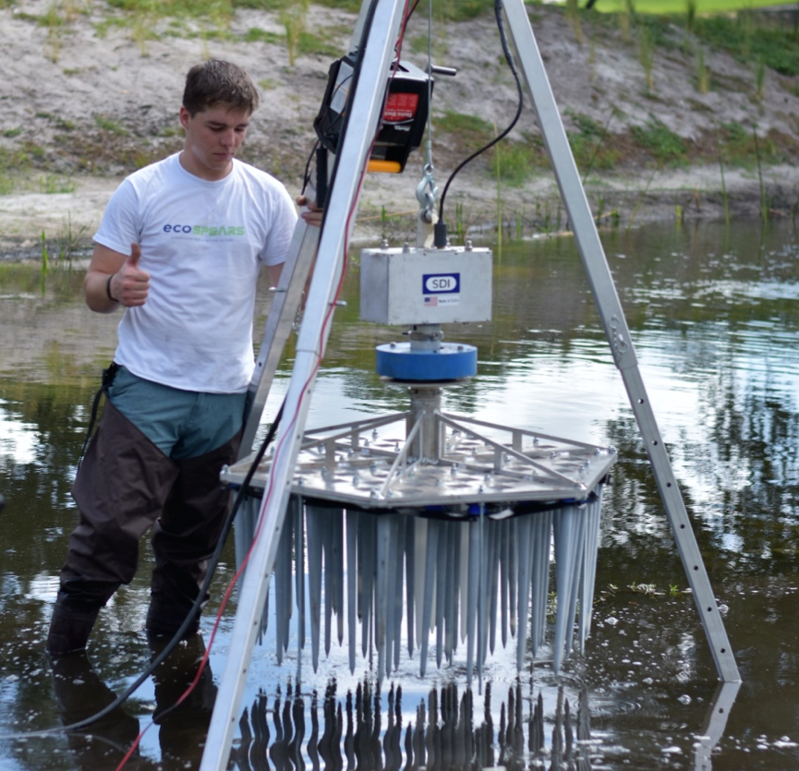
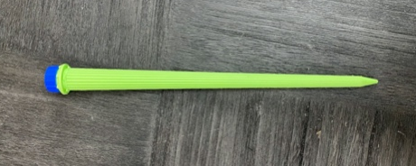
Cleaning Up a Toxic Legacy
System for removing toxins from buildings is repackaged to clean up contaminated sediment
Kennedy Space Center
ecoSPEARS: Altamonte Springs, FL
Abstract:
NASA created technology that absorbs toxins
from sediment and groundwater. A company
licensed it and now sells a system that is both cheaper and more effective than traditional cleanups.

Slide 29
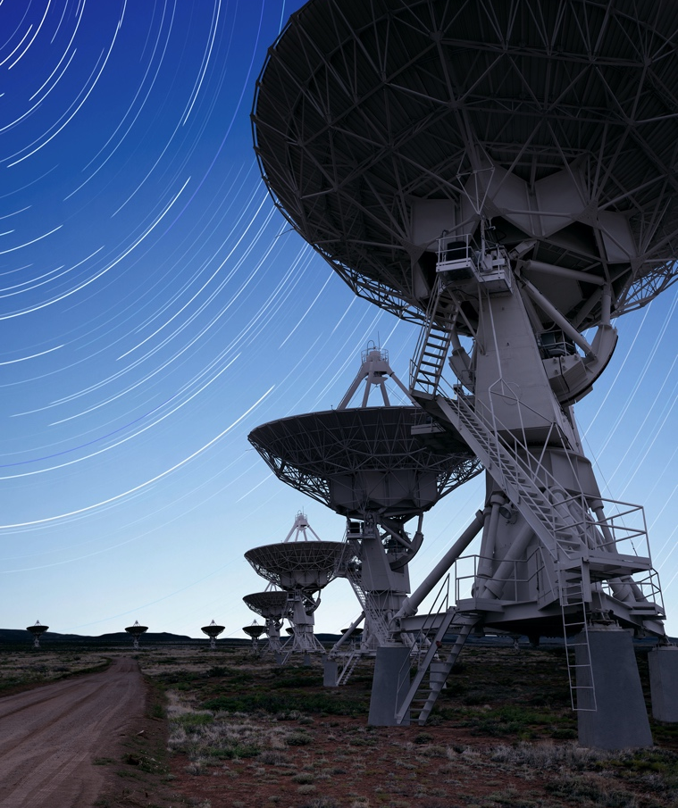
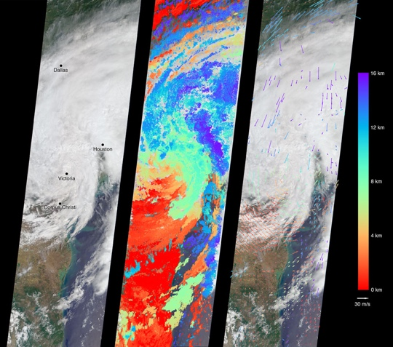
In Cloud Computing, Open Source Becomes Big Business
OpenStack, co-created by NASA, gained a huge user base and gave rise to other open source cloud computing tools
Ames Research Center
Red Hat: Raleigh, NC
Abstract:
NASA co-created the first open source cloud infrastructure, OpenStack, which companies have commercialized and built upon with other open source tools like the OpenShift platform. Open source cloud computing subsequently exploded across industries.

Slide 30
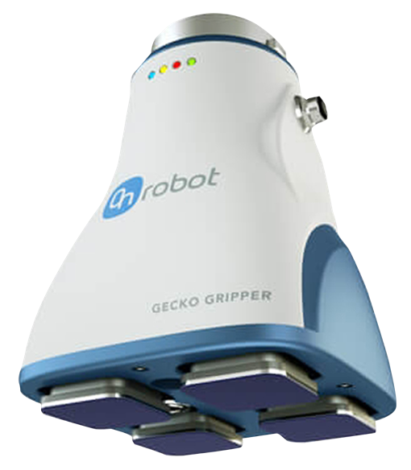
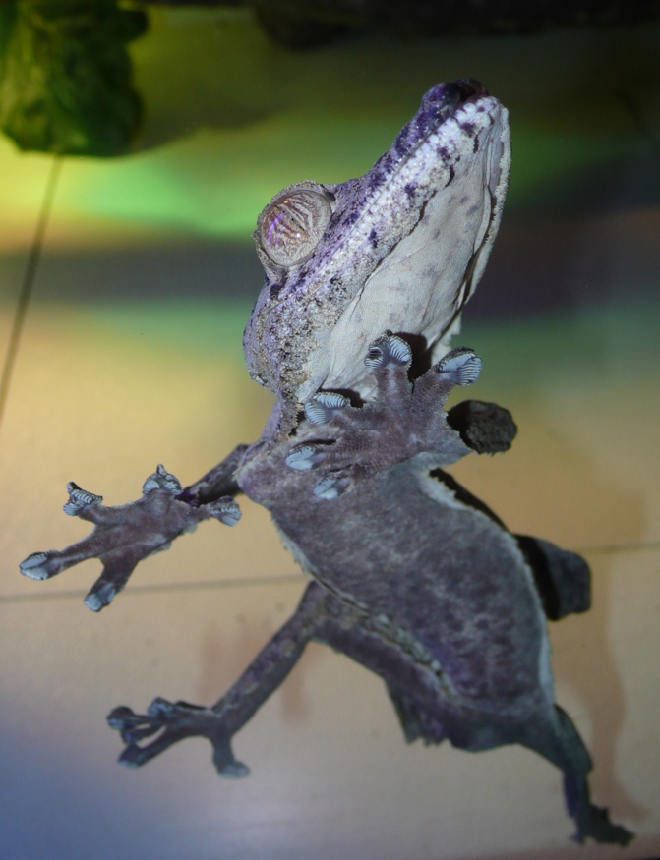
Gecko Gripper Finally Sticks
After two decades of effort, gripper imitating a gecko’s toe pads outfits industrial robots
Jet Propulsion Laboratory
OnRobot: Culver City, CA
Abstract:
NASA was interested in the technology for astronaut mobility and grappling satellites in orbit. A former JPL researcher licensed it and received NASA SBIR funding to develop it for industrial grippers, which are now going into factories.

Slide 31
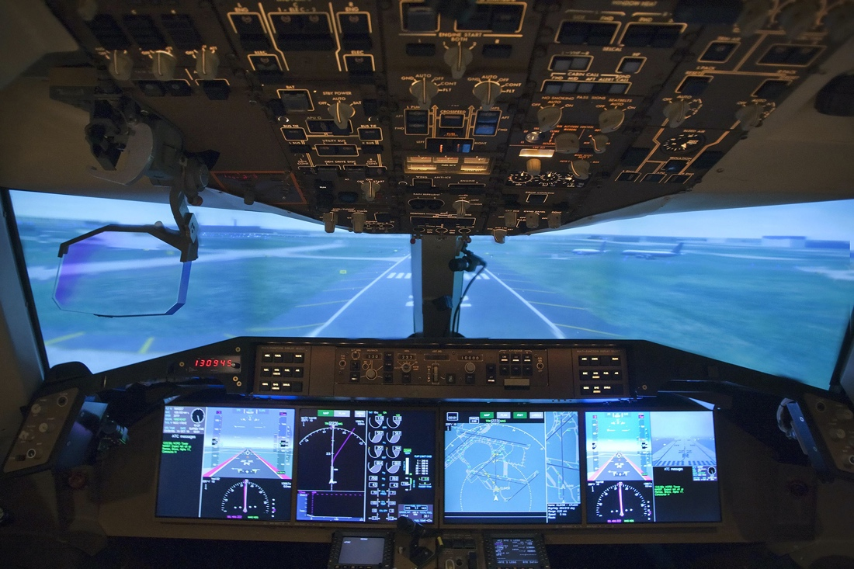
Airports Go Digital
NASA’s aviation expertise helps usher in digital communications at airports worldwide
Glenn Research Center
Telrad: Delmar, NY
Abstract:
Airport communications are getting safer and more efficient thanks to a new international technology standard developed with decades of NASA expertise, leveraged in a Space Act Agreement with the FAA and now used by private companies.

Slide 32
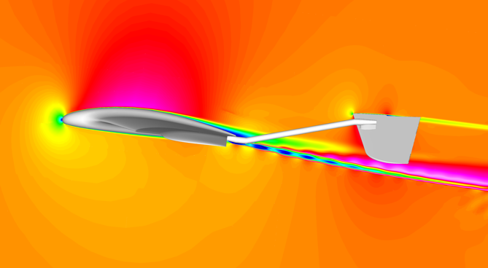
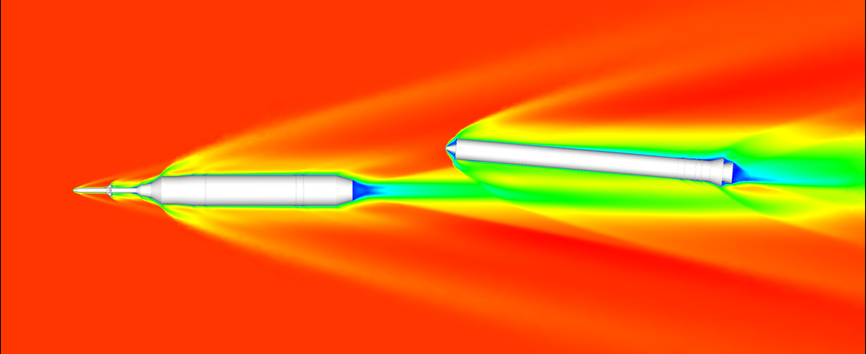
TetrUSS Stacks Up Building Blocks for Aircraft Design
NASA’s most popular and most-awarded software simulates aerodynamics for aircraft development and much more
Langley Research Center
Helden Aerospace: Acworth, GA
Abstract:
The TetrUSS software suite is available for free to U.S. citizens through a software usage agreement. Aircraft and spacecraft designers, government agencies, academics and many others use the software for a variety of purposes.

Slide 33
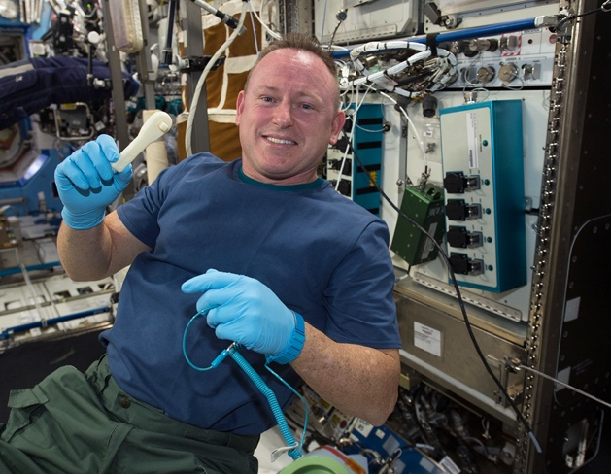
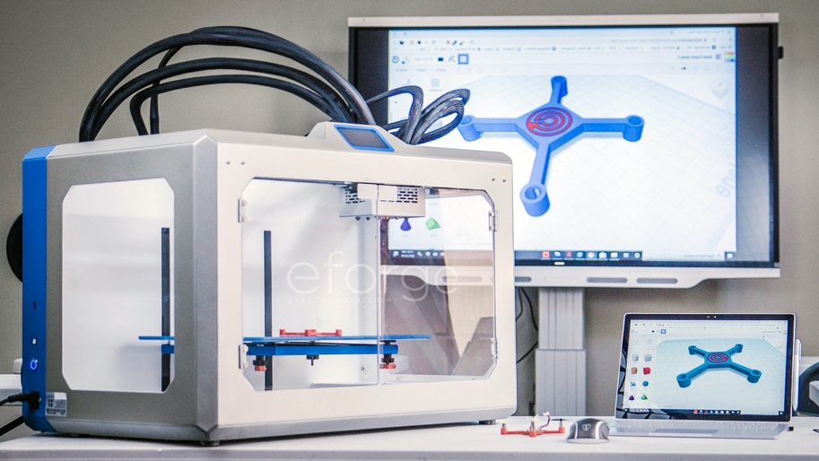
NASA Research Helps Make Electronics on Demand
The agency’s interest in printing components in space results in a commercially available 3D printer for electronic devices and parts
Marshall Space Flight Center
Electronic Alchemy: Huntsville, AL
Abstract:
Electronic Alchemy developed the eForge 3D printer with NASA STTR and SBIR funding. The space agency was interested in 3D printing electronics on orbit and beyond.

Slide 34
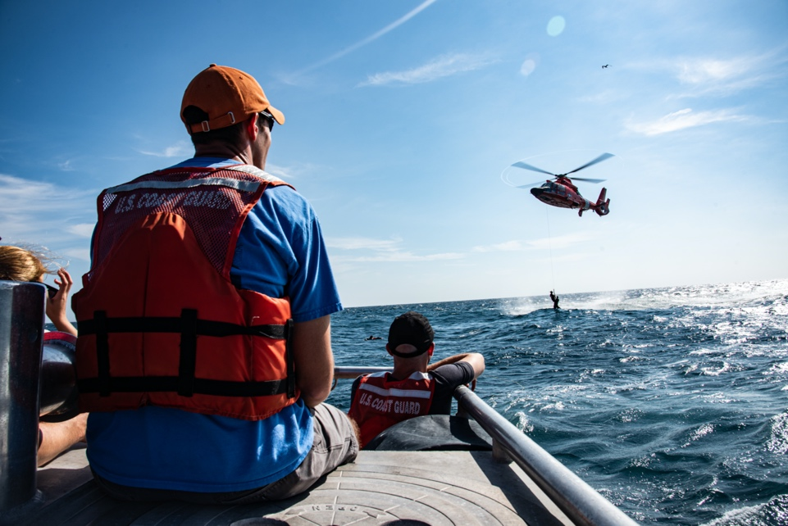
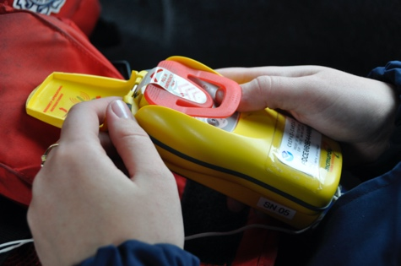
Answering the Call of Distress
Software created with NASA expertise helps improve search and rescue system established under NASA’s lead
Johnson Space Center,
Goddard Space Flight Center
Orbit Logic: Greenbelt, MD
Abstract:
NASA helped establish the Search and Rescue Satellite Aided Tracking (SARSAT) system and remains its research and development lead. Now software built with NASA know-how is helping additional satellites significantly improve response time and location accuracy.

Slide 35
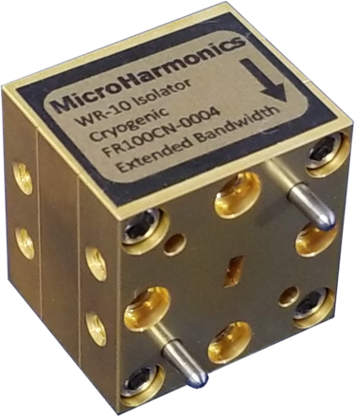


Catch the Waves
NASA-funded sensors test 5G cellular systems
Jet Propulsion Laboratory
Micro Harmonics: Fincastle, VA
Abstract:
Through NASA SBIR contracts, Micro Harmonics built a new line of isolators that can operate at higher frequencies, and they are now being sold to testing laboratories for communications equipment.

Slide 36


Debugging Code Is Rocket Science
A simple NASA static program analyzer finds coding errors for business as well as rockets
Ames Research Center
IKOS: Vejle, Denmark
Abstract:
Incorrect computer code can blow up rockets. So Ames Research Center developed software to evaluate any program written in C or C++ computer language. The open source code now saves businesses costly mistakes and ensures customer safety.

Slide 37


Space Fuel Cell Provides Deep-Sea Power
Rugged, reliable fuel cells provide power for offshore drilling
Johnson Space Center
Teledyne Energy Systems: Hunt Valley, MD
Abstract:
Under a Space Act Agreement, NASA taught one company how to make more efficient, reliable fuel cells. They’re now on the ocean floor, providing backup power for wells and recharging the remotely operated vehicles
that service them.

Slide 38


Eagle Eyes in Treacherous Skies
A rugged drone designed for NASA supports research and commercial enterprise from the air
Goddard Space Flight Center
Black Swift Technologies: Boulder, CO
Abstract:
To collect Earth science data, NASA awarded SBIR contracts to Black Swift Technologies to develop a rugged remotely piloted drone. Now farmers and other industries use it to monitor everything from soil moisture to Arctic atmospheric conditions.

Slide 39


Keeping Tabs on the Sky
Research done for NASA is now helping airports and businesses around the world track airplanes
Ames Research Center
Metron Aviation: Herndon, VA
Abstract:
Years of air traffic research conducted for NASA helped shape air traffic control software that enables airports and private freight-carrying businesses to share flight data, track airplanes, predict weather impacts, and find alternative flight paths.

Slide 40

Odor-Eliminating Shoe Inserts Rely on NASA-Tested Cloth
Zorpads patches use a material that NASA has considered for spacecraft filters
Marshall Space Flight Center
Zorpads: New York, NY
Abstract:
NASA studied cloths that might replace granules for filtering with activated carbons in spacecraft. Having consulted with NASA while working with similar materials at SpaceX and elsewhere, a business school student tried out one of the cloths for absorbing shoe odors.

Slide 41

Fix It Like an Astronaut with Augmented Reality
A program to help astronauts visualize repairs assists workers on the ground
Johnson Space Center
Tietronix Software: Houston, TX
Abstract:
Augmented reality and 3D animation can help astronauts conduct maintenance in low-Earth orbit. A system NASA contracted to guide procedures in space now helps businesses improve training and field operations on this planet.

Slide 42



Hearing Silence from the Stratosphere
NASA microphone can detect turbulence hundreds of miles away
Langley Research Center
Stratodynamics: Lewes, DE
Abstract:
NASA researchers developed a specialized microphone to pick up sounds made by clear-air turbulence. Now private industry is using it to help conduct research and keep high-altitude drones in the air longer.

Slide 43

For Work or Play, Comfort All Day
Two NASA technologies converge for more comfortable chairs
Johnson Space Center
Raynor Gaming: West Hempstead, NY
Abstract:
Cooling materials based on NASA SBIR contracts and memory foam stemming from an agency airline safety project are both used in high-end chairs from two sister companies

Slide 44


Hot Water on Demand
NASA expertise leads to improved in-home tankless water heaters
Johnson Space Center
Seisco: Houston, TX
Abstract:
Former NASA employees and contractors leveraged experience gained while working on electronics for testing equipment and the space shuttle to design control systems for a whole-home tankless water heater.

Slide 45



A New Doorway to Space
The privately funded Bishop Airlock expands commercial access to the space station
Johnson Space Center
Nanoracks: Webster, TX
Abstract:
The Bishop Airlock Module, built through a public-private partnership with NASA, expands commercial access to low-Earth orbit by adding real estate to the space station and a larger doorway for putting CubeSats into orbit.

Slide 46



Communicating via Long-Distance Lasers
A NASA partnership made lasers viable for satellite communications
Goddard Flight Research Center
Ames Research Center
Glenn Research Center
BridgeComm: Denver, CO
Abstract:
After a demo flight, NASA partnered with a private company to further develop laser communications technology, and the resulting system is now preparing for launch on multiple satellite constellations.

Slide 47


Smart Glasses Focus Attention
Narbis improves concentration with NASA neurofeedback technology
Langley Research Center
Narbis: Ambler, PA
Abstract:
NASA “engagement index” algorithms gauge attention levels by measuring brainwaves. The results darken glasses to alert users when their concentration strays – and train their brains to stay focused.

Slide 48



Modeling Airflows to Help Air Filters
NASA expertise improves air filtration technology
Glenn Research Center
Health-Mor: Brooklyn, OH
Abstract:
Through Glenn Research Center’s Adopt-A-City Program, a small vacuum cleaner and air purifier company got engineering help from NASA researchers to improve its product’s efficiency and reduce noise levels.

Slide 49


Taking Out the Trash, NASA-Style
Plasma-arc technology for testing heat shields transforms garbage into reusable chemicals
Ames Research Center
InEnTec: Richland, WA
Abstract:
Before NASA launched anything into space, it had to test heat-shield material. The patented plasma-arc technology the space agency developed now transforms garbage into a variety of reusable materials.

Slide 50


Recalibrating Fine Motor Skills
Space app for testing fine motor skills touches down in the Apple App store
Johnson Space Center
Leidos Holdings: Reston, VA
Abstract:
How does leaving and returning to gravity impact fine motor skills? An app to test astronaut performance helps NASA learn more, and now it helps anyone measure their abilities via an app released by the agency.

