Slide 1
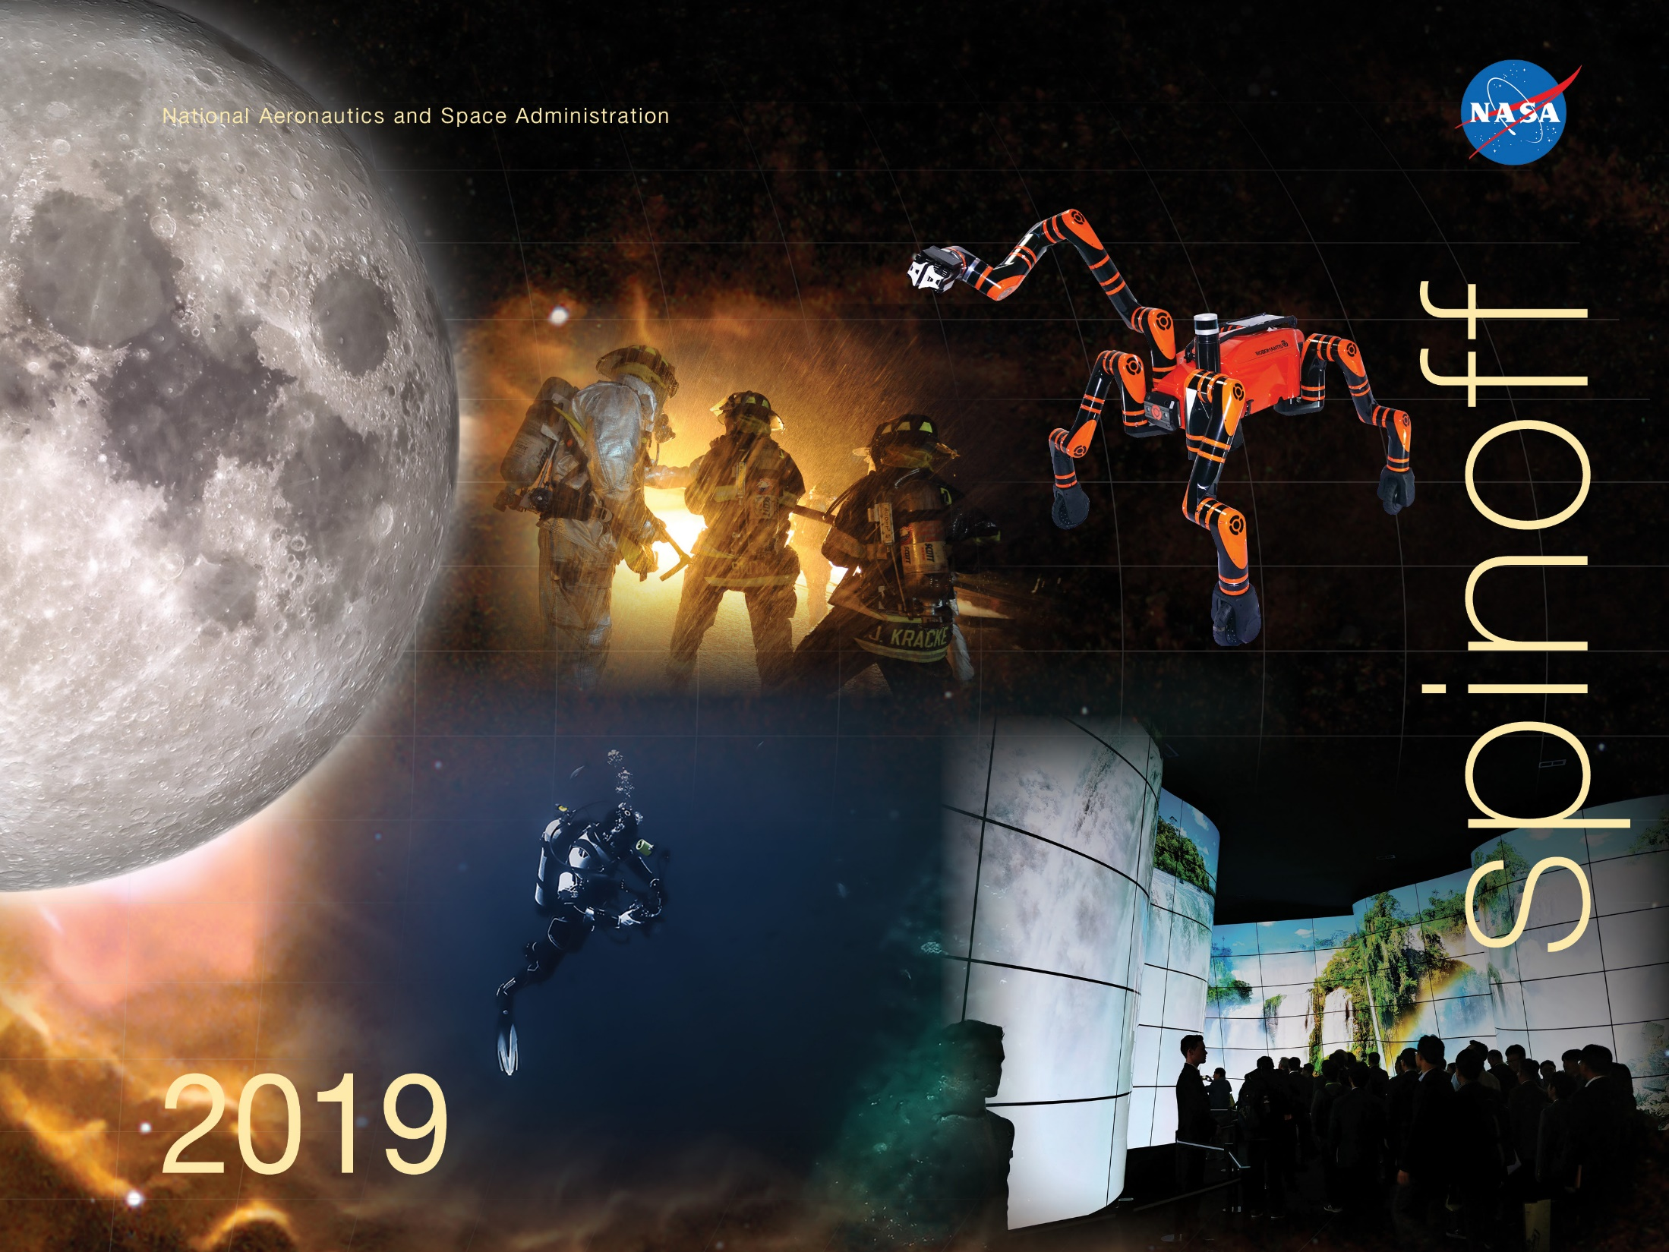

Slide 2


Slide 3
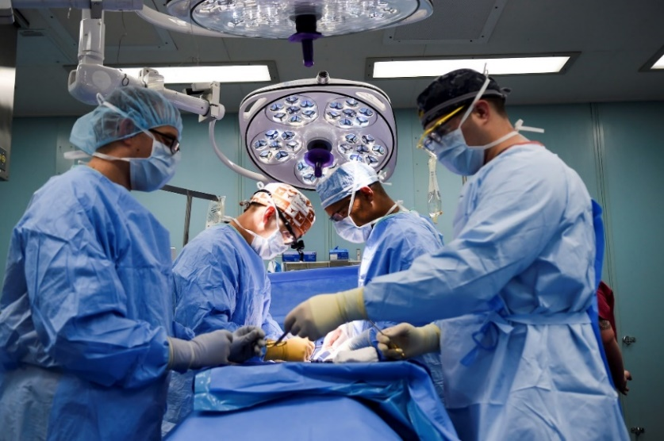
Unique Polymer Finds Widespread Use in Heart Devices
Langley Research Center
Medtronic
Minneapolis, Minnesota
NASA Technology
A program to develop an aircraft able to carry passengers from Los Angeles to Tokyo at more than twice the speed of sound required materials for advanced composites and adhesives
Through research conducted by NASA, a formula for a unique polymer resulted in the creation of the Langley Research Center-Soluble Imide (LaRC-SI)
Technology Transfer
Sources for the raw materials used to manufacture LaRC-SI began to move overseas
Through a series of SBIR contracts, a small company called Imitec began producing LaRC-SI
Medtronic received a license from Langley to commercialize LaRC-SI, purchased from Imitec, and the Medtronic eventually brought the original Langley inventor on as a consultant
Benefits
LaRC-SI allows for cardiac resynchronization therapy to be better applied to patients with congestive heart failure or cardiomyopathy
The company’s line of ventricular leads are some of the safest and easiest to implant on the market
Medtronic’s engineers continually evaluate different applications for LaRC-SI
Spinoff 2019
Health and Medicine

Slide 4
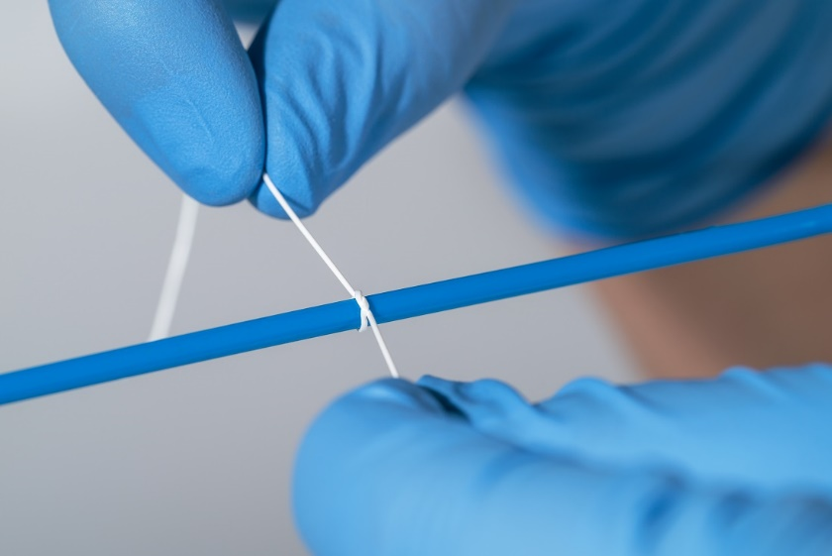
Material for Mars Makes Life-Saving Sutures
Jet Propulsion Laboratory (JPL)
Zeus Inc.
Orangeburg, South Carolina
NASA Technology
NASA is very interested in one day bringing samples from Mars to study in labs here on Earth
Taking samples can be a dusty, gritty task; NASA needed a self-cleaning seal to prevent contamination
Technology Transfer
A “knife-edge” seal wipes off debris by pushing through a barrier—it must be soft enough to be punctured while still stiff enough to push away debris
With SBIR funding, Zeus tested multiple expanded PTFE prototypes, before going back and trying an alternate manufacturing process
Using large-diameter extrusion, Zeus was able to create ePTFE ribbon that worked on the seal
Benefits
This material is soft, flexible, strong, and biocompatible, allowing it to be used inside the body without needing to be removed
The material now encapsulates arterial stents and is sold for surgical sutures
The material is also being used by oil and gas drilling companies for other applications
Spinoff 2019
Health and Medicine

Slide 5
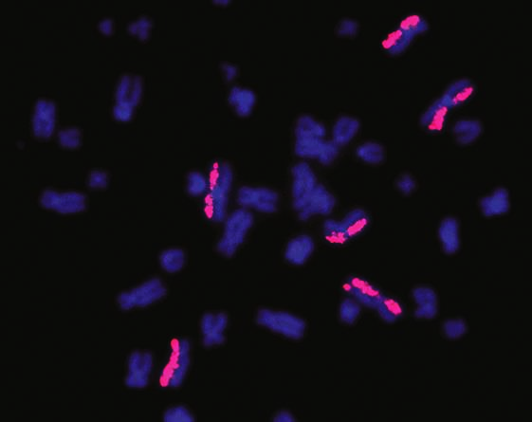
Fluorescent Paints Spot DNA Damage from Radiation, Gene Editing
Johnson Space Center
KromaTiD Inc.
Fort Collins, Colorado
NASA Technology
Astronauts are exposed to high-energy charged particles from the sun and cosmic sources, ions which can rip through DNA and inflict random harm leading to cancers and other medical problems
Doctors at Johnson took blood samples from astronauts to look for genetic damage
Technology Transfer
NASA awarded two SBIR contracts to KromaTiD to develop chromatid paints to highlight previously undetectable abnormalities
DNA inversions within a chromosome can be observed for the first time
The technology was used to detect abnormalities in Scott Kelly’s DNA after living in space for a year—the damage was minimal
Benefits
KromaTiD Inc. calls their technology directional Genomic Hybridization (dGH)
In oncology, this technology will aid in identifying genetic diseases, observing chromosomal damage, and tailoring therapies
The company sees its biggest opportunities in the field of gene editing and testing techniques
Spinoff 2019
Health and Medicine

Slide 6
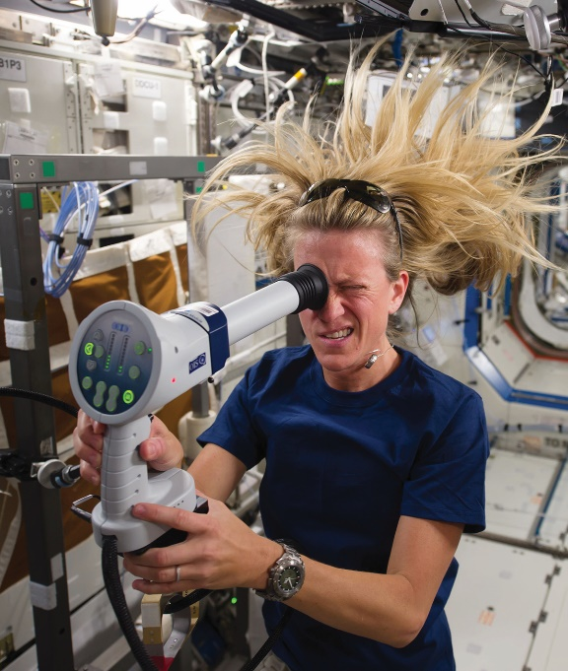
Image-Analysis Software Sees Cancer in 3D
Ames Research Center
ERT
Philadelphia, Pennsylvania
NASA Technology
NASA studies the health risks of space travel, which can also benefit ground-based medical research
One health risk only detected when space missions extended from weeks to months: vision changes
One theory suggests these changes are related to blood flowing differently in zero gravity
Technology Transfer
In an earlier study, funded partly by Ames, Ron Midura of Cleveland Clinic’s Learner Research Institute investigated vascular remodeling due to space travel
Midura worked with ERT to develop software that would help analyze vascular images for changes
The software has since been used for clinical studies
Benefits
The advanced imaging software is called ImageIQ
It removes human variability by having a computer analyze an image pixel-by-pixel
The software can detect the 3D shape of a tumor by analyzing a series of 2D images, which can aid in diagnosis and in excision surgery
Also helps study pulmonary embolisms, aneurysms and lesions
Spinoff 2019
Health and Medicine

Slide 7
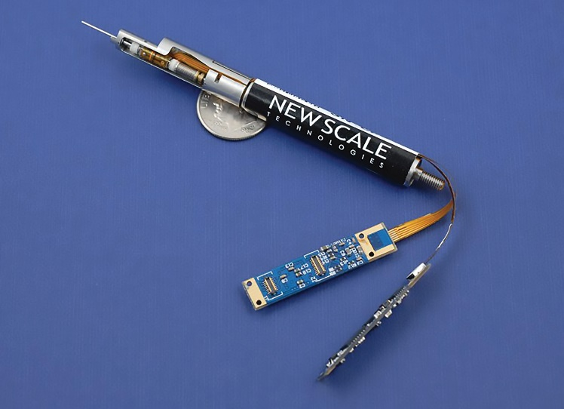
Miniature Positioner Focuses Lenses with Precision
Jet Propulsion Laboratory (JPL)
New Scale Technologies
Victor, New York
NASA Technology
NASA is working on new technology to better study dark matter, which is thought to hold galaxies together
One instrument built by NASA engineers, set to be installed on Japan’s Subaru telescope in Hawaii, will help understand dark matter and dark energy by measuring the expansion of the universe
Technology Transfer
The team at JPL needed thousands of tiny motors, each identical to the next and perfectly precise
New Scale modified its existing Squiggle linear piezoelectric motor, adding rotary movement to meet NASA specifications
New Scale also packaged the motors into complete positioners, with reduced energy needs and precision manufacturing
Benefits
Reduced-voltage piezoelectric motors have implications well beyond space telescopes
The motors are used in medical instruments, including in blood analyzers, with interest also for robotic surgery and implantable devices
Another area of interest is beam steering for lidar; two-axis positioners can point precisely
Spinoff 2019
Health and Medicine

Slide 8
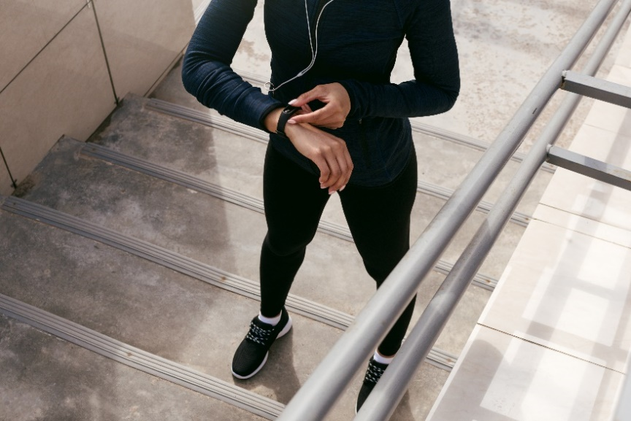
Biometric Sensor Tracks Vital Signs for Health
Johnson Space Center
Salutron
Newark, California
NASA Technology
NASA monitors astronauts 24/7 to learn the effects of space travel and ensure they are healthy
One metric NASA is interested in is real-time stress, for example if the astronaut needs to think fast and be very alert
Any monitor must be unobtrusive but very accurate
Technology Transfer
Researcher Lino Velo used funding from SBIRs to test a miniaturized, wearable PPG (photoplethysmography) sensor that tracks blood flow under the skin
The goal was to see if PPG could measure heart rate variability as accurately as other proven methods and whether it accurately reflected cognitive stress
Benefits
PPG was shown to accurately measure heart rate variability and stress level
Salutron initially developed a consumer device but now sells sensors to device-makers
So far it is mostly used to track fitness, but heart rate variability can also indicate changes to health over time
Spinoff 2019
Health and Medicine

Slide 9


Slide 10
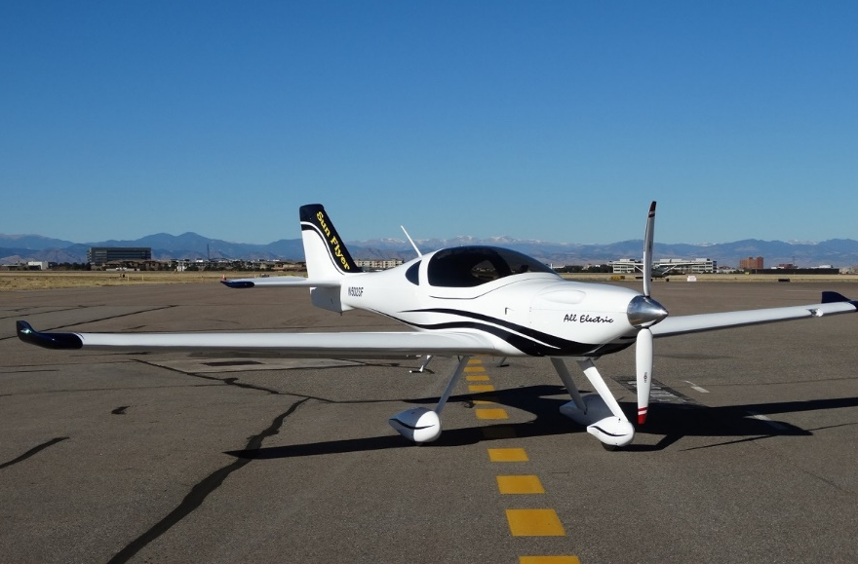
Battery Innovations Power All-Electric Aircraft
Armstrong Flight Research Center
Electric Power (EP) Systems
Industry, California
NASA Technology
The X-57 Maxwell is an all-electric NASA flight demonstrator that needed an innovative battery system to safely deliver power to 14 engines
Innovations in pulling heat from battery cell surfaces, welding techniques and lightweight packaging make it possible to use standard lithium batteries
Technology Transfer
Under SBIR contracts, EP Systems built an 850-pound lithium-ion battery pack to meet NASA specifications
After the pack caught fire during testing, a number of NASA experts offered assistance and testing and manufacturing technology
Bye Aerospace powers its Sun Flyer with batteries based on the X-57 batteries
Benefits
Commercial sales of EPiC batteries began before NASA’s first scheduled test flight in 2019
New vehicle concepts and aviation business models can now leverage low-noise, zero-emission electric engines; urban transport and flights between small airports are envisioned
Sun Flyer operates at a cost of $3 per hour
Spinoff 2019
Transportation

Slide 11
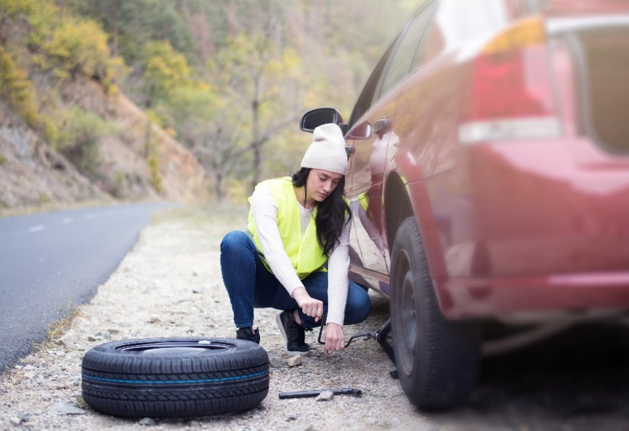
Shuttle Tire Sensors Warn Drivers of Flat Tires
Kennedy Space Center
Amphenol Advanced Sensors
St. Marys, Pennsylvania
NASA Technology
A redesign of the space shuttle tires included plans for a pressure sensor to replace the previously used external strain gauge
The sensor was designed to go inside the tires and give astronauts and ground control highly accurate readings before descent to avoid a bad landing
Technology Transfer
NovaSensor, later acquired by Amphenol, built the new sensor using miniaturized piezoresistive technology
The device had to work through extreme conditions during launch and in space, work using only a small battery, send results via radio frequency, and mount inside the tire
Benefits
The company adapted the sensor for car tires, using nearly the same design delivered to NASA
Millions of pressure sensors are in passenger vehicles, as well as on “run-flat” tires in the U.S.
U.S. law mandates a pressure gauge on every car tire because of the increased safety enabled by pressure sensors like these
Spinoff 2019
Transportation

Slide 12
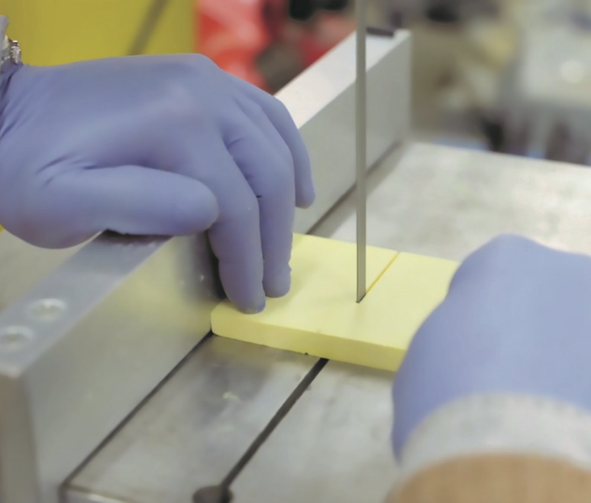
Space-Age Insulation Evolves to Replace Plastic and Save Weight
Glenn Research Center
Aerogel Technologies
Boston, Massachusetts
NASA Technology
A NASA-funded project figured out how to turn brittle aerogel, the world’s lightest solid, into a useful form
Silica aerogel was infused into blankets to make high-performing insulation
Later work created aerogels from other polymers, which can be cast in thin, flexible, very tough sheets
Technology Transfer
Aerogel Technologies licensed patents from Glenn and has done additional research and development to improve aerogel manufacturing
A new ambient drying process developed by the company dramatically lowers production costs
Glenn is studying electromagnetic resistance; Aerogel Technologies is interested in thermal conductivity—sharing results, benefits both teams
Benefits
Airloys can have a wide array of mechanical properties—high temperature tolerance, transparency, flexibility, and stiffness
Aegogel Technologies is working with plane and car manufacturers from Airbus to Ford to potentially replace heavier plastic parts
Lighter vehicles mean greater fuel efficiency
Spinoff 2019
Transportation

Slide 13
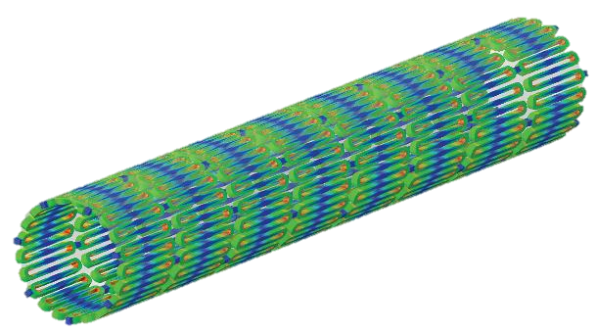
Software Helps Design Artery Stents, Lawn Mowers, Airplanes
Langley Research Center
Abaqus Inc.
Johnston, Rhode Island
NASA Technology
The roof blowing off Aloha Airlines Flight 243 in 1983 resulted in an investigation involving NASA to diagnose a cause
NASA turned to finite element analysis software, which enables the modeling of complicated structures by subdividing them into small parts
Technology Transfer
Computer design and modeling reduces the number of expensive physical tests by simulating the response of different materials in advance
Finite element analysis improved, but the use of new materials required extensive software changes
Abaqus embarked on a major software upgrade, adding decades of analysis and composite materials
Benefits
Abaqus finite element analysis software is used in a host of industries to test products
Improvements have been made to existing products such as optimizing windshield wiper blades, tires, and composite airframes
Stents for human hearts (pictured above), lawn mower design and more are designed, improved
Spinoff 2019
Transportation

Slide 14

Super-Accurate Atomic Clocks Could Aid in Navigation, Communication
Goddard Space Flight Center
AOSense Inc.
Sunnyvale, California
NASA Technology
Measuring time precisely on spacecraft is fundamental to positioning calibration and advanced scientific research
More accurate positioning would unlock new possibilities, such as enabling a fleet of satellites to conduct a synchronized, distributed experiment
Technology Transfer
Several SBIR contracts from NASA, most of them with Goddard, funded components for a small, portable optical atomic clock
Each component must be reengineered from the lab-sized versions to be small, low-powered and robust enough for space
The AOSense atom source outperforms the room-sized atomic clock previously used in academia
Benefits
This small clock will improve and secure satellite communications for GPS, ATMs, and more
University labs are now buying their atom source from AOSense and getting better measurements
The new clock components, such as a laser that cools the atom source, can also be leveraged by other businesses now and into the future
Spinoff 2019
Transportation

Slide 15

Probes Characterize Air and Water Flows over Aircraft, Yachts
Langley Research Center
Tao Systems
Hampton, Virginia
NASA Technology
NASA uses devices called anemometers to measure and understand how air flows around an object
A new approach to characterizing high-speed turbulence in wind and fluid flows was needed for wind tunnel tests for supersonic flight, with measurements at very high frequencies
Technology Transfer
With two SBIR contracts, Tao Systems developed the constant voltage anemometer (CVA)—a new probe
Because the probe regains equilibrium more quickly than related systems, it’s capable of taking readings at frequencies up to 1 million per second
It measures flow velocity and, at low voltage levels, detects temperature fluctuations
Benefits
Measurements take milliseconds, not minutes
CVA can endure a wide range of temperatures and does the job of two traditional sensors
America’s Cup winners have used the technology to design yachts
The Air Force uses it for aircraft and to characterize flows/turbulence in the stratosphere
Spinoff 2019
Transportation

Slide 16
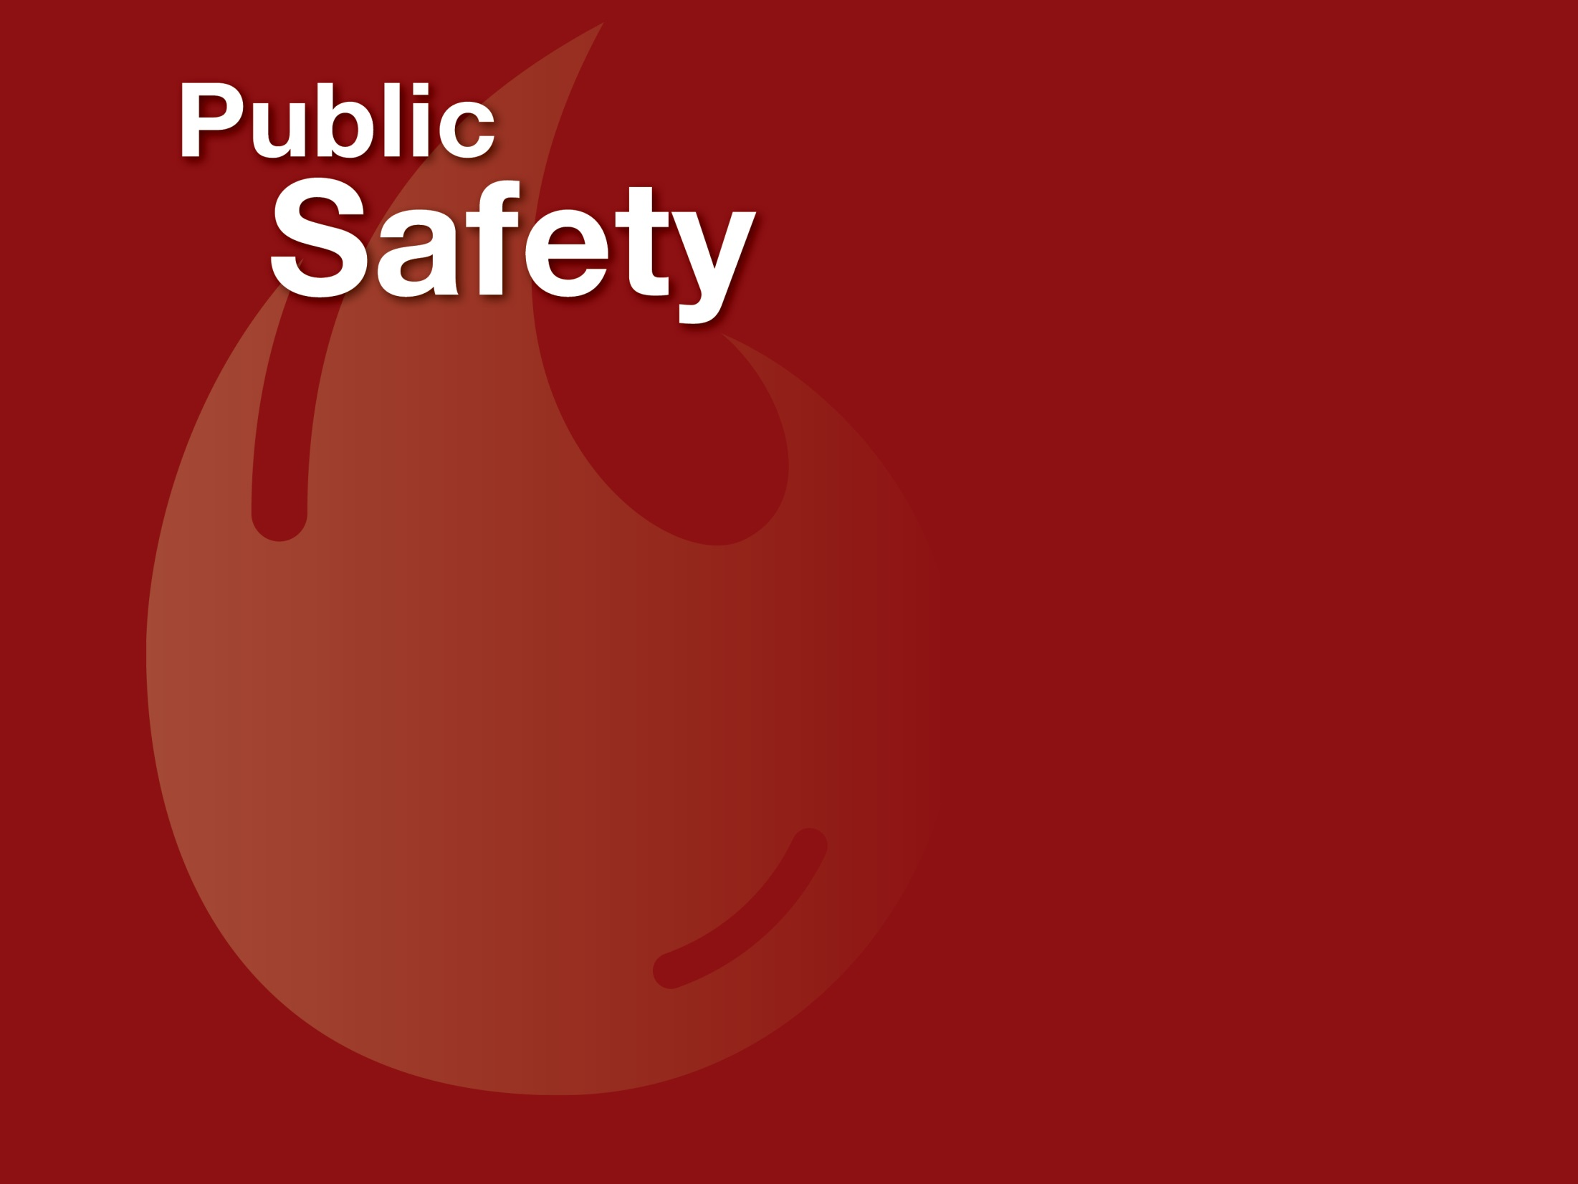

Slide 17
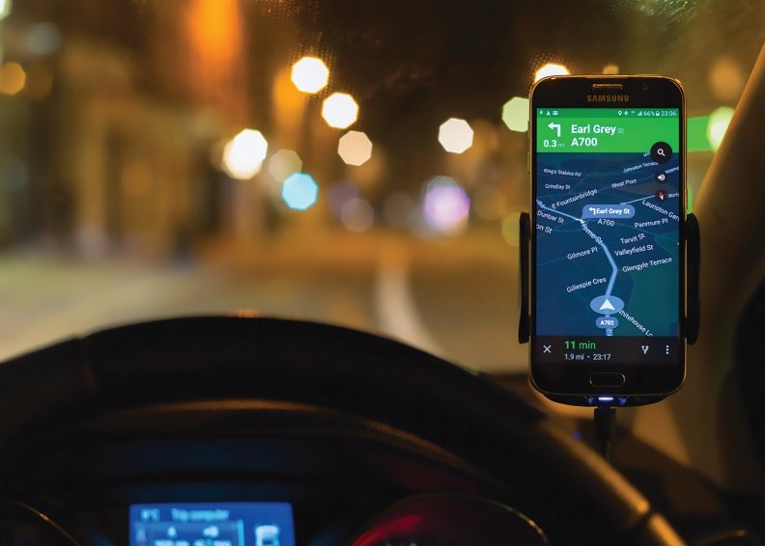
NASA Brings Accuracy to World’s Global Positioning Systems
Jet Propulsion Laboratory (JPL)
Comtech Telecommunications Corporation
Long Island, New York
NASA Technology
Raw GPS data can produce positioning errors of 30 feet or more if not calibrated for signal delays, but for a long time real-time corrections weren’t possible
JPL developed software to correct for those errors, enabling real-time precision GPS
Technology Transfer
Real-time tracking software conducts all GPS corrections, updating them every second, and results are accurate to within less than three inches
Location-based service is used in multiple industries
Using a license from JPL, Comtech delivers location data from cell phones to first responders, among other services
Benefits
Comtech provides location-based services for asset tracking, navigation, and social media
Corrected GPS enables the detection and monitoring earthquakes and predicts tsunamis
Accurate GPS enables flight navigation, precision agriculture, mapping, Earth science and imaging, offshore oil drilling, and more
Spinoff 2019
Public Safety

Slide 18
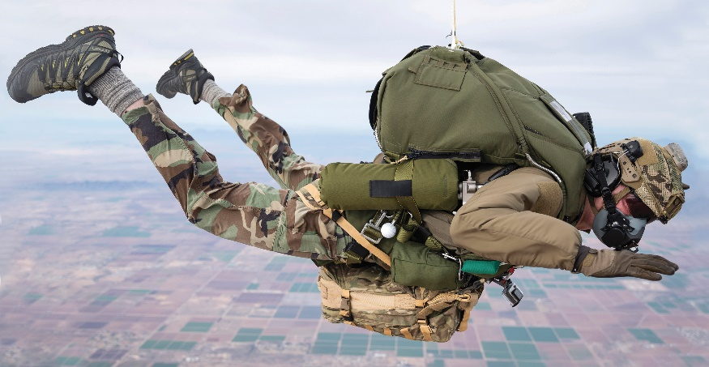
Gas Regulators Keep Pilots Breathing
Johnson Space Center
Cobham Mission Systems
Orchard Park, New York
NASA Technology
Astronauts must bring air to breathe with them, but it is dangerous if the air comes out from pressurized cannisters too fast or too slow
Compressed oxygen is also highly flammable
Systems designed to regulate air flow have been a part of NASA since the first space missions
Technology Transfer
Cobham innovated a new gas regulator for John Glenn’s historic first orbit around Earth
The company has updated the design and built on the expertise gained to continue making air regulators for every US astronaut since
NASA’s Orion uses an automated electric motor to hit set pressure points, but still relies on the basic innovation Cobham created for John Glenn
Benefits
Cobham regulators are used in emergency breathing systems for airline pilots
Other uses include military planes, submarines, as well as elite, high-altitude military parachutists
In these dangerous applications, Cobham’s reputation for reliability, and its successful track record with NASA, lend confidence
Spinoff 2019
Public Safety

Slide 19
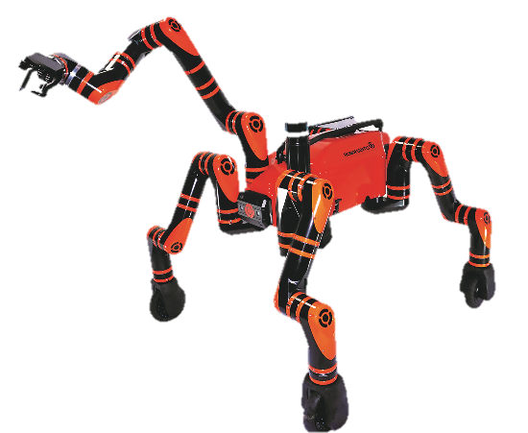
RoboMantis Offers to Take Over Dangerous Missions
Jet Propulsion Laboratory (JPL)
Motiv Space Systems
Pasadena, California
NASA Technology
The JPL robotics team built RoboSimian for the 2015 DARPA Robotics Challenge
The robot was a modular design packed with features—actuators, sensors, manipulators, simplified interfaces—that could be repurposed
Technology Transfer
The entire robot was available for license as a package with the goal of enabling new technology
Motiv licensed RoboSimian and used NASA’s design to develop a five- or six-limbed robot for disaster response and working in hazardous areas.
The new software’s increased computational ability is based on open source code and is publicly available
Benefits
Rutgers University was Motiv’s first customer
RoboMatis can take over for humans in dangerous situations such as disaster relief or power plant maintenance
Individual pieces of the technology can support numerous industries, and the manipulators and power systems are getting attention
Spinoff 2019
Public Safety

Slide 20
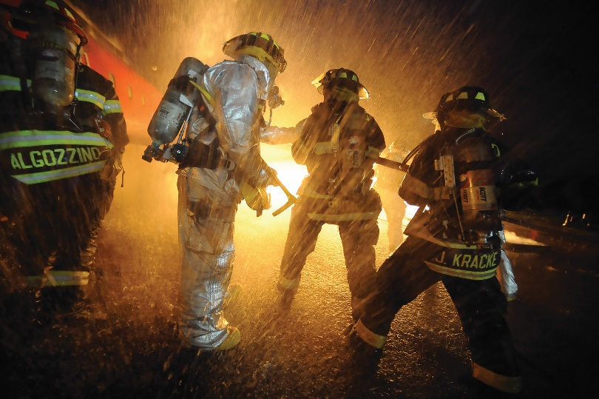
Wrapped Tanks Cut Weight on Everything from Buses to Paintball Guns
Glenn Research Center
Worthington Industries
Pomona, California
NASA Technology
The space shuttle design required a new tank to safely store gases and liquids at higher pressures than previously possible, cutting the tanks’ weight
Composite overwrapped pressure vessels (COPVs) have a liner wrapped in high-strength filament and can weigh 50 percent less than metal tanks
Technology Transfer
Under contract to Glenn, Structural Composites Industries, now part of Worthington, spent years trying different liners, fibers, resins, and test methods
The company created a computer program to design and analyze the vessels, calculating stresses and strains, establishing optimum physical characteristics
Kevlar and carbon fibers developed in the 1990s can reduce weight by an additional 20 percent
Benefits
Company sells 60,000–80,000 COPVs a year
Firefighter oxygen tanks reduce injury rates
Large tanks hold compressed and liquid natural gas for fuel on buses and other vehicles
COPVs cut weight on planes, helicopters, life-support equipment, breathing gear, military systems, spacecraft, paintball guns, and more
Spinoff 2019
Public Safety

Slide 21
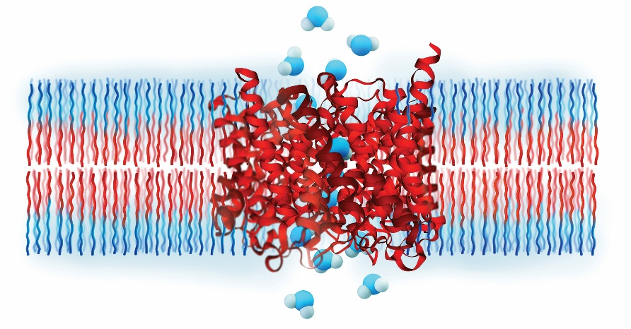
Membranes Mimic Kidneys to Filter Water
Ames Research Center
Aquaporin A/S
Copenhagen, Denmark
NASA Technology
Heavy filtration beds on the International Space Station (ISS) that weigh down resupply missions have to be swapped out every 90 days, and certain semivolatile contaminants can’t be filtered out
NASA needs a more effective, lighter-weight and longer-lasting filtration system for future missions
Technology Transfer
Using funds from the NASA Next Generation Life Support project, Ames helped fund Aquaporin A/S prototypes to try as an alternative
Proteins called aquaporins, found in virtually all life forms, filter water effectively
Aquaporin A/S embedded them in a lightweight membranes, and testing on the ISS showed they outperformed current filters
Benefits
NASA and the European Space Agency have placed orders for water purification systems
Household modules use reverse osmosis to filter water about twice as fast and with nearly double the water recovery rate of other home purifiers
Company is eyeing industrial uses for forward osmosis and pilot-testing with companies
Spinoff 2019
Public Safety

Slide 22
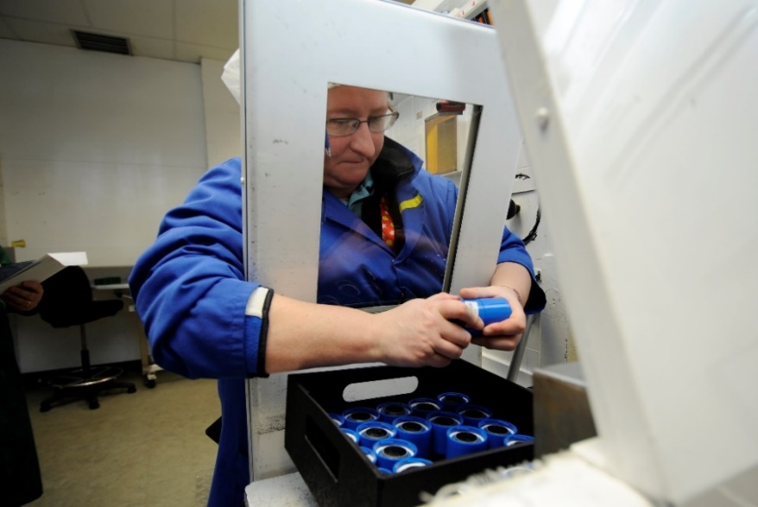
Detailed Spectrometry Makes Dangerous-Materials Testing Safer
Ames Research Center
Applied Spectra
Fremont, California
NASA Technology
Curiosity Mars rover’s laser spectrometer can zap a sample at a distance and analyze the resulting flash to determine molecular content
This process can’t identify isotopes, which reveal more about a sample’s age, formation, radioactivity
Technology Transfer
A grant let an Ames researcher work on a version of the technology that identifies isotopes—most researchers thought this was impossible
After the researcher joined Applied Spectra, two Ames SBIR contracts helped him and the company successfully control the laser pulse, find the right sensors, and program them to observe the right moment and wavelengths
Benefits
Applied Spectra calls the new technology Laser Ablation Molecular Isotopic Spectrometry (LAMIS)
It analyzes samples without the need to collect or even approach them
LAMIS has proved useful in testing radioactive elements that are harmful yet must be observed
Spinoff 2019
Public Safety

Slide 23
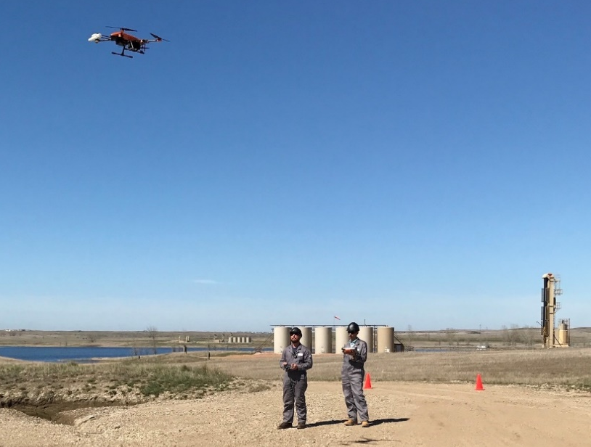
Methane Detector Sniffs out Leaks
Jet Propulsion Laboratory (JPL)
SeekOps
Pasadena, California
NASA Technology
Earth-based telescopes detected methane on Mars, suggesting the possibility of the presence of micro-organisms there
A spectrometer on a rover could confirm the gas’ presence, but existing options either weren’t powerful enough or were too big
Technology Transfer
Engineers built the tunable laser spectrometer (TLS) for the Mars Curiosity rover to detect minute traces of methane, carbon dioxide, and water vapor
NASA saw potential for Earth-based applications too, so JPL engineers worked to adapt the device
SeekOps licensed the sensor technology to use it for methane inspections and manufacture it for sale
Benefits
Drones perform comprehensive industrial leak detection for oil and gas companies in about a third of the time of conventional inspections
A vehicle-mounted system transmits results in real-time to a tablet in staff cars
Climate scientists could also use the sensor to monitor naturally occurring methane emissions
Spinoff 2019
Public Safety

Slide 24
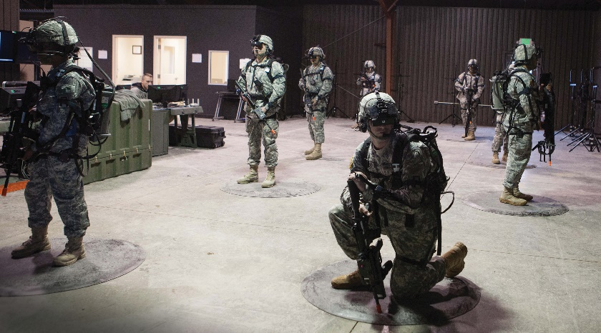
Biofeedback Loops Aim to Augment Sports, Military Training
Langley Research Center
J&F Alliance Group Inc.
Hampton, Virginia
NASA Technology
Pilot distractibility during flight was a concern, so NASA developed an index for measuring engagement by observing brainwave outputs
Test subjects who were shown their engagement level, as determined by brainwave output while performing a task, learned to control their focus
Technology Transfer
Games incorporating biofeedback were created to test and train pilots—MindShift, a video game, and a putting green, Zeroing Out Negative Effects (ZONE)
J&F licensed ZONE and MindShift technologies to use with virtual reality and augmented reality training
Merging physiological data with a virtual reality world is a new approach for military/police training
Benefits
Biocyber Physical System will train the user to enter a state of heightened engagement and calmness by making targets easier to hit in response to higher outputs of beta waves
Sports training, healthcare, and education are additional areas that can benefit from virtual reality training with biofeedback
Spinoff 2019
Public Safety

Slide 25


Slide 26
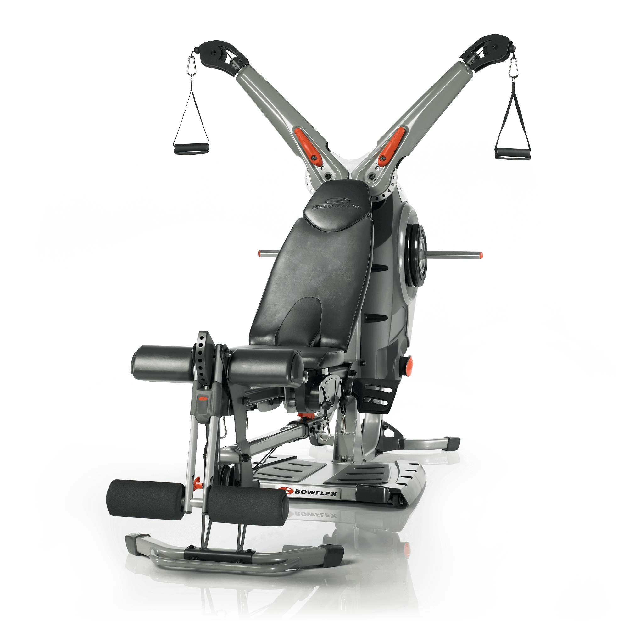
Bowflex System Spurs Revolution in Home Fitness
Johnson Space Center
Nautilus Inc.
Vancouver, Washington
NASA Technology
Astronauts lose muscle and bone mass and density while in orbit, so they make heavy use of exercise equipment on the space station
The Interim Resistive Exercise Device (IRED) used stacks of elastomer spring disks to produce up to 300 pounds of resistance.
Technology Transfer
Contracted through commercial partner Lockheed Martin, inventor Paul Francis built a prototype, refining his SpiraFlex technology
A 16-week ground test showed exercising with IRED produced the same results as using free weights
The device was launched with the first long-duration crew staying on the ISS in 2000, and rotating teams of astronauts used it for the next decade
Benefits
Nautilus licensed Spiraflex and other technology from Francis to build the Bowflex Revolution home gym, which is lightweight and quiet and takes up little space
The design leverages the technology of the system built to NASA specifications
Spinoff 2019
Consumer Goods

Slide 27
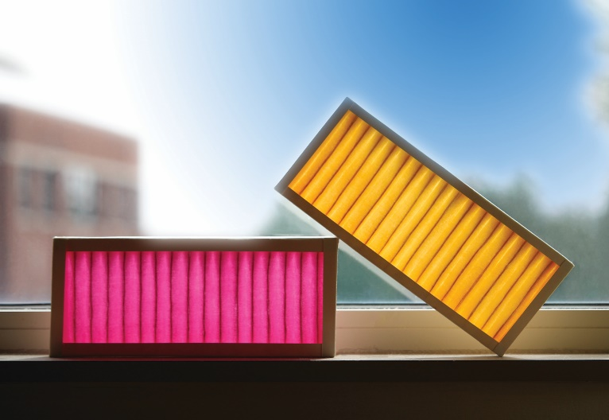
Spacesuit Air Filters Eliminate Household Pet Odors
Johnson Space Center
Seronix
Champaign, Illinois
NASA Technology
A NASA solicitation called for research on spacesuit air quality, primarily for the safety, health, and comfort of the astronauts
Seronix proposed polymer substances with a permanent electrical charge on them that removes toxic chemicals and kills viruses, bacteria, and mold
Technology Transfer
A Small Business Innovation Research contract demonstrated a lightweight, high-performing system for removing ammonia and formaldehyde from next-generation spacesuits
The company’s patent-pending Colorfil technology uses a polyelectrolytes coating, applied to the surface of a fabric-like nonwoven material
Benefits
Colorfil-branded air purifier, an HVAC filter, and a cabin air filter for automobiles are available
When spent, the color changes from magenta to yellow; this prevents unnecessary filter changes
Product development for industry is ongoing with a microchip manufacturer, a process highly sensitive to ammonia and corrosive gases
Spinoff 2019
Consumer Goods

Slide 28
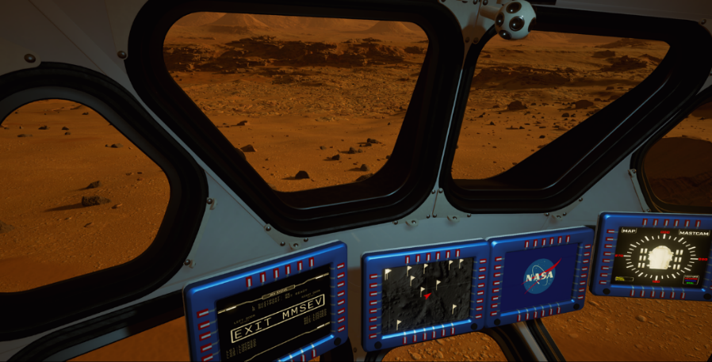
NASA Research Sends Video Game Players on a Journey to Mars
Langley Research Center
Fusion Media Group Labs
Miami, Florida
NASA Technology
NASA has spent years studying and planning for an eventual crewed mission to Mars
Data gathered from many satellites and rovers help scientists understand the planetary environment
NASA is interested in finding strategies for a Mars mission that is low-cost and sustainable over time
Technology Transfer
Fusion Media Group Labs read news reports of a proposed commercial Mars mission and was inspired to create a realistic virtual reality Mars experience
MIT students published a report that the commercial venture wasn’t feasible, so FMG contacted them to ask for resources describing a real mission
The students pointed the company to NASA, which ultimately provided many resources
Benefits
Mars 2030 is a game that allows players to experience what it might be like to explore Mars
The game depicts a real rover design and includes sound recorded driving JPL’s model; the surface was created using NASA’s digital terrain models
Everything in Mars 2030 is interactive, so players can experiment with technology to see how it will respond to the Mars’ environment
Spinoff 2019
Consumer Goods

Slide 29

Memory Foam Supports and Shapes in Women’s Apparel
Ames Research Center
ThirdLove
San Francisco, California
NASA Technology
NASA was tasked with making commercial flight safer in the 1960s, with one project being a crash-proof seat that would protect passengers
Temper foam, now known as memory foam, was invented during this project—it absorbs shock, cushions the body, and readily springs back to shape
Technology Transfer
Never patented, NASA released the formula for temper foam into the public domain in the 1980s
The material is now used in everything from mattresses to wheelchairs to protective gear
ThirdLove needed a thinner but supportive pad for bras, so it tweaked the formula to make it lighter, less dense, and able to be cast in a very thin sheet
Benefits
Memory foam softens with body heat, allowing it to conform to the body
Laminating the nylon fabric directly to the foam using a heat process adds extra structure to the foam, ensuring it is supportive enough while minimizing the amount of material and layers
Spinoff 2019
Consumer Goods

Slide 30
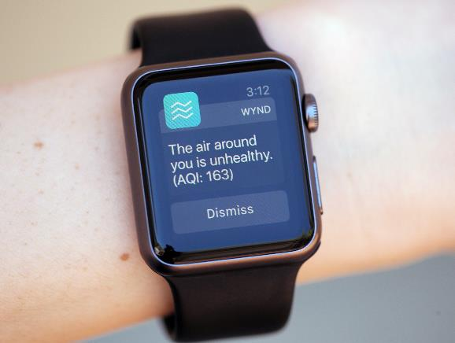
Rocket Design Leads to Turbo-Charged Air Purifier
Kennedy Space Center
Marshall Space Flight Center
Wynd
Redwood City, California
NASA Technology
Jason You gained experience in air quality sensors while working for Kennedy, where launches are closely monitored for their environmental effects
Separately, a hardware engineer at NASA named Eric Munoz worked on rocket engine designs and built up experience directing fluid flows
Technology Transfer
You, inspired from a trip to China where he dealt with significant pollution, went on to cofound Wynd in order to build a personal air purifier
The company hired Munoz, who used his experience in fluid flow to develop a powerful fan for the water-bottle-sized device, which can move nine cubic feet of air per second
Benefits
Wynd’s air filter is effective at alleviating allergy symptoms and reducing pollution
A silver liner that kills germs when oxidized can protect users from airborne illnesses
A crowd-sourced, global map of air quality using sensor data will display information on the company’s free app
Spinoff 2019
Consumer Goods

Slide 31
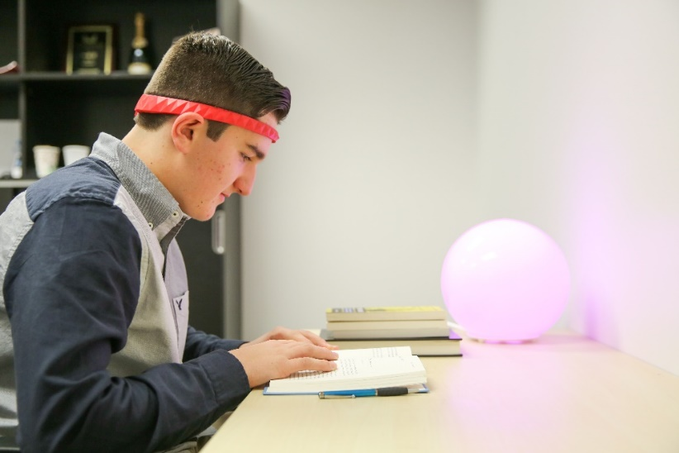
Brainwaves Reveal Student Engagement, Operate Household Objects
Langley Research Center
BrainCo Inc.
Cambridge, Massachusetts
NASA Technology
Autopilot systems can cause pilots to become bored, complacent, and disengaged
A team at Langley developed techniques to use electroencephalographic (EEG) data—brain waves—to quantify an individual’s level of engagement
Technology Transfer
BrainCo Inc. was founded with the idea of creating a practical way to use EEG readings to monitor students
The company came across Langley’s EEG research and the resulting “engagement index,” which it incorporated into its product
The technology will be used in classrooms and at home to monitor and train students’ attention
Benefits
BrainCo’s Focus line has three products: EDU for classrooms, FocusFit for the gym, and FocusNow for home
The company aims to use the technology to help people with ADHD by training them to better control their attentiveness
Technology trains attention, improves workouts, and lets teachers monitor students’ attention
Spinoff 2019
Consumer Goods

Slide 32
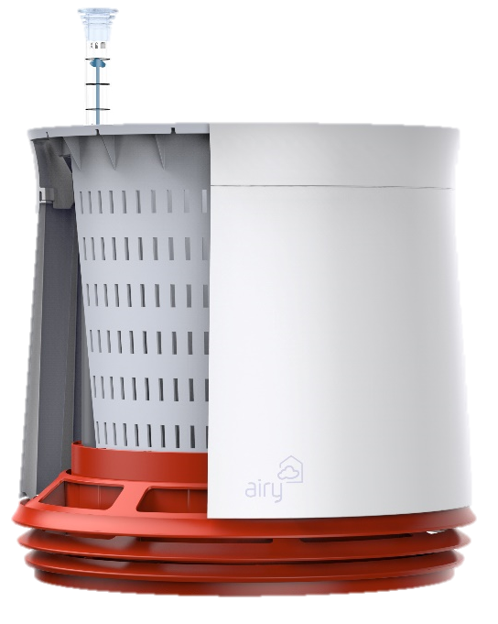
NASA Plant Research Offers a Breath of Fresh Air
Stennis Space Center
Airy GreenTech
Hamburg, Germany
NASA Technology
To better understand the air-purifying ability of plants for space habitat life support systems, NASA funded research to see which plants work best and how
A surprising result was the discovery that most air filtration happens in and around a plant’s roots
Technology Transfer
With results of the study published and available to the public, engineers and entrepreneurs use the data to inform their own projects and products
Airy GreenTech sought out to capitalize on the study’s findings by designing a plant pot to maximize air flow to the roots and increase filtration capacity
Benefits
The AIRY Plant Pot draws air through the soil into the plant’s roots using a simple design
The company claims its system can neutralize virtually all environmental toxins from a typical room in 24 hours
The AIRY Pot is works best in smaller rooms, and the AIRY Box in larger rooms
Spinoff 2019
Consumer Goods

Slide 33

Light Research Aids Slumber
Johnson Space Center
Headwaters Research and Development Inc.
Marblehead, Massachusetts
NASA Technology
Lack of normal day/night cycle disrupts the body’s circadian rhythms, so NASA needed to find a way to help astronauts sleep better and be more alert
NASA-funded research found a photoreceptor in the eye that responds to blue light and suppresses melatonin, which plays a role in sleep/wake cycles
Technology Transfer
NASA tailored LED lights to stimulate alertness and support regular sleep while in orbit
After interviewing a NASA-funded researcher and reading studies going back two decades, Headwater developed a lighted sleep mask
Short-wavelength, blue light promotes wakefulness in the morning, and longer-wavelength, and red light aims to promote drowsiness
Benefits
Light cues may help a person fall asleep faster and sleep more deeply throughout the night, reinforcing natural circadian rhythms
The Illumy mask is lightweight, flexible, and uses an app for Apple and Android devices to program the mask for users’ individual settings, including when they wish to go to sleep and wake up
Spinoff 2019
Consumer Goods

Slide 34


Slide 35
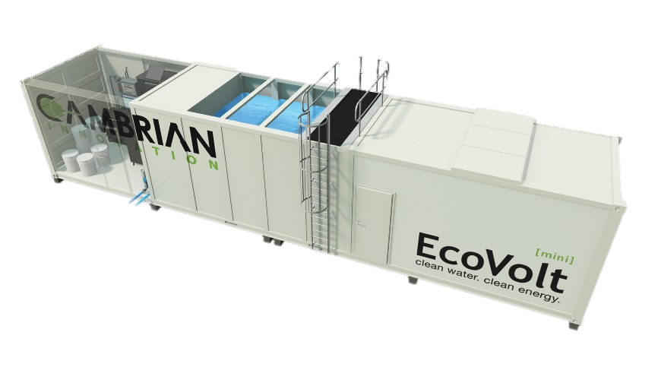
Electrified Bacteria Clean Wastewater, Generate Power
Ames Research Center
Cambrian Innovation
Watertown, Massachusetts
NASA Technology
Exoelectrogens are microbes that can transfer electrons as part of their anaerobic metabolism process, essentially “breathing” an electrical charge
NASA investigated ways to put exoelectrogens to work in space, purifying wastewater while generating desirable by-products
Technology Transfer
A grant and subsequent SBIR contract helped fund the development of a bioelectrically enhanced wastewater treatment system from Cambrian Innovation
Microbes break down waste, generating cleaner water and methane-rich natural gas for power
The work validated the efficiency of the technology and the best conditions for the microbes to perform
Benefits
EcoVolt Reactor wastewater treatment system is a commercial-scale version of the same technology, which makes methane for energy
10 breweries and wineries use the system
Water output is clean enough to discharge into municipal systems without surcharges, or it can be further refined for reuse
Spinoff 2019
Energy and Environment

Slide 36
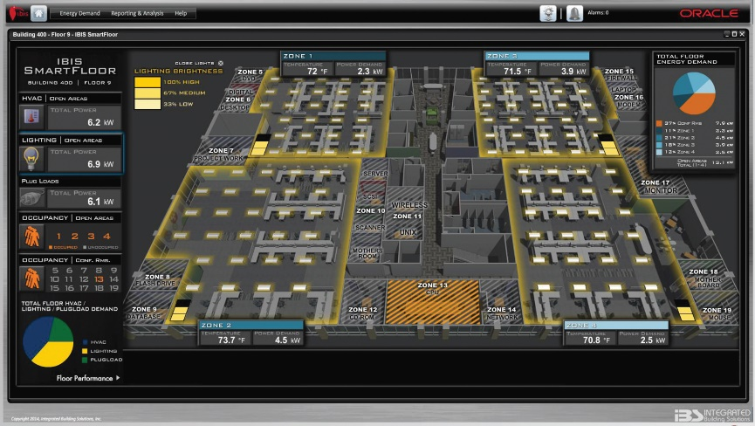
Building Monitoring System Provides Insights for Sustainability
Ames Research Center
Integrated Building Solutions (IBS) Inc.
San Ramon, California
NASA Technology
Ames built Sustainability Base to be the “greenest” building in the Federal Government
It aimed to produce more energy than it consumed, both reducing usage and generating energy onsite
To show results, it needed a system monitoring energy going into and out of the facility
Technology Transfer
IBS adapted its existing system to create a dashboard displaying all energy-related activities
At NASA’s request, it added fault-detection technology developed for aerospace, which alerts when there is a change from the baseline
This helps avoid unnecessary maintenance while still alerting to malfunctions so a repair can be made
Benefits
Fault detection is now standard the Intelligent Building Information System offered by IBS
The upgraded system has been installed on a number of government buildings and big tech company campuses
Building operators use it to monitor and reduce energy usage and warn of faulty equipment
Spinoff 2019
Energy and Environment

Slide 37
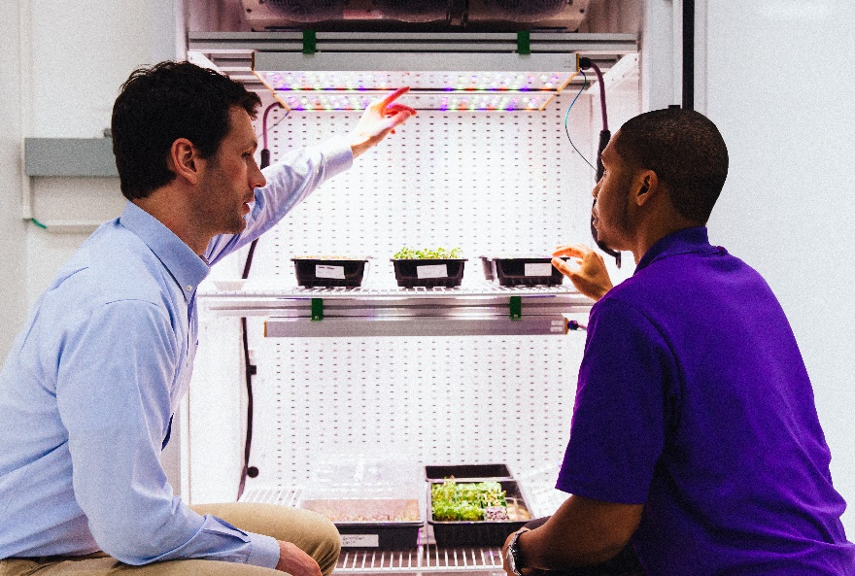
Space Station Garden Shines Light on Earth-Based Horticulture
Kennedy Space Center
OSRAM
Wilmington, Massachusetts
NASA Technology
Long-duration missions will need space crops to sustain human life
NASA’s Advanced Plant Habitat (APH) uses a custom-designed LED system to create diverse light “recipes,” which can affect the growth and characteristics of plants
Technology Transfer
Kennedy researchers used an OSRAM-provided prototype, called Phytofy, to conduct ground-based studies mimicking natural light on Earth
The device offers choices in light wavelength, which determines light color, that can simulate the APH without having to build another complete habitat
NASA is getting new light recipes and shares feedback with OSRAM to validate the device
Benefits
Phytofy RL is a tray-like fixture with LED lights, temperature control, and a software-controlled panel to adjust settings
Growing interest in vertical farming in places like skyscrapers, old warehouses, or shipping containers require indoor growing techniques
These crops can help alleviate food insecurity
Spinoff 2019
Energy and Environment

Slide 38
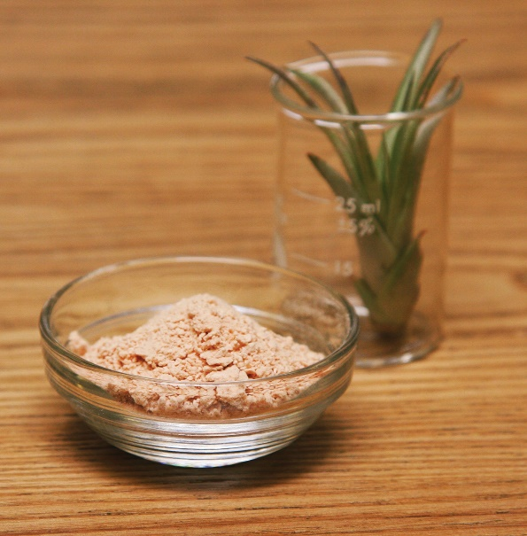
Carbon Capture Process Makes Sustainable Oil
Ames Research Center
Kiverdi
San Francisco, California
NASA Technology
The closed environment of a spacecraft during long-term missions requires a life-support system that reuses the waste products, including CO₂
One study calculated that a person generates 10–14 pounds of waste a day—a 10-person, 3-year mission would generate 100,000+ pounds of waste
Technology Transfer
Hydrogen-fixing bacteria is highly efficient at recycling carbon dioxide (CO₂) into useable by-products requiring minimal energy to yield results
Kiverdi used NASA’s research to develop a process using microorganisms to capture and use CO₂
CO₂ and other ingredients are mixed into a large vat, where the gases are consumed by microorganisms, producing proteins and oils
Benefits
Kiverdi’s products include a high-protein, high-nutrient flour and PALM+, and a sustainably produced palm oil alternative
These by-products can reduce excess CO₂ in the atmosphere, while decreasing the environmental impact of producing ingredients such as soy beans and palm oil—a primary cause of deforestation
Spinoff 2019
Energy and Environment

Slide 39
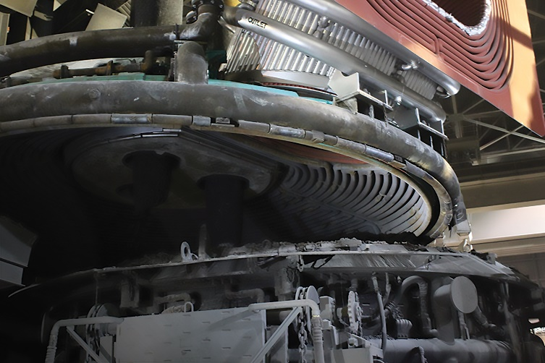
Emissive Coatings Cut Industrial Costs, Emissions, Fuel Consumption
Ames Research Center
Emisshield Inc.
Blacksburg, Virginia
NASA Technology
Two X-planes, X-33 and X-34, sparked the development of a protective coating for high-speed spaceplanes to travel 15 times the speed of sound
Protective Coating for Ceramic Materials (PCCM) is a paper-thin, highly stable coating that removes heat from the thermal protection system it covers
Technology Transfer
Ames patented PCCM and licensed it exclusively to Emmisshield
The company made about 40 variations, adapting PCCM for metals, giving it a longer shelf life, and making it easier to apply
The coatings have been applied to building materials, racecar parts, clothing, and industrial facilities
Benefits
As carbon dioxide restrictions tighten, Emmisshield has significantly expanded its use in industrial kilns, boilers, refractories, and more
Substantial reductions in carbon emissions and fewer equipment repairs and replacements save businesses millions of dollars annually
Used in more than 400 plants worldwide
Spinoff 2019
Energy and Environment

Slide 40
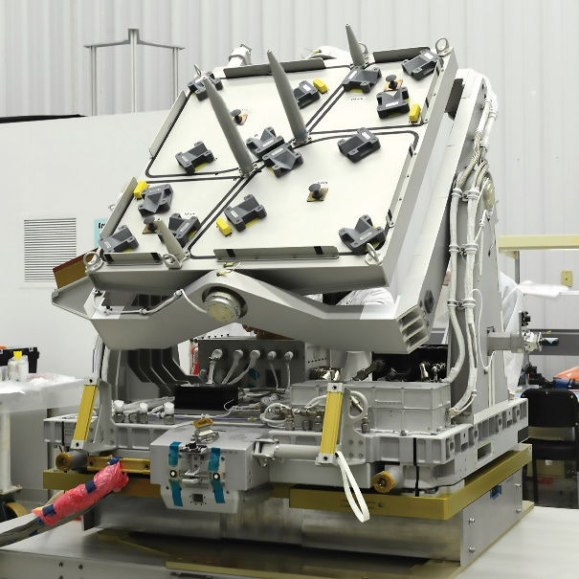
Pointing Platform Enables Earth Imaging from Space Station
Johnson Space Center
Teledyne Brown Engineering
Huntsville, Alabama
NASA Technology
Congress mandated that half of the U.S. National Laboratory resources on the space station be used by entities outside NASA, including commercial, academic, and government organizations
Industry collaboration is needed to execute this order
Technology Transfer
Through a cooperative agreement with NASA, the Multi-User System for Earth Sensing (MUSES) facility was built by Teledyne with NASA support and was mounted to the exterior of the station in 2017
It offers a new level of precision pointing and tracking for Earth imaging devices
Teledyne now rents out space aboard MUSES
Benefits
Testing on the ISS is more affordable and needs less engineering than testing on a satellite
The German Aerospace Center’s DLR Earth Sensing Imaging Spectrometer (DESIS) is the first MUSES tenant
Teledyne retains commercial rights to sell the high-spectral-resolution data from DESIS
Spinoff 2019
Energy and Environment

Slide 41
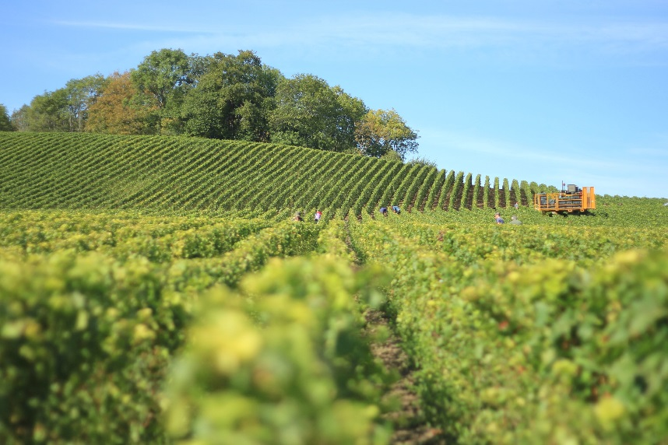
Algorithms to Detect Clouds Forecast Global Crop Production
Stennis Space Center
Geospatial Data Analysis (GDA) Corporation
State College, Pennsylvania
NASA Technology
Landsat 8, an Earth-observing satellite, takes imagery that’s used to monitor forest and crop health, icecap and glacier coverage, and more
Cloud cover has to be accounted for and removed from imagery to perform analysis, so a new software was needed for the purpose
Technology Transfer
Stennis awarded GDA an SBIR contract to develop software capable of detecting cloud cover in imagery
Algorithms were also developed to identify crop types and health and to correct for factors such as topographical effects on lighting
GDA automated its systems that pull imagery from Earth-observing systems
Benefits
GDA’s GeoSynergy webGIS service puts all crop data in one place to let users manipulate and analyze calibrated, full-resolution data
USGS, US Forest Service, and USDA are among the company’s customers
Plans on are in development for adding new capabilities and sources of imagery
Spinoff 2019
Energy and Environment

Slide 42


Slide 43

Space Mission Planning System Targets Advertising with Precision
NASA Headquarters
dataxu
Boston, Massachusetts
NASA Technology
Planning future missions to Mars is incredibly complicated, so NASA funded tools to explore as many mission architectures as possible
Using previous missions as a starting point, team at MIT identified 35 major decisions as the basis for a set of algorithms called the Object Process Network
Technology Transfer
Team members from the NASA project founded a company to develop computational approaches to problems in big data
Two years spent researching industries and building prototypes helped enable a new online bidding process
dataxu led the effort to launch the OpenRTB (real-time bidding) protocol standardization in use today
Benefits
Digital advertisers find ad space based on the probability of the user taking action and the value of the product advertised, then bid for the spot
Algorithms created by dataxu consider every possibility and self-correct to improve results
The company’s service is 35–40 percent more efficient than competitors’
Spinoff 2019
Information Technology

Slide 44
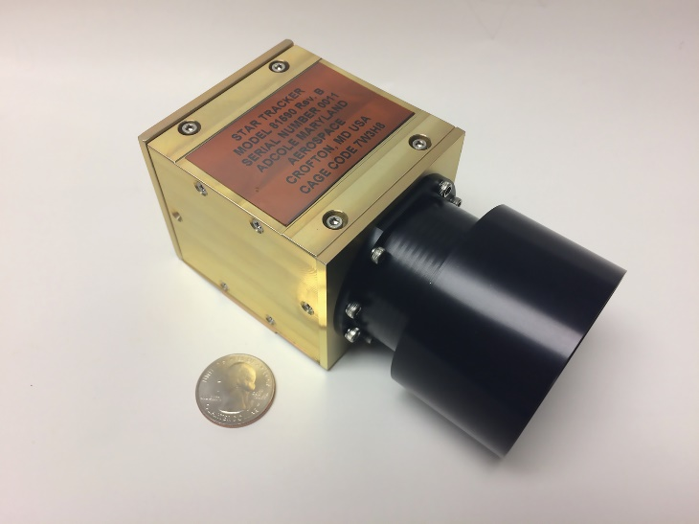
Tiny Star Trackers Help Spacecraft Find Their Place
Goddard Space Flight Center
Adcole Maryland Aerospace
Crofton, Maryland
NASA Technology
The more precisely a satellite can be positioned, the better the image and science that results
NASA’s flagship missions require this high level of precision, which had meant bulky, costly technology
Miniaturized pointing devices may allow inexpensive CubeSats, or a fleet of them, for science missions
Technology Transfer
Adcole’s star tracker, developed under SBIR contracts, snaps a picture of the starscape and uses software to analyze the angle of separation between known stars to calculate orientation
These help point a spacecraft with high-level accuracy, down to about 0.1 degrees of error
A two-camera system provides additional flexibility
Benefits
Adcole offers a stand-alone star tracker, a single-camera package with star tracker and the attitude control, or a double-camera package
The primary application is Earth-observation, such as monitoring deforestation and methane emissions, but CubeSats orbiting other planets will require star tracking for orientation
Spinoff 2019
Information Technology

Slide 45
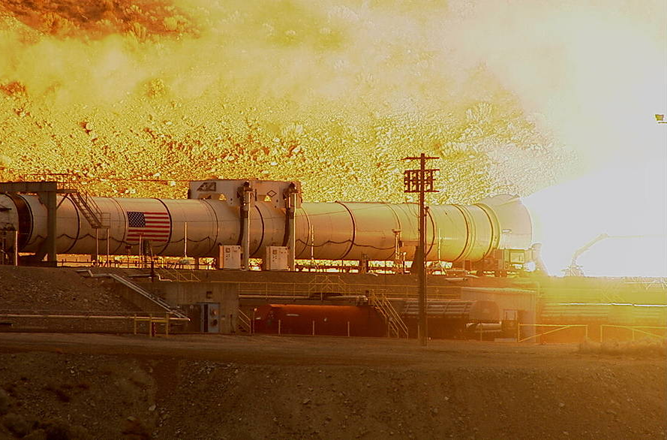
Software Toolkit Steadies Rockets
Marshall Space Flight Center
Gloyer-Taylor Laboratories LLC
Tullahoma, Tennessee
NASA Technology
Combustion instability is one of the highest risks in designing a new engine
The issue is resonance, as when a high note causes glass to shatter, but in rockets, it’s not just sound
Because of the complex interactions, combustion instability has been difficult to model computationally
Technology Transfer
The Universal Combustion Device Stability process and toolkit, with funding from SBIR contracts, can predict instability and identify its cause
UCDS calculates all the sources of energy flowing into resonant modes such as simple acoustics, vorticity, combustion, thermal effects, and more
Hardware testing has confirmed the validity of UCDS predictions and recommendations
Benefits
The software has the potential for huge cost reductions in the design and improving the operation of rockets, jet engines, power plants
GTL is adapting the software to design better, more efficient car engines
Research opportunities in resonance, such as testing musical instruments, are also a possibility
Spinoff 2019
Information Technology

Slide 46
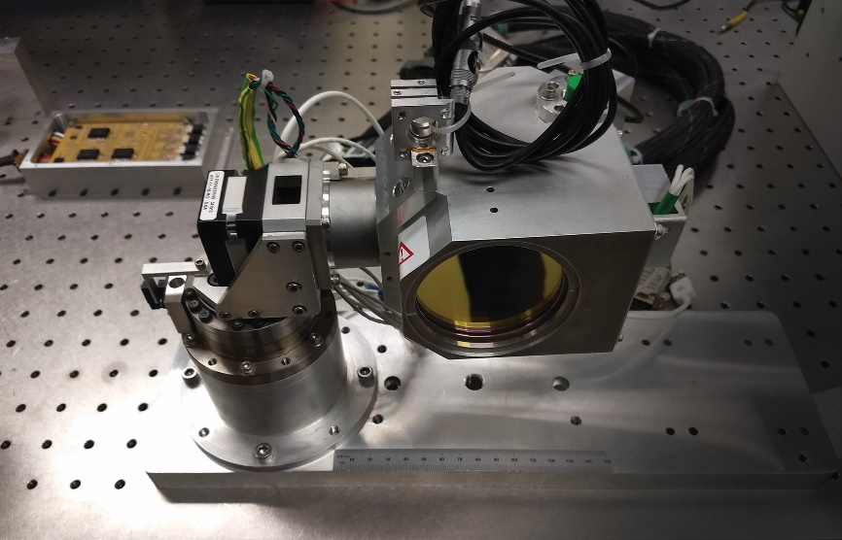
Low-Cost Transceiver Will Allow First Laser Mass Communication
Jet Propulsion Laboratory (JPL)
Xenesis
Atlanta, Georgia
NASA Technology
A Team at JPL was tasked with designing a low-cost laser communications transceiver capable of moving large amounts of data cheaply and efficiently
Light waves can transmit many more times the amount of data when compared to radio waves
Technology Transfer
Mark LaPenna, founder of Xenesis, licensed the tested and proven NASA technology
The goal is to start with using the technology for ground-to-ground laser communication
Xenesis is partnering with other companies to establish a ground network for exchanging laser signals with satellites and to create global standards for laser communications
Benefits
Xenesis offers wireless laser communication over land, potentially saving millions in buried cables and making hacking impossible
The radio spectrum is becoming crowded, but satellite laser communication has no such limits
Xenesis plans to offer cheap, secure, abundant, high-speed Internet access
Spinoff 2019
Information Technology

Slide 47
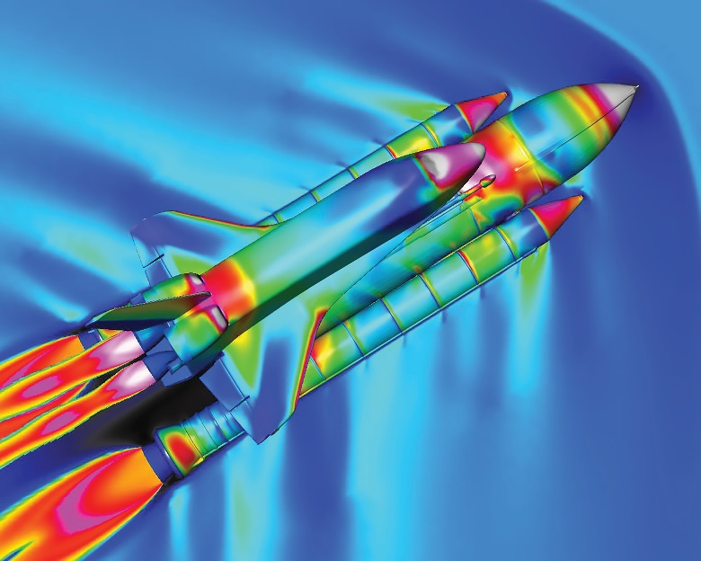
NASA Code Speeds Nation’s Aircraft, Spacecraft Design
Langley Research Center
Boeing Commercial Airplanes
Seattle, Washington
NASA Technology
NASA studies how air flows around vehicles in order to improve design and performance
Computational fluid dynamics (CFD) software creates realistic air flow simulations
NASA’s OVERFLOW CFD solver and accompanying software accurately model multiple bodies in flight
Technology Transfer
OVERFLOW became available through software usage agreements with the agency
Boeing was an early adopter and now uses NASA programs throughout its commercial, military, space, and research and development operations
Boeing offers NASA suggestions for improvements and changes, supporting ongoing development
Benefits
The code provides Boeing with efficient and accurate flow solutions supporting virtually every product in the company
The continuous information sharing improves the code while benefitting Boeing and NASA
The code is used by many spacecraft and aircraft manufacturers and government agencies
Spinoff 2019
Information Technology

Slide 48
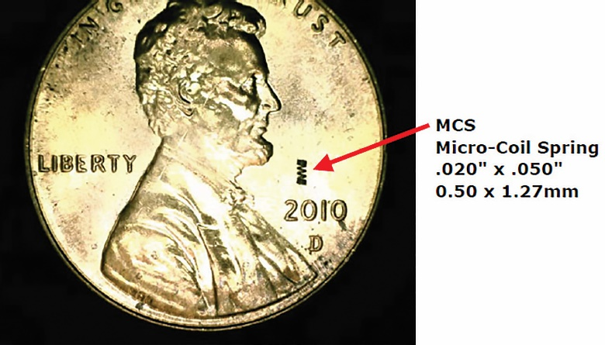
Tiny Springs Improve Electronic Reliability
Marshall Space Flight Center
Topline Corporation
Milledgeville, Georgia
NASA Technology
The extreme temperature swings in space can break solder connections between electric components
The common solution, a solder column, added some flexibility, but it was still too brittle
A tiny spring was fabricated to be more flexible and to create stronger, longer-lasting connections
Technology Transfer
NASA engineers designed, tested, and refined the micro-coil spring for circuit boards, and it went on to win the 2014 top prize in the electronics category of Tech Briefs’ Design the Future challenge
Topline obtained a license to produce and sell the micro-coil spring interconnectors
The company perfected and streamlined the process for attaching the springs
Benefits
A variety of sizes are available from 0.2 mm diameter by 0.5 mm in length up to 0.5 mm diameter by 1.27 mm long
Topline is attaching springs to components for industry to perform their own tests
Potential future markets include medical devices such as hearing aids
Spinoff 2019
Information Technology

Slide 49
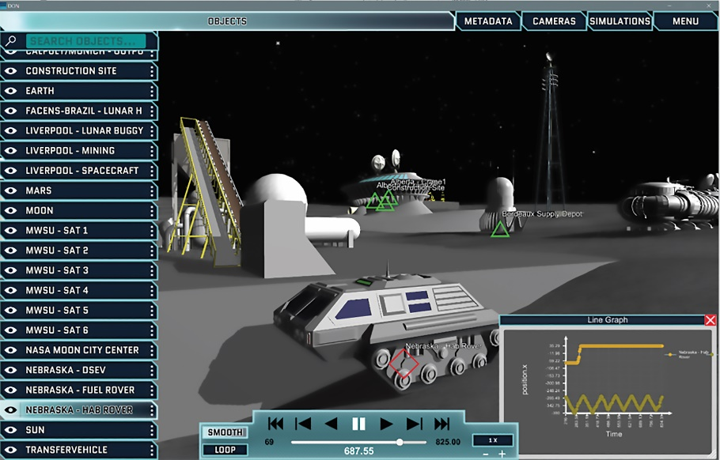
Collaborative Platform Trains Students in Simulation and Modeling
Kennedy Space Center
Simulation Exploration Experience (SEE)
Kennedy Space Center, Florida
NASA Technology
NASA uses modeling and simulation to avoid making mistakes with multimillion-dollar equipment
The Distributed Observer Network (DON) is a simulation viewer created by NASA that preserves data from simulations for later use or to share with others
Technology Transfer
The Simulation Exploration Experience (SEE) was created with the idea of putting college students to work on simulated lunar missions
The program introduces students to collaborative modeling and simulation, subjects rarely taught in universities
DON allows students participating in SEE to collaborate internationally on a simulated moon base
Benefits
DON is unique in its ability to model complex systems spanning hundreds of millions of miles
The software makes simulations portable, preserving results for collaboration and future use
SEE enhances students’ employability by giving them experience in simulation and modeling
Spinoff 2019
Information Technology

Slide 50
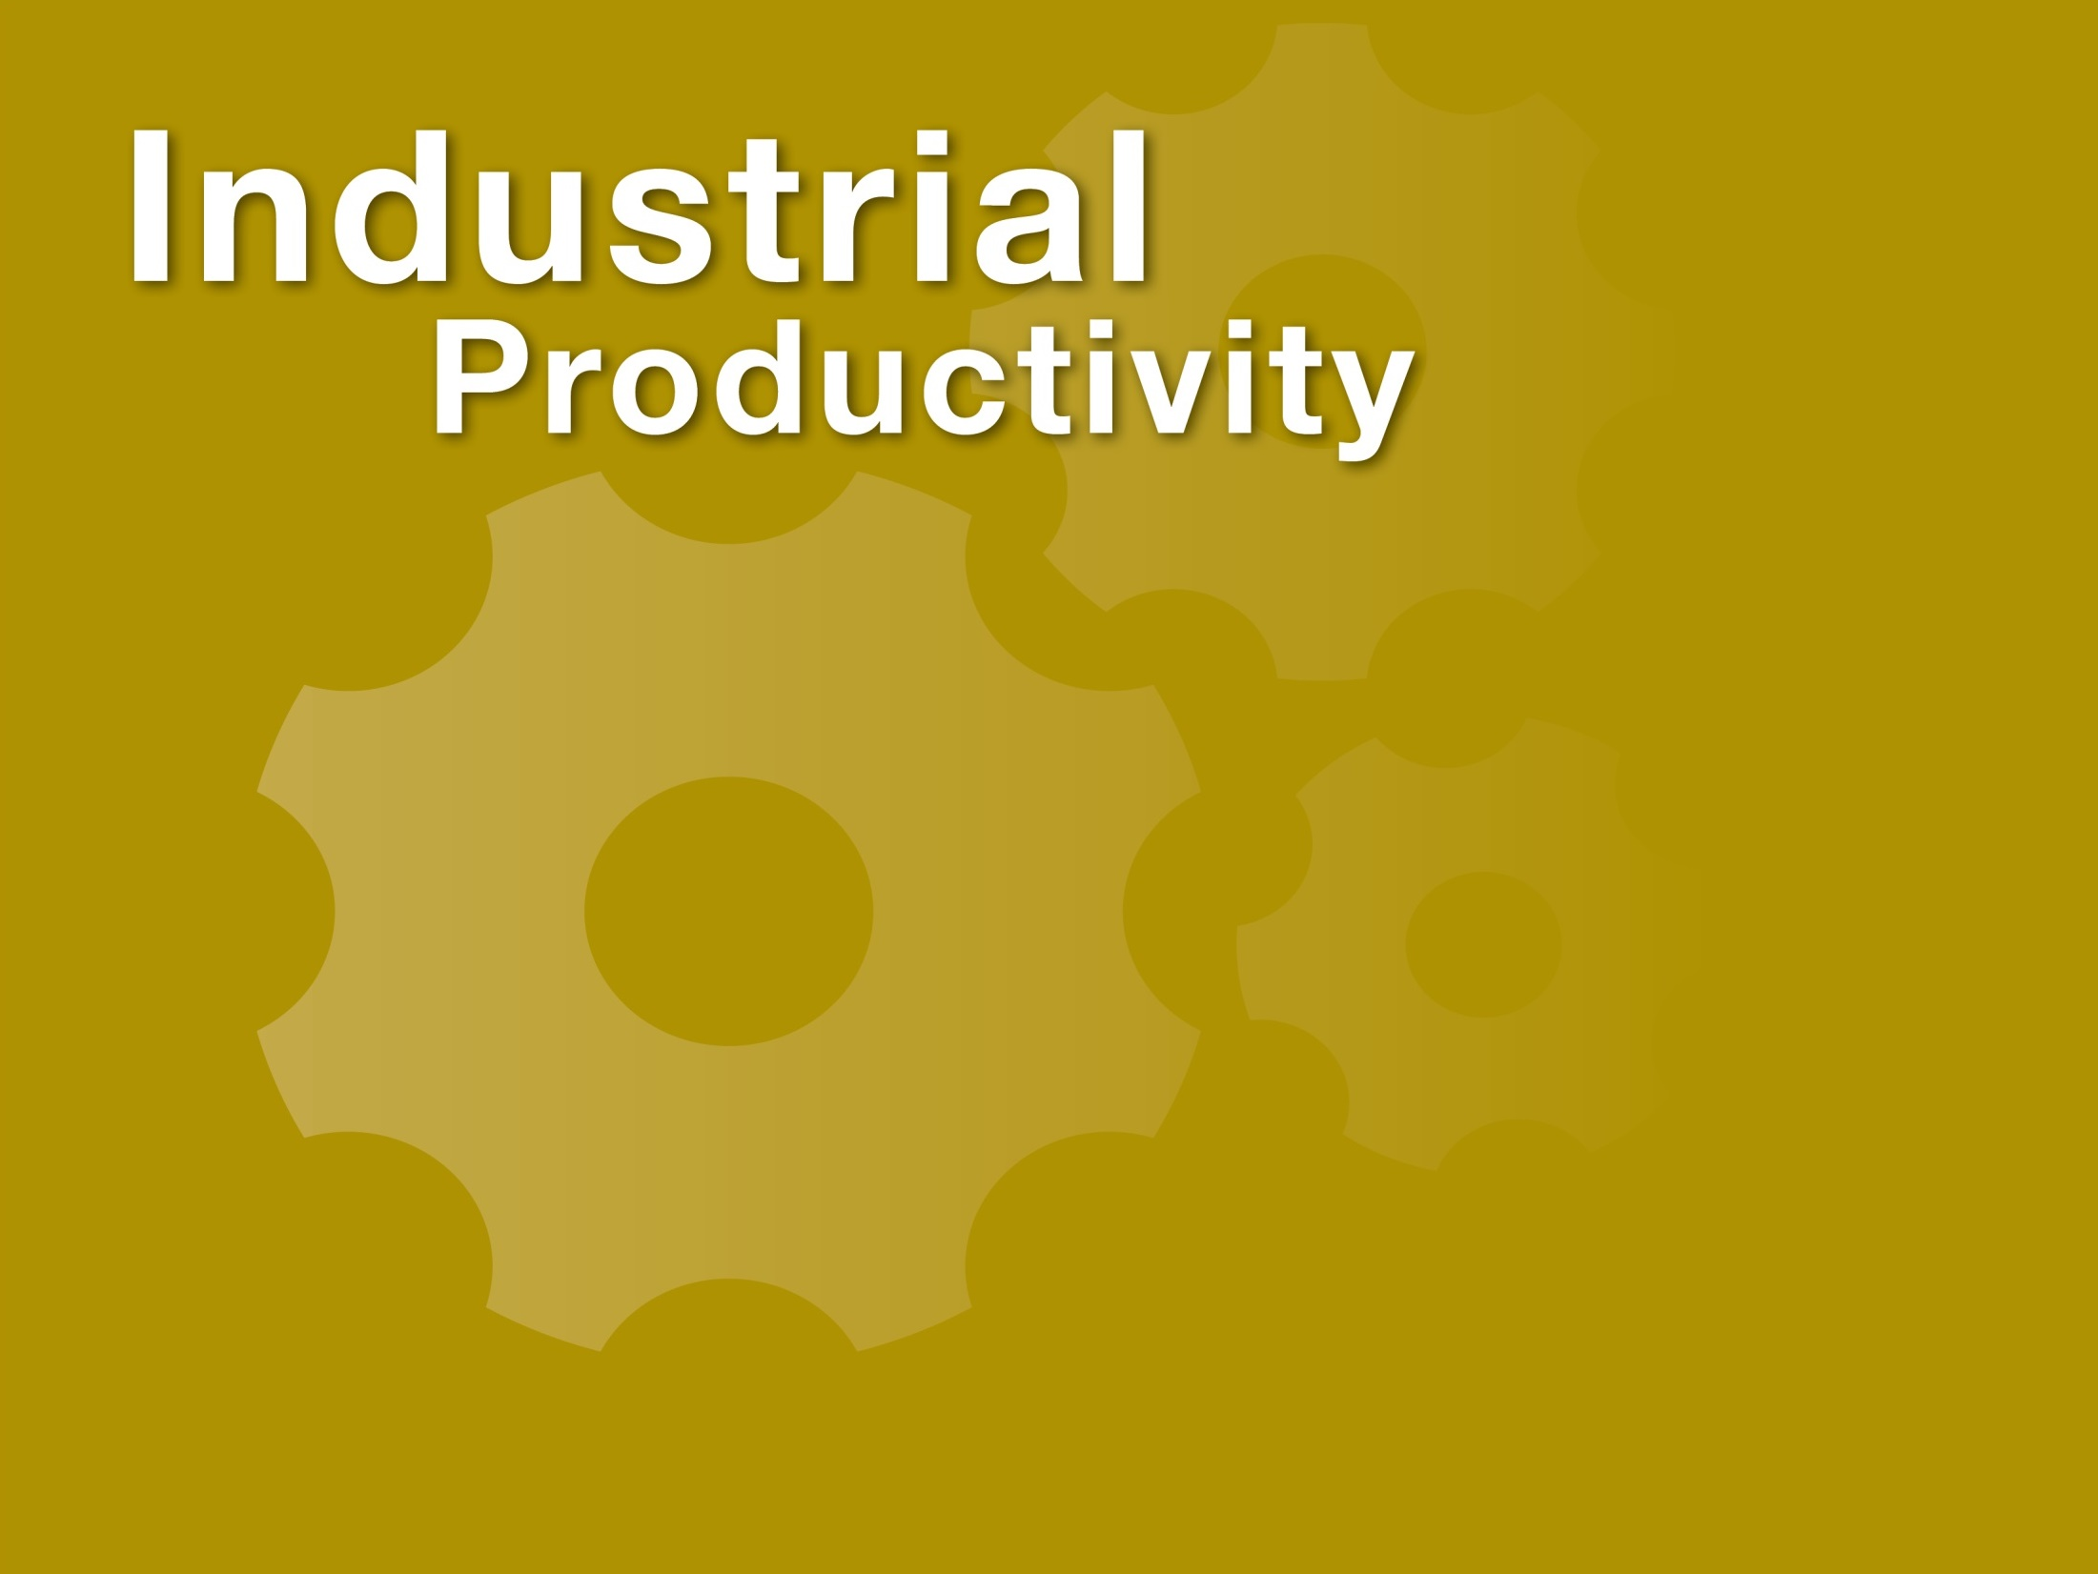

Slide 51
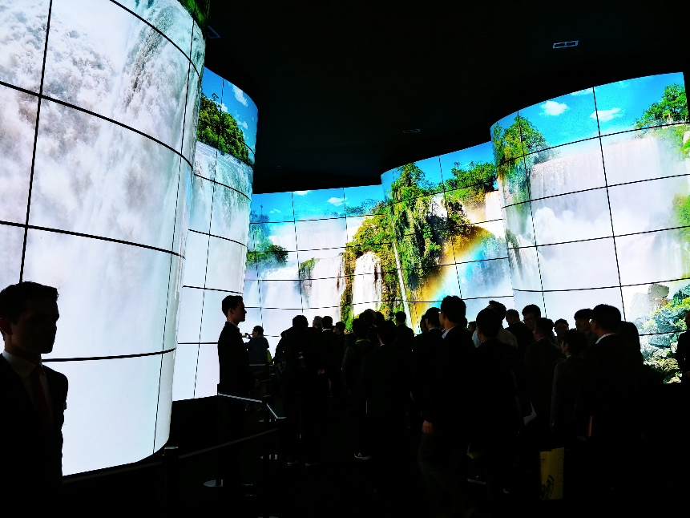
Spray Analyzer Turns Up in Cars, Planes, Medicine, Cutting-Edge TVs
Glenn Research Center
Artium Technologies Inc.
Sunnyvale, California
NASA Technology
NASA wanted a way to characterize fuel sprays in a turbulent environment such as a jet engine
The Phase Doppler Particle Analyzer (PDPA) characterizes the interaction of atomized fuel and air in terms of droplet sizes, velocity distribution, turbulence intensity, and fluctuations in turbulence
Technology Transfer
Several SBIR contracts developed and expanded the technology since the 1980s; it now includes determining droplet temperature
PDPA is now the standard for spray characterization
Artium continues to work with NASA on measuring particulate emissions from various combustion sources and to study airframe and jet engine icing
Benefits
Applications include developing and testing automobile fuel injectors, inkjet printers, pill-coating systems, and more
Organic LED displays for smartphones and TVs are now a huge market. Manufacturers are working to print the screens with inkjet printers, reducing their cost. PDPA is used for printer quality control
Spinoff 2019
Industrial Productivity

Slide 52
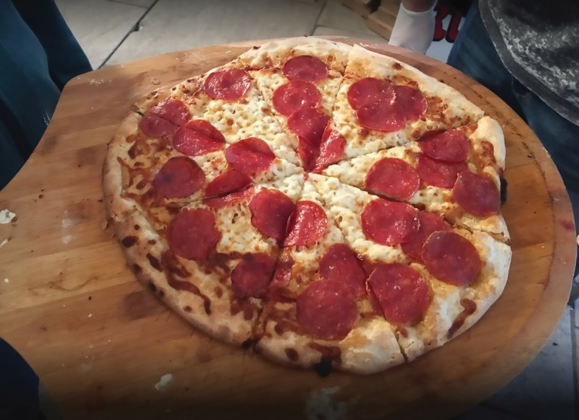
Deep-Space Food Science Research Improves 3D-Printing Capabilities
Johnson Space Center
BeeHex
Austin, Texas
NASA Technology
Crew time is limited and cooking isn’t an option in space, so NASA is always looking for ways to provide good nutrition that also tastes good
One option is powdered nutrients, but they degrade over time and controlling amounts precisely is difficult
Technology Transfer
Developing the initial technology for 3D printing food from macronutrient powders came from a Small Business Innovation Research contract
A successful test had dry powders such as starch and protein fed directly to the 3D printer where oil or water were mixed in at the printhead with micronutrients and flavors
Benefits
BeeHex created the Chef 3D which can be customized for creating pizzas and decorating cookies and cakes
BeeHex has provided breakfast- and lunch-bar 3D printers to the military that can tailor food to each user’s needs
Spinoff 2019
Industrial Productivity

Slide 53
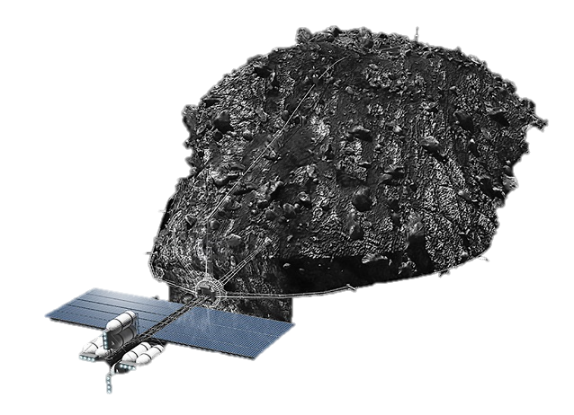
Simulated Space Dirt Supports Future Asteroid Mining
Kennedy Space Center
Johnson Space Center
Deep Space Industries (DSI)
San Jose, California
NASA Technology
Developing capabilities for space mining will take years, so NASA scientists are studying the mechanics of handling surface material of other worlds, known as regoliths
Everything from dust management and transporting samples to anchoring techniques requires study
Technology Transfer
NASA issued two SBIR contracts for “simulants”—material that replicates the composition of asteroids
DSI matched the chemical composition of asteroids that have fallen on Earth and tried to recreate the compaction, porosity, and granularity of their original surfaces, delivering more than 11,000 pounds of four different asteroid simulants
Benefits
Simulants support mining equipment testing
Universities have purchased the simulants to get started on basic research
Harvesting water in in space from asteroid and planet sources will support deep space travel—Boeing has signed a letter of intent to buy tons of water in space whenever DSI can harvest it
Spinoff 2019
Industrial Productivity

Slide 54
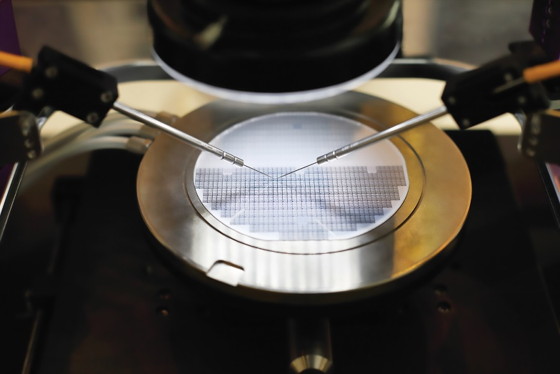
Vibration Isolator Steadies Optics for Telescopes
Jet Propulsion Laboratory (JPL)
Minus K Technology
Inglewood., California
NASA Technology
A vibration isolator creates a more stable platform where external vibrations won’t interfere with sensitive equipment such as telescopes
For sensitive instruments, motion on the scale of one micron (one-millionth of a meter), and in some cases even less, can disturb image quality
Technology Transfer
A new project required testing space-ready optics in a fairly high degree of vacuum compared to typical industry standards, so Johnson turned to their existing vibration isolator supplier for options
Minus K studied high vacuum levels, tested special greases and parts to find what would work best, and modified their isolators to meet NASA specifications
Benefits
Minus K sells models similar to NASA’s for tasks such as silicon chip quality control testing
The isolators steady electron and optical microscopes, and other scientific instruments
The vacuum-compatible isolators are also used to assist quality control in manufacturing semiconductors
Spinoff 2019
Industrial Productivity

Slide 55
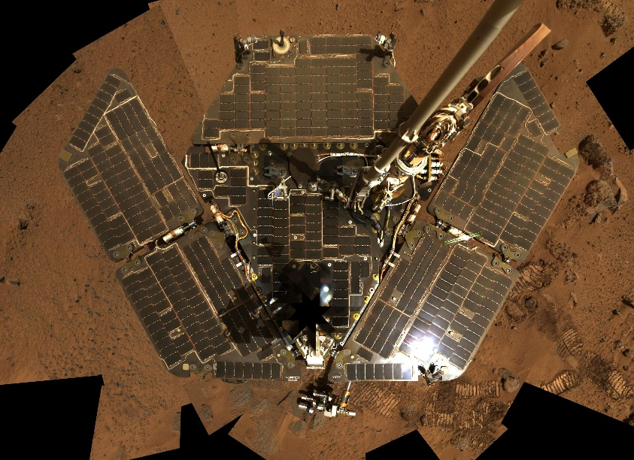
IonCCD Enables Fast, Reliable, Inexpensive Mass Spectrometry
Jet Propulsion Laboratory (JPL)
Xylem
College Station, Texas
NASA Technology
NASA used the charge-coupled device (CCD) to build some of the first digital cameras
Custom-built specialized imagers used on Mars rovers, based on CCD arrays, are highly photosensitive, low-power, low-noise, high-speed yet simply designed
Technology Transfer
JPL designed a CCD-based prototype mass spectrometer in a small, rugged, inexpensive, efficient device, but didn’t have the budget to build it
After licensing the intellectual property, Intelligent Ion, now part of Xylem, worked with JPL engineers to produce it, resulting in a commercial line of IonCCD devices for the company
Benefits
The simultaneous counting of all isotopes on a single sensor for fast, accurate results is beneficial for analytical chemists and the pharmaceutical industry
Researchers are using the technology outside of mass spectrometers for applications such as ion beam experimentation and solar wind detection
Spinoff 2019
Industrial Productivity

Slide 56
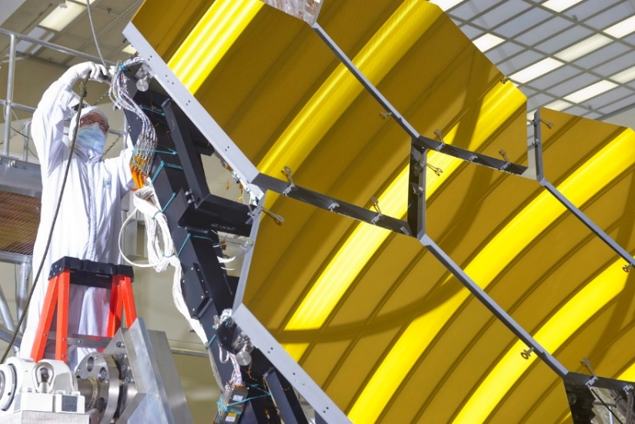
Beryllium Blazes New Trail for Telescopes
Goddard Space Flight Center
Materion Corporation
Mayfield Heights, Ohio
NASA Technology
For the James Webb Space Telescope’s mirrors, NASA needed a lightweight, durable material that would maintain a stable shape at frigid temperatures
Beryllium is stiff and doesn’t change size at temperatures below about -300 °F
Technology Transfer
Materion produced beryllium powder with spherical grains by atomizing it in a gas, increasing uniformity and durability
Working under multiple contracts, the company created new tools, modified existing manufacturing processes, advanced the material, and made other components for Webb
Benefits
Thanks to working on the satellite, Materion was able to develop an industrial standard for gas-atomized spherical beryllium powder
Beryllium is used in military satellites and other Department of Defense equipment
Other applications include X-ray and mammogram machines
Spinoff 2019
Industrial Productivity

Slide 57
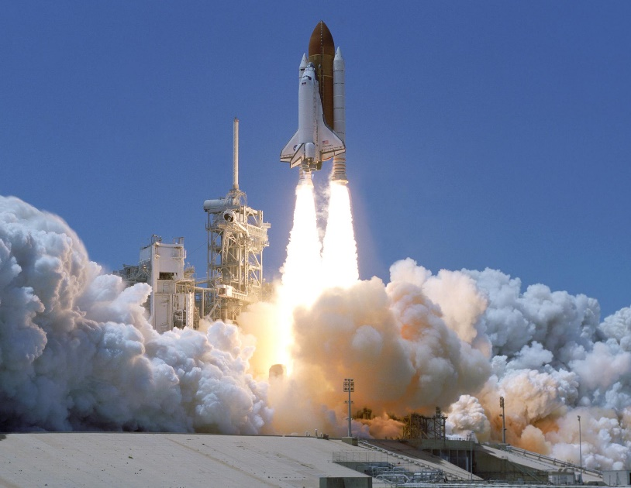
Phase-Change Coating Absorbs Heat from Rockets, Pipes, Beer
Marshall Space Flight Center
PrimeBilec
Austin, Texas
NASA Technology
NASA has developed coatings to protect spacecraft parts from the intense heat of launch
The standard coating used on shuttle was effective, but needed to be reapplied after every launch
Engineers developed a new coating with phase-change material suspended in a paint-like plastic
Technology Transfer
PrimeBilec licensed the phase-change coating patent from NASA and is developing products
Like ice in a glass, the phase-change material absorbs heat as it transforms from a solid to a liquid, keeping down the temperature around it
The phase-change material returns to a solid state when it cools, enabling the coating to be reused
Benefits
PrimeBilec is testing a paint that would coat the back end of a plane to prevent heat damage from the jet engines
Other industrial applications include coatings for heat traps that monitor the heat of pipes in hospitals
An iceless cooler keeps contents colder longer
Spinoff 2019
Industrial Productivity

Slide 58
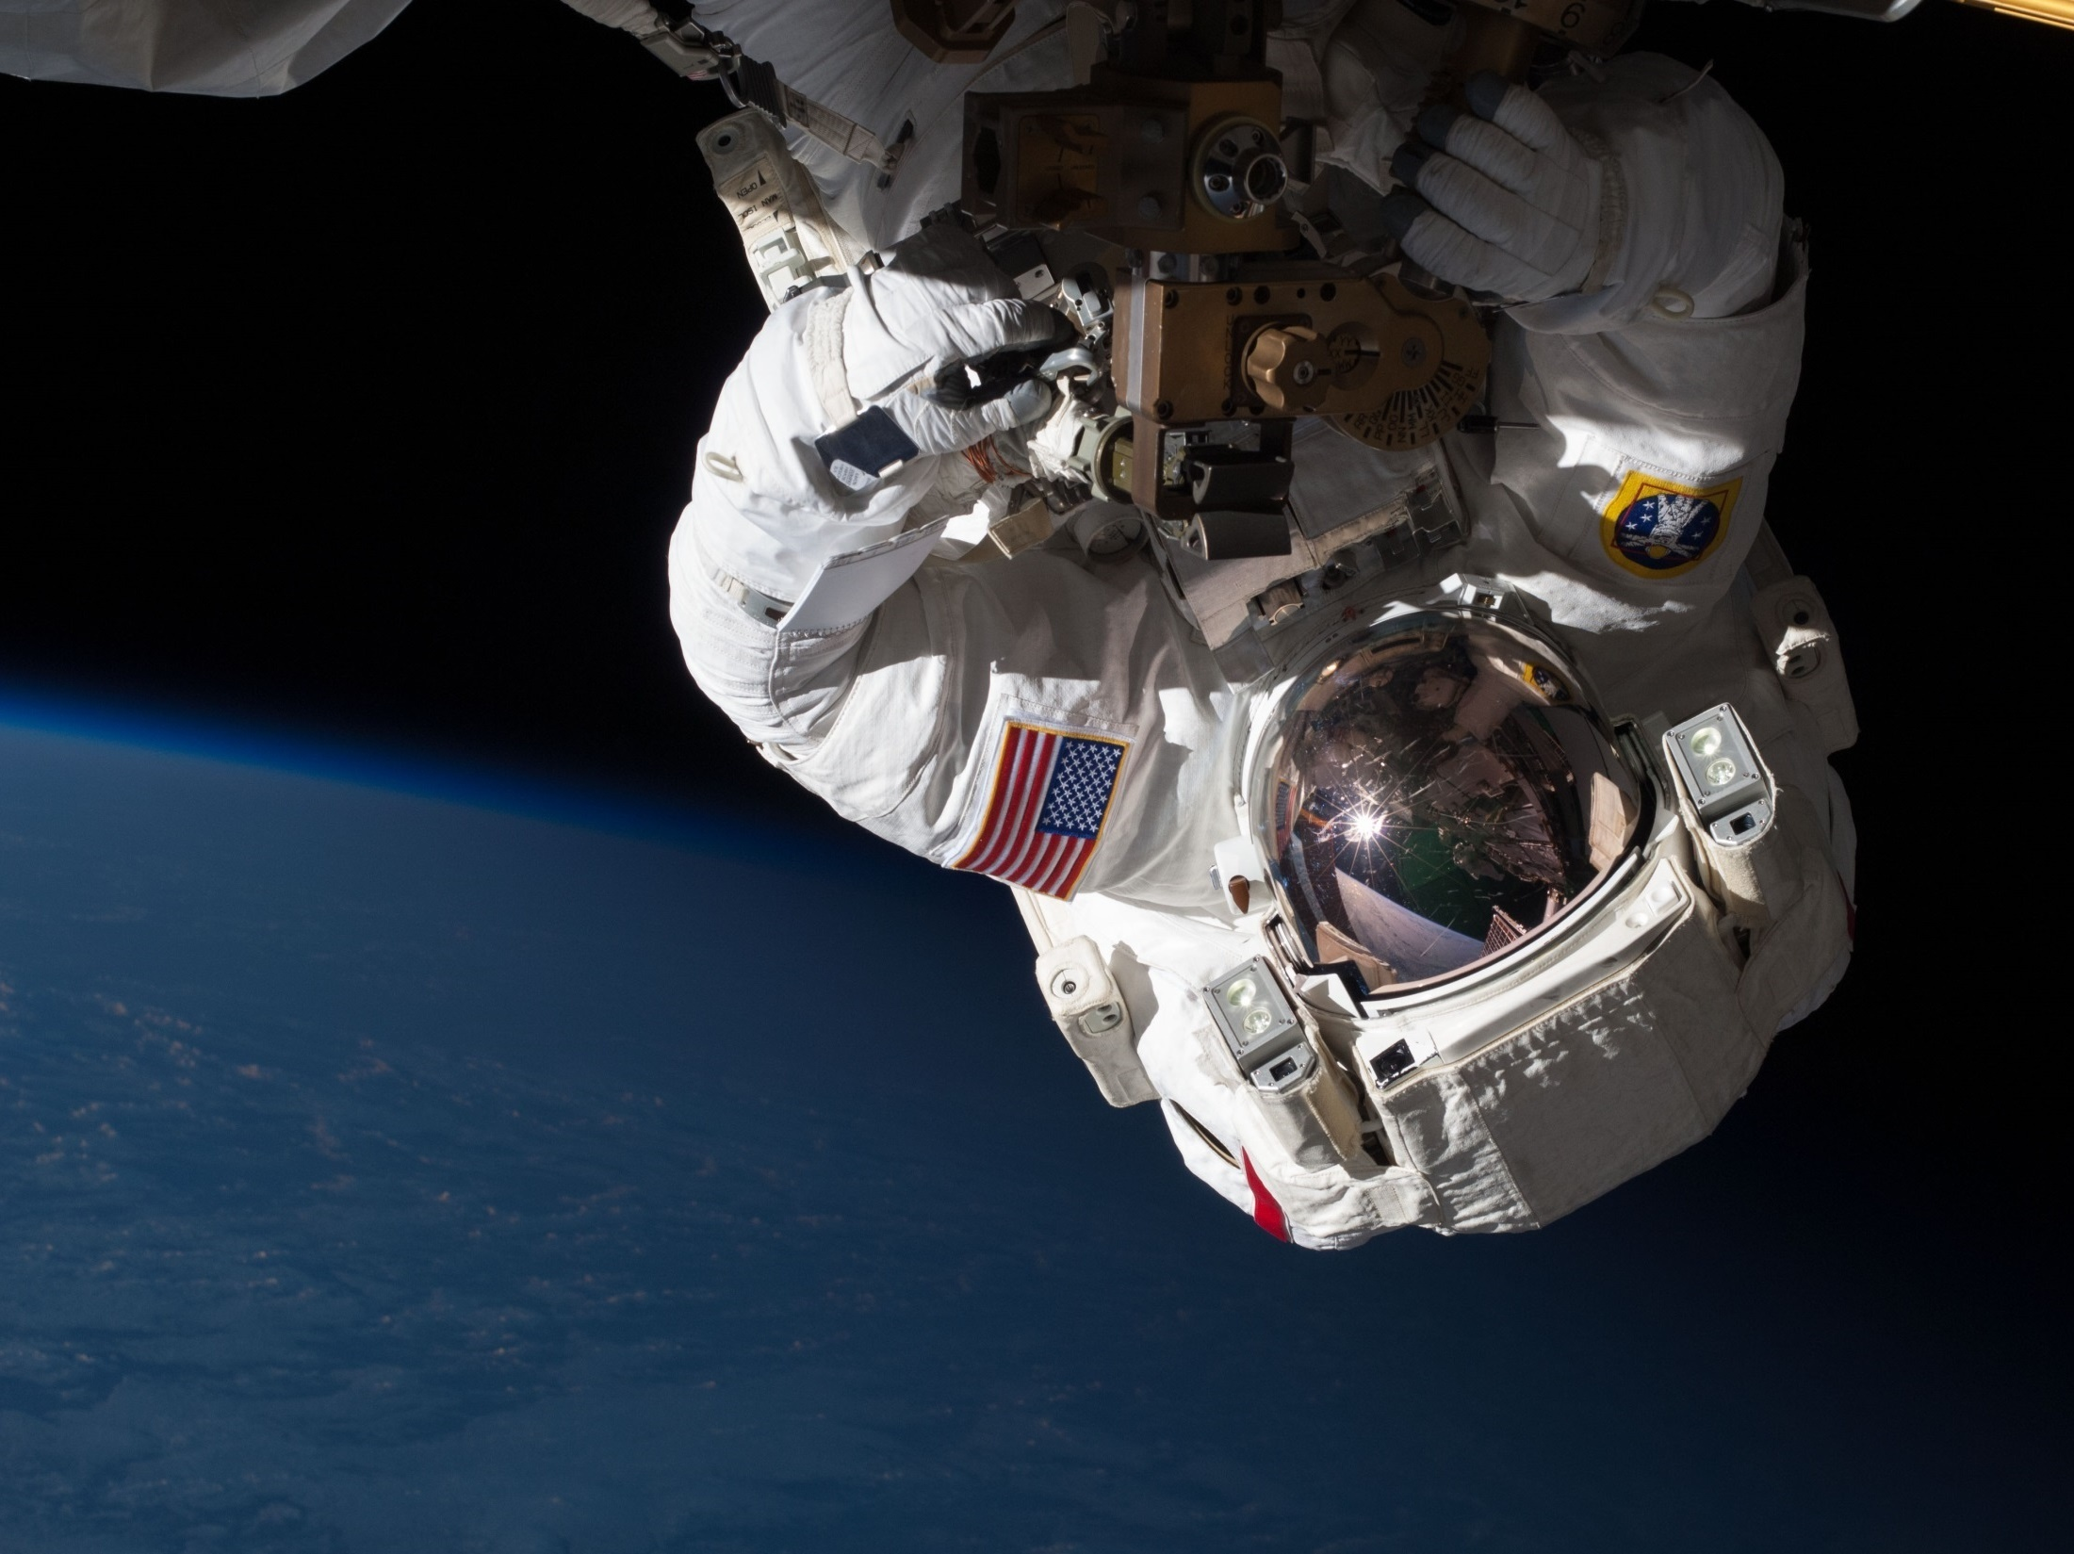
Visit the Spinoff website for more examples of NASA technology transfer: http://spinoff.nasa.gov

Slide 59
