Slide 1
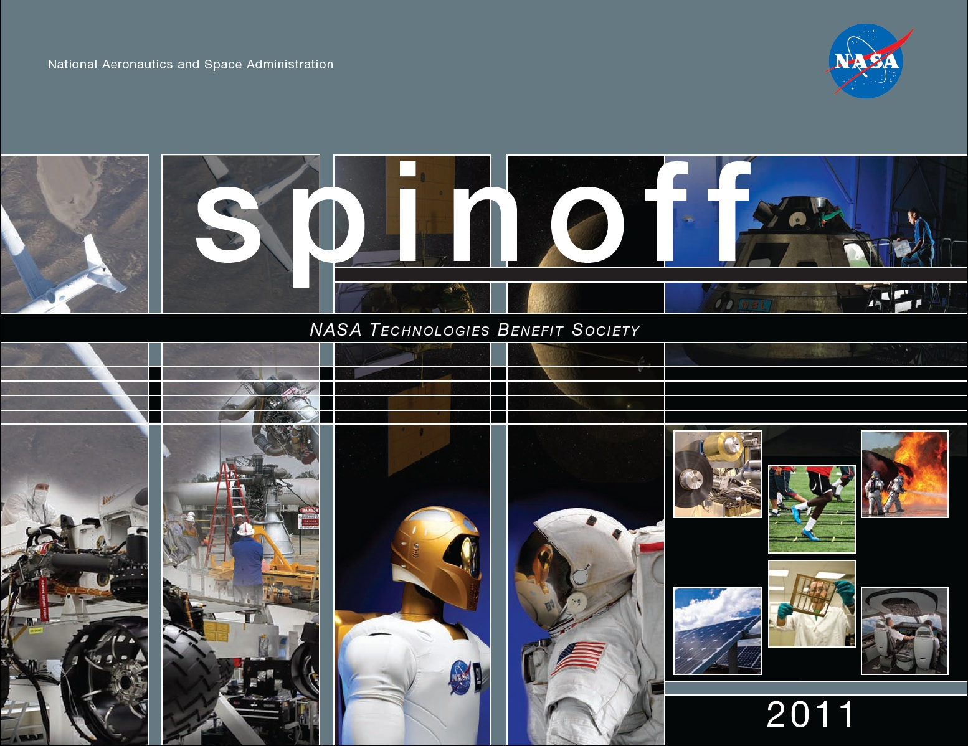

Slide 2
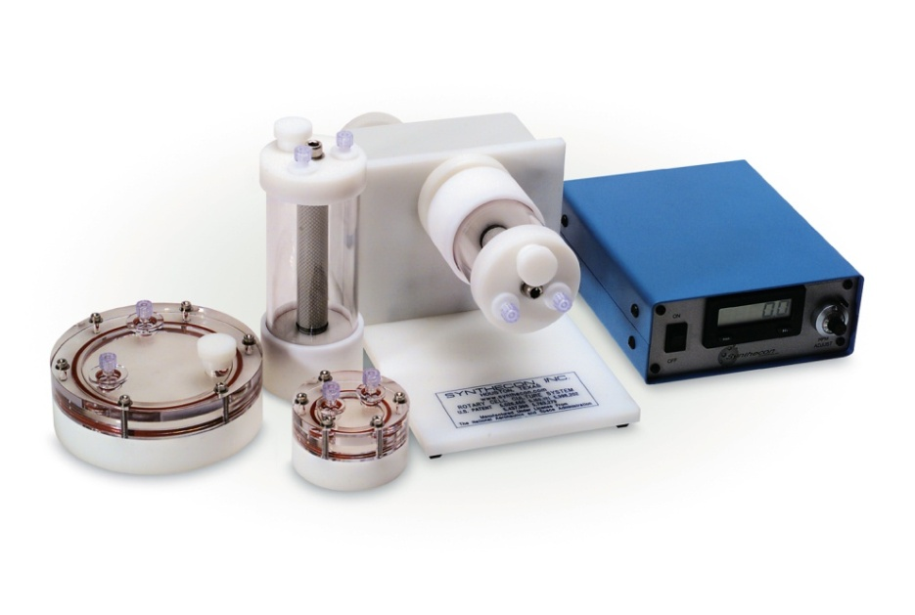
Bioreactors Drive Advances in Tissue Engineering
Johnson Space Center
Synthecon Inc.
Houston, Texas
NASA Technology
NASA scientists wanted to test cell cultures using the benefits of microgravity
Rotating the wall of the bioreactor created a suspended environment without also introducing turbulent conditions that might harm cells
Benefits
The Rotary Cell Culture Systems (RCCS) grow cell cultures used in advanced tissue engineering
A gentle growing environment allows for complex and three-dimensional cell structures
An RCCS produces 10 times more cells than standard systems and creates more realistic cultures for testing
Partnership
NASA built a grant program around the technology, funding researchers at top universities and helping Synthecon, a small company that licensed the technology, to survive and grow
Synthecon’s bioreactor system won an “R&D 100” award and was inducted into the Space Technology Hall of Fame
Spinoff 2011
Health and Medicine

Slide 3
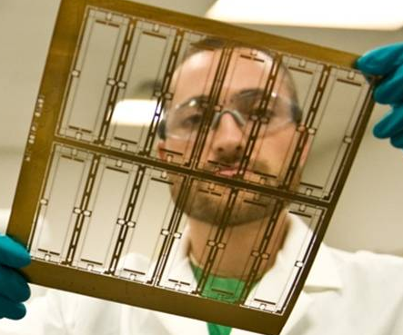
Tooling Techniques Enhance Medical Imaging
Goddard Space Flight Center
Mikro Systems Inc.
Charlottesville, Virginia
NASA Technology
The causes of solar flares—which pose a danger to spacecraft and can disrupt life on Earth—remain largely mysterious
NASA funded the development of a device to capture high-resolution X-ray and gamma-ray images of eruptions
Partnership
Through Small Business Innovation Research (SBIR) contracts, Mikro Systems innovated the manufacturing process of fine, complex tungsten grids
Using the technology, NASA has captured about 50,000 images of solar flares for analysis
Benefits
The company commercialized the technology in multiple markets, including medical devices, security scanners, and turbine-engine blades
Process lowers material costs by 96 percent and reduces production time by 90 percent
By developing this technology, Mikro has created more than 35 jobs
Spinoff 2011
Health and Medicine

Slide 4
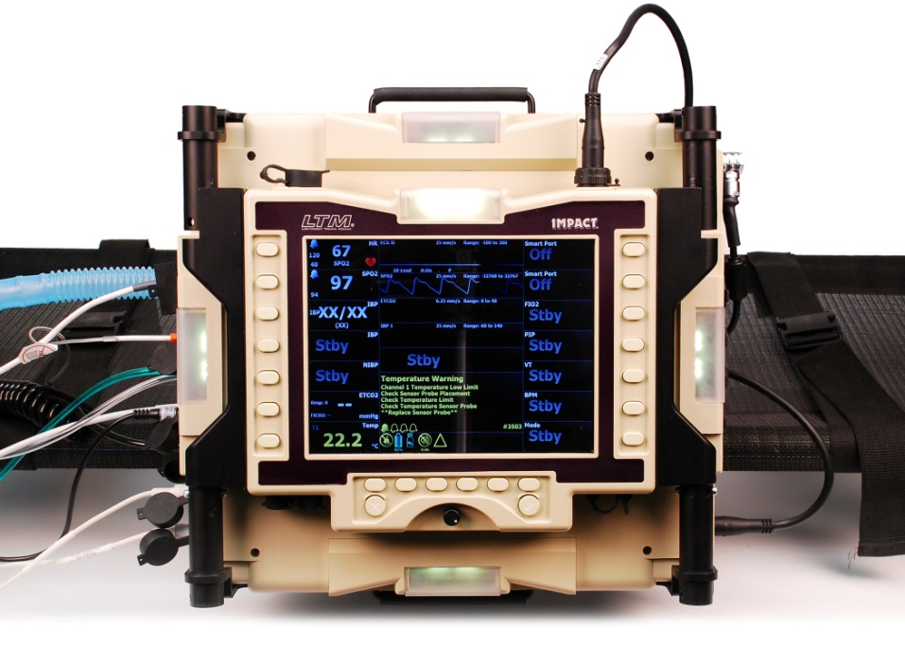
Ventilator Technologies Sustain Critically Injured Patients
Johnson Space Center
Impact Instrumentation Inc.
West Caldwell, New Jersey
NASA Technology
From its beginning, NASA has been concerned with providing effective remote medical care
The Space Medicine Division Advanced Projects Group incorporates the expertise of clinicians and engineers to develop medical equipment capable of full automation or remote control
Benefits
Impact used experience developing the Model 754-AP to produce the Uni-Vent 731 Series of ventilators, made for prehospital use and use in emergency rooms and intensive care units
While fully automated equipment remains a future goal, the partnership resulted in smaller, smarter, more compact devices capable of remote control
Partnership
NASA and Impact Instrumentation Inc. entered into a Space Act Agreement, focusing on adapting ventilators for use in space
The primary achievement of the partnership, the Model 745-AP ventilator, led Impact to develop closed-loop capabilities and run clinical trials of a ventilator that could operate itself
Spinoff 2011
Health and Medicine

Slide 5
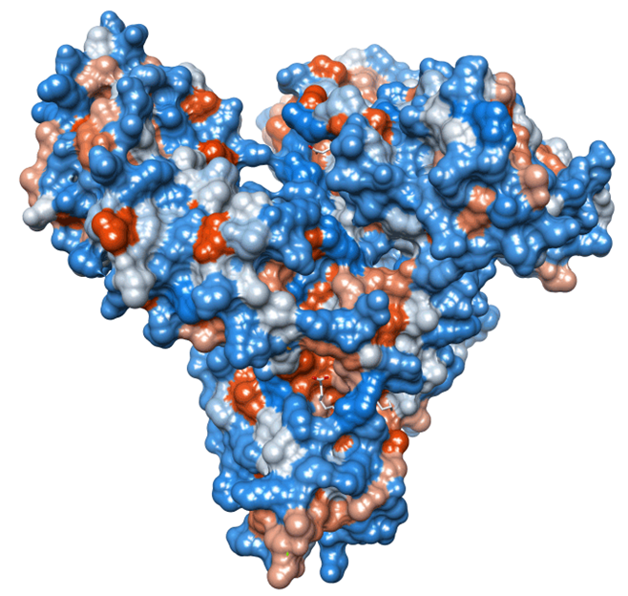
Protein Innovations Advance Drug Treatments, Skin Care
Marshall Space Flight Center
New Century Pharmaceuticals Inc.
Huntsville, Alabama
NASA Technology
NASA was experimenting with crystal growth in space in order to create and study complex protein structures
Among the targeted proteins was the human serum albumin, notable for absorbing portions of drug treatments and making them less effective
Benefits
Knowledge of albumin led to the creation of Albagen, a hypoallergenic drug delivery product, as well as a unique line of skin-care products
New Century recently developed Salus, a treatment approach that fine-tunes anti-cancer drugs to individuals and lowers dose requirements
Partnership
Using crystal-growing techniques and specialized X-ray detection equipment, NASA scientist Dan Carter mapped albumin’s structure for the first time
Carter formed New Century with colleagues and continued to work with NASA through grants
New Century compiled CADEX, the world’s most extensive library of atomic structures showing the binding characteristics of drugs and albumin
Spinoff 2011
Health and Medicine

Slide 6
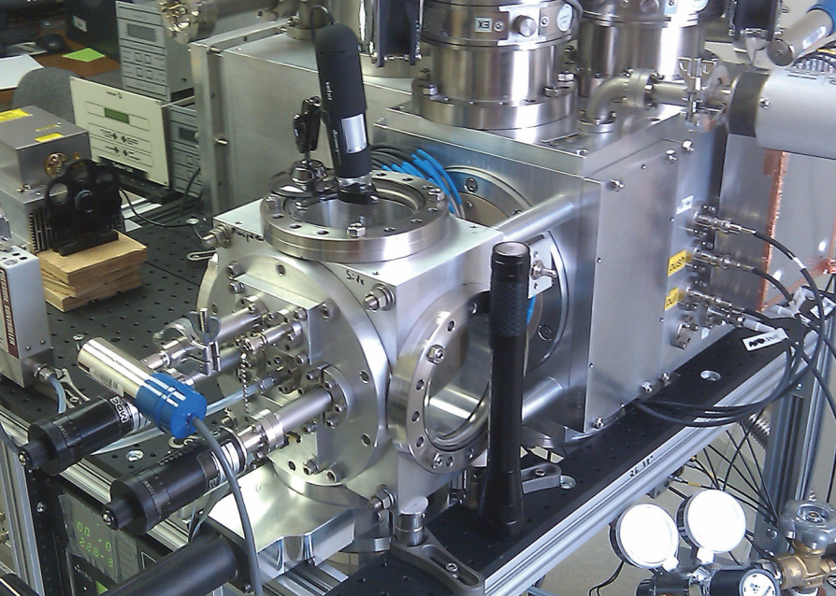
Mass Analyzers Facilitate Research on Addiction
Kennedy Space Center
Ionwerks Inc.
Houston, Texas
NASA Technology
During a shuttle launch, engineers and automated systems closely guard the balance of conditions and make adjustments
NASA wanted to enhance the technology that monitors gas levels inside of the shuttle by using a fast, precise, and compact time-of-flight instrument
Partnership
Kennedy Space Center awarded a Small Business Innovation Research (SBIR) contract to Ionwerks to fabricate a device capable of detecting parts-per-million changes in gasses
Ionwerks’ contributions made through the SBIR program were recognized with a “Tibbetts Award”
Benefits
Ionwerks used the technology to develop large-molecule detection devices for bio-surfaces
Spectrometers developed for NASA found applications in addiction and brain injury research at the National Institutes of Health
Researchers also improved commercial gas analyzers for airborne contaminants
Spinoff 2011
Health and Medicine

Slide 7
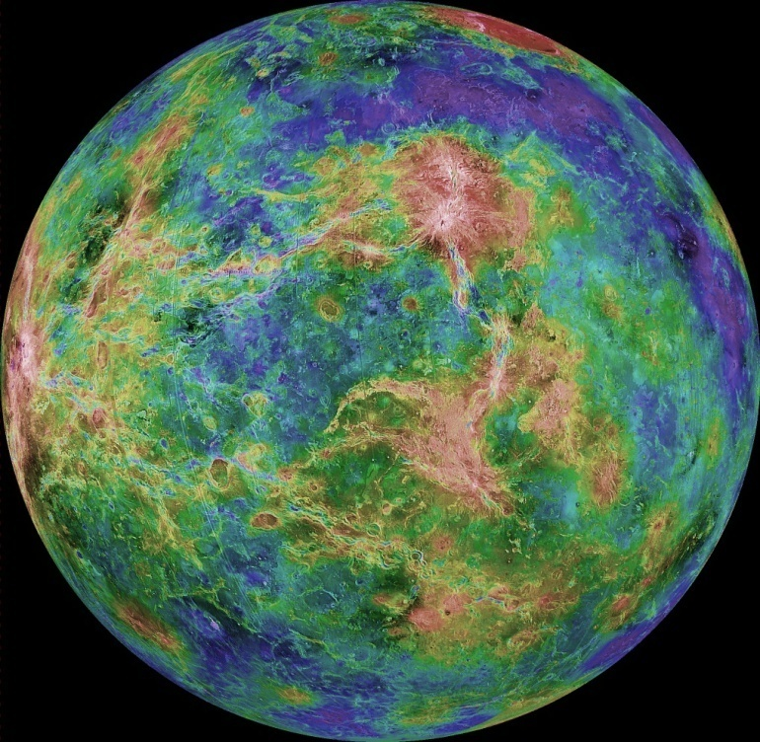
Frameworks Coordinate Scientific Data Management
Jet Propulsion Laboratory (JPL)
Apache Software Foundation (ASF)
Forest Hill, Maryland
NASA Technology
NASA’s Planetary Data System (PDS) is an ever-growing archive of data products delivered from robotic missions
To help researchers access the information they need, JPL designed the Object Oriented Data Technology (OODT) framework to archive PDS data
Partnership
JPL targeted ASF, a nonprofit, open-source industry leader, as an ideal partner to transfer OODT
ASF provides infrastructure and leadership for housing, distributing, and managing the project
ASF placed OODT in their incubation program, which eventually resulted in an Apache Top-Level Project designation—the first NASA project to receive this distinction
Benefits
Apache OODT version 0.1 is available for public consumption and is currently used by The National Cancer Institute, Children’s Hospital Los Angeles, and other organizations
Since the technology is open source, it is receiving attention and development from programmers all over the world
Spinoff 2011
Health and Medicine

Slide 8
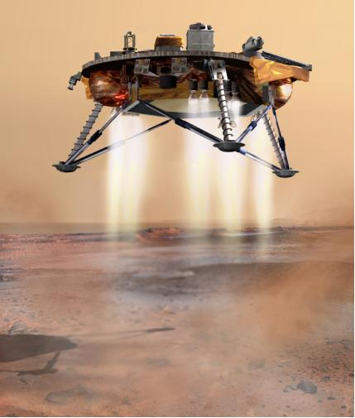
Cameras Provide Safe Navigation for Pilots, Drivers
Jet Propulsion Laboratory
Johnson Space Center
Langley Research Center
Advanced Scientific Concepts Inc.
Santa Barbara, California
NASA Technology
An otherwise successful 423-million-mile trip to Mars can be threatened in the final few feet due to surface hazards preventing a safe landing
NASA investigated terrain-sensing technologies, including cameras capable of real-time, 3D imagery under a variety of lighting and surface conditions
Partnership
Advanced Scientific Concepts Inc. (ASC) received a Small Business Innovation Research (SBIR) award from the Jet Propulsion Laboratory to adapt their 3D flash light detection and ranging (LIDAR) camera for entry-, descent-, and landing-phase applications
ASC also received SBIR awards and a NASA Research Announcement contract to adapt flash LIDAR for docking at the International Space Station
Benefits
Two versions of the LIDAR camera are available: the DragonEye Space Camera and the TigerEye camera for terrestrial use
ASC has sold 100 cameras to a number of large- and medium-sized aerospace organizations
LIDAR cameras are useful in almost any vehicle for collision avoidance and object detection
Spinoff 2011
Transportation

Slide 9
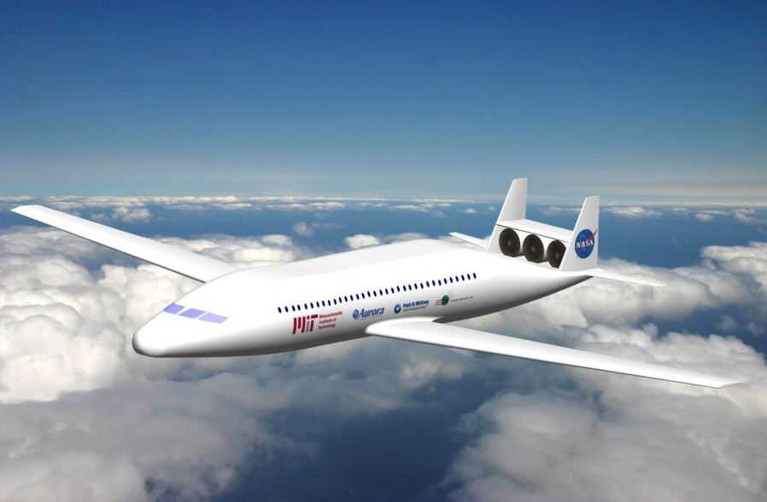
Integrated Design Tools Save Time, Money
Langley Research Center
Phoenix Integration Inc.
Wayne, Pennsylvania
NASA Technology
NASA employs many design tools to enhance flight and provide data to engineers; however, the programs don’t always communicate with each other
NASA wanted a way to integrate its flight design tools into one complex system
Partnership
A Small Business Innovation Research (SBIR) program contract was awarded to Phoenix Integration, an established industry leader
Through SBIRs, Phoenix Integration modified its process and design software for use in flight
Ongoing development brings more advanced integration tools to NASA and commercial clients
Benefits
The partnership resulted in the PHX ModelCenter, a graphical environment for process integration and design automation
The tool lowers costs for NASA and commercial clients by allowing engineers to spend less time on programming and more time on design
The software is used by over 1,000 engineers in 100 locations
Spinoff 2011
Transportation

Slide 10
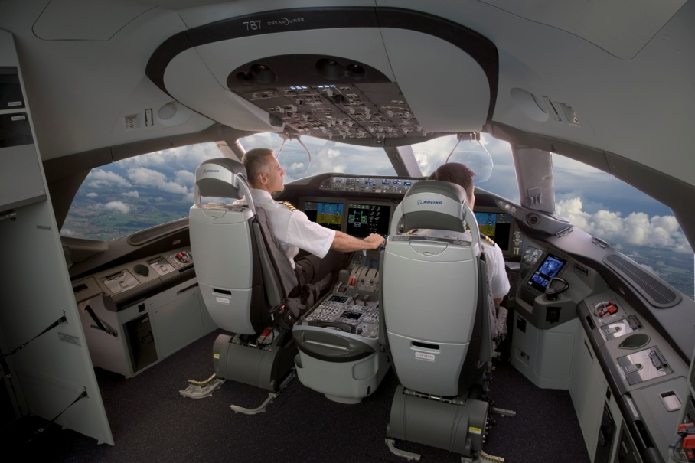
Advisory Systems Save Time, Fuel for Airlines
Ames Research Center
Boeing
Seattle, Washington
NASA Technology
A team at Ames Research Center developed a software suite to reduce restrictions and improve the efficiency of air traffic control
One of the tools, Direct-To, automates the process of assigning and redirecting routes, ensuring that aircraft are always taking the most efficient route available
Partnership
Signing a Space Act Agreement, Boeing partnered with Ames to make the program suitable for private use
NASA’s core algorithms became a subscription-based product that is available to commercial and business airlines, military, general aviation, and international flights
Product Outcome
The final product, Direct-Route, monitors a range of variables affecting route choice
The software finds more efficient routes immediately available to aircraft in flight and notifies either the pilot or the air traffic controller
Improved routes can save up to 20 million gallons of fuel per year (roughly $50 million)
Spinoff 2011
Transportation

Slide 11
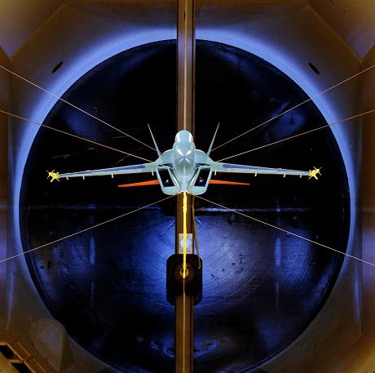
Modeling Programs Increase Aircraft Design Safety
Dryden Flight Research Center
ZONA Technology
Scottsdale, Arizona
NASA Technology
When certain airliners mysteriously crashed in the 1950s, NASA and partners investigated
The culprit was flutter, or aerodynamic forces that act on wings and cause them to vibrate
Today, aircraft designers must take flutter into account, and most test designs in wind tunnels
Partnership
Through the Small Business Innovation Research (SBIR) program, ZONA partnered with Dryden to develop aeroelastic modeling software
The partnership continued with a Phase II Small Business Technology Transfer (STTR) project to develop Dry Wind Tunnel (DWT) technology
The Air Force now partners with ZONA for special flutter-related projects
Benefits
The ZONA Online Flutter Estimator is a software tool that can predict flutter for various aircraft designs and help test these designs safely
ZONA’s software and DWT innovates and advances flutter testing without using traditional wind tunnels, which require a lot of resources, time, and personnel to operate
Spinoff 2011
Transportation

Slide 12
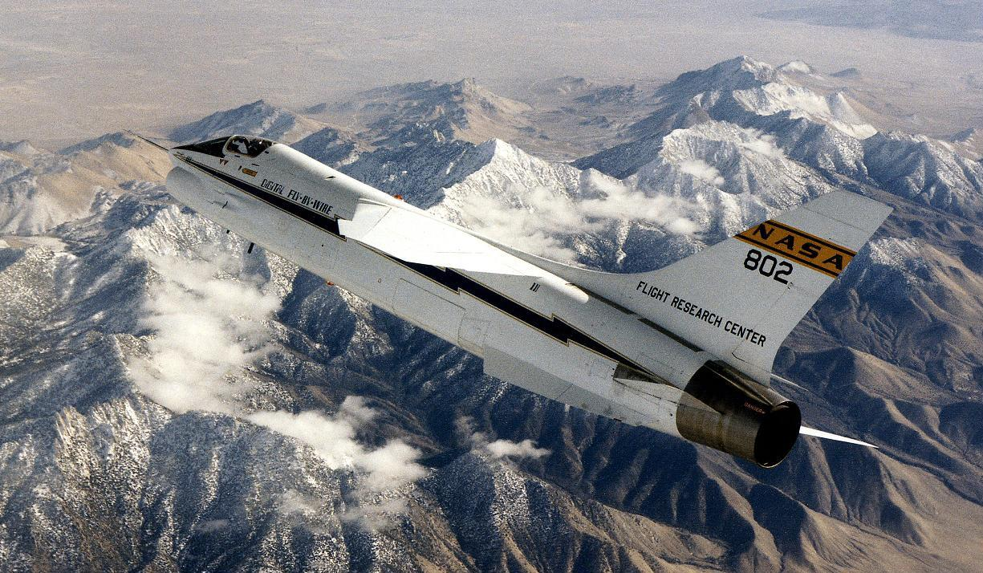
Fly-by-Wire Systems Enable Safer, More Efficient Flight
Dryden Flight Research Center
Draper Laboratory
Cambridge, Massachusetts
NASA Technology
In preparing for a mission to the Moon, NASA developed a fly-by-wire electronic guidance system to allow pilots to control the Lunar Module digitally
After the system worked flawlessly for the Apollo missions, NASA’s engineers began developing similar systems for aircraft on Earth
Partnership
Dryden, in partnership with Draper, adapted the Apollo navigation system for a plane, which became the Digital Fly-by-Wire (DFBW) research aircraft
The DFBW program was divided into two phases: Phase I featured the first flight by digital input alone, and Phase II developed a full system to implement it
Benefits
DFBW technology has sparked a revolution in design for larger airplanes, where digital controls make complex aircraft possible
The benefits of DFBW have enabled developments in an array of vehicles, including cars, motorcycles, and submarines
Spinoff 2011
Transportation

Slide 13
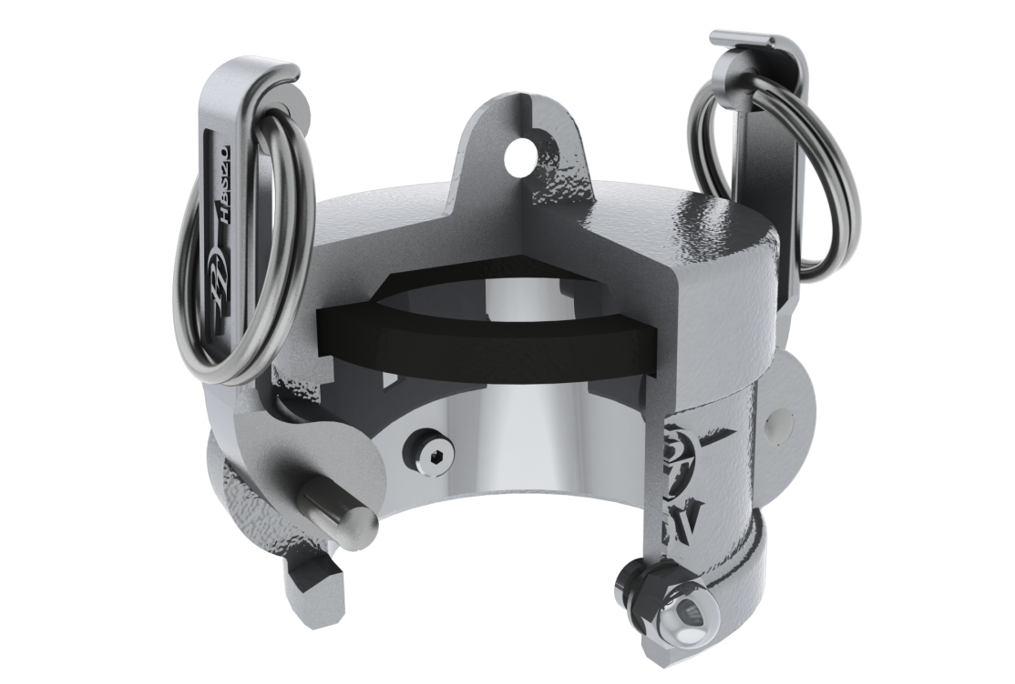
Modified Fittings Enhance Industrial Safety
Kennedy Space Center
PT Coupling Company
Enid, Oklahoma
NASA Technology
In a massive processing facility at Kennedy Space Center, workers move large and heavy machinery with air-powered pallets
NASA developed custom cam and groove fittings to prevent accidental releases of the pressurized hoses, which can cause injury
Partnership
Years later, an engineer at PT Coupling was trying to solve the same problem but with little success
In researching the issue, the engineer discovered NASA’s product, and PT Coupling licensed the technology
Since then, PT Coupling has modified the design for its own purposes and commercialized the cam and groove fittings it developed
Benefits
The company sells the PT Pressure Safe, a coupling for liquid and dry material transfers in the petroleum and chemical industries
The couplings feature quick connections (no hand tools or threaded connections needed), and they negate the harm posed by a sudden or accidental release
Spinoff 2011
Public Safety

Slide 14
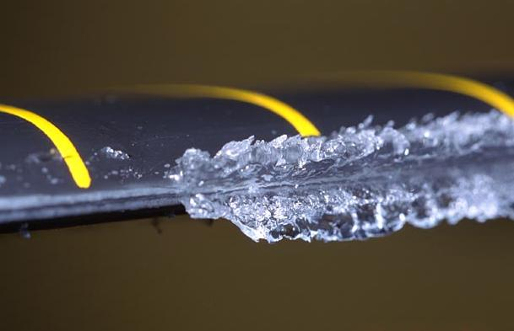
Simulation Tools Model Icing for Aircraft Design
Glenn Research Center
American Kestrel Company, LLC
Ithaca, New York
NASA Technology
Water in the atmosphere is prone to freeze on airframes, wings, turbines, and engines
To enhance aviation safety, NASA developed the LEWICE ice accretion simulation software
Its versatility, ease of use, and speed make LEWICE the premier ice-shape generation program
Partnership
American Kestrel Company, LLC (AKC) provides consulting services to aircraft manufacturers in the field of aviation safety and icing
AKC improved LEWICE’s user interface and formed a partnership with Glenn Research Center through a Space Act Agreement, allowing AKC to distribute the updated program internationally
Benefits
AKC’s modified program, LEWINT, adds a user interface, analysis tools, and automated plotting
The software reduces testing times and late-stage design changes, saving money and reducing risks
Since 2007, AKC has licensed LEWINT to 25 customers, rivaling LEWICE’s popularity
Spinoff 2011
Public Safety

Slide 15
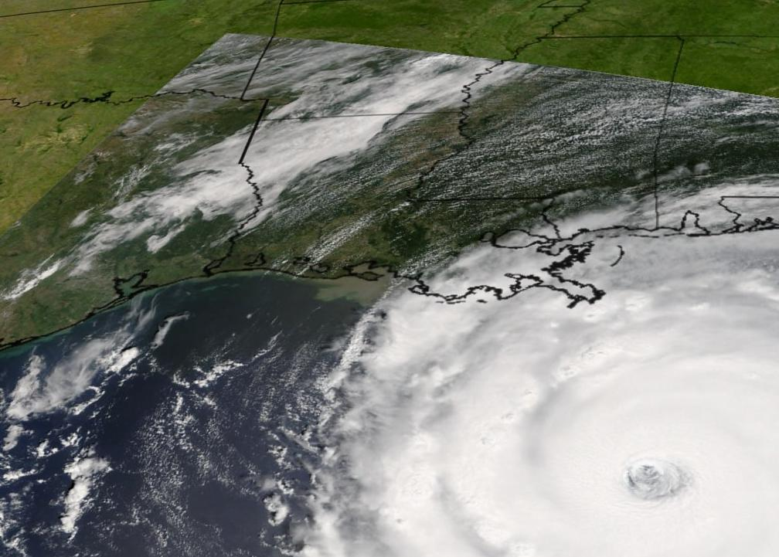
Information Systems Coordinate Emergency Management
Stennis Space Center
NVision Solutions Inc.
Bay St. Louis, Missouri
NASA Technology
With many Earth-observing satellites orbiting the globe, NASA generates a wealth of data about conditions on the surface
Recognizing that this host of data was unique and valuable, NASA decided to make it available to governments and private firms
Partnership
In 1998, Stennis and Mississippi worked together to form NASA Small Business and Innovation Research (SBIR) partnerships with local companies
NVision engaged with Stennis through multiple dual-use and SBIR projects, drawing on NASA’s data for its emergency response system
Through a Phase III SBIR agreement, NVision’s system is now used by every NASA center
Benefits
NVision’s principal product utilizing NASA’s data is the Real-Time Emergency Action Coordination Tool (REACT)
REACT has generated $2 million in revenue and helped the company create 75 high-tech jobs
NVision has also developed touchscreen tabletops to expand REACT’s capabilities
Spinoff 2011
Public Safety

Slide 16
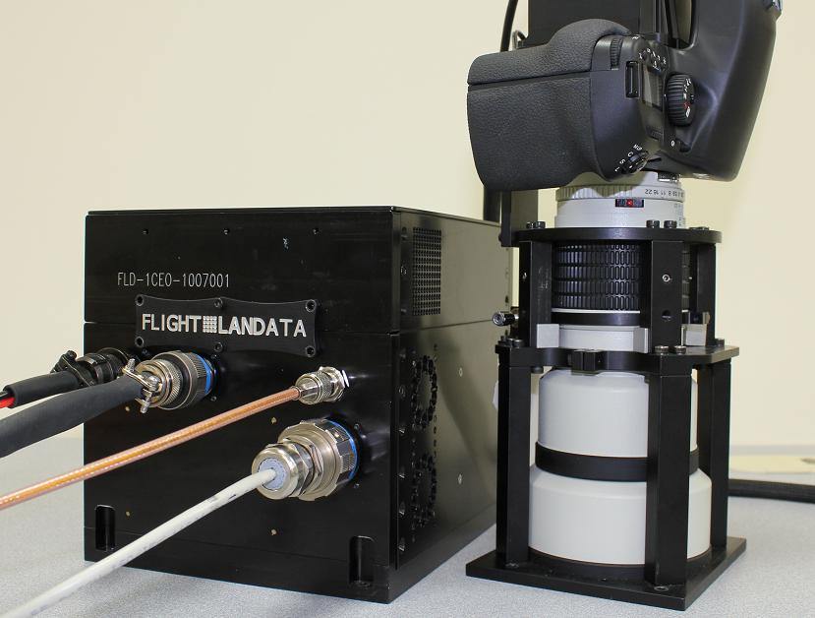
Imaging Systems Provide Maps for U.S. Soldiers
Goddard Space Flight Center
Flight Landata Inc.
North Andover, Massachusetts
NASA Technology
The Landsat program has provided NASA with four decades’ worth of data about the Earth’s surface
Data from the sensors is processed, analyzed, and used to create information-rich images of the planet
NASA is continually seeking to advance its remote sensing technology
Partnership
Over the last 10 years, Flight Landata has received multiple Small Business Innovative Research (SBIR) awards, including a Phase III SBIR in 2005 that resulted in its 3D imaging technology
Flight Landata received a “Tibbets Award” in 2002 and the Army’s “Greatest Invention of the Year” award in 2006
Benefits
The BuckEye instrument suite provides high-resolution, 3D surface data for tactical missions and intelligence, which (being unclassified) can be used by any soldier on the ground
In 5 years, the BuckEye collected 85,000 square kilometers of data over Iraqi urban areas at 1-meter resolution; and in 4 years it collected 40,000 square kilometers of data in Afghanistan
Spinoff 2011
Public Safety

Slide 17
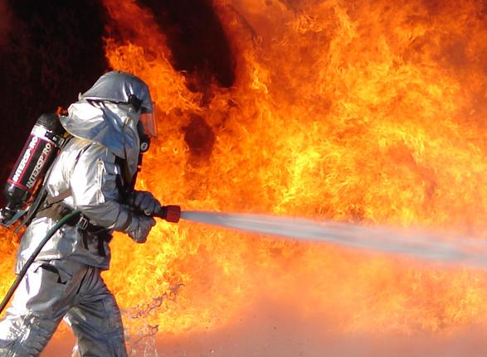
High-Pressure Systems Suppress Fires in Seconds
Marshall Space Flight Center
HMA Fire/Orbital Technologies Corporation (ORBITEC)
Madison, Wisconsin
NASA Technology
NASA has long partnered with ORBITEC to develop rocket and spacecraft propulsion design
ORBITEC’s innovations created higher-powered, lower-cost, versatile, and even reusable vortex hybrid rocket engines that effectively manage ultra-high pressure (UHP) flows
Partnership
HMA, a subsidiary of ORBITEC, took the design ideas from these advanced rockets and applied the technology to water delivery systems for firefighting
HMA consistently drew from the advances of the NASA-ORBITEC partnership; for example, managing the flow of liquids to produce an energetic blanket of fine water droplets that can cover four times more surface area than other systems
Benefits
HMA has produced multiple suppression delivery systems, including hoses and vehicles
In one test, HMA put out a fire 80 percent faster than a traditional system while using only 6 percent as much water
HMA’s system extinguishes cars fully engulfed by a hydrocarbon fire in 9 seconds
Spinoff 2011
Public Safety

Slide 18
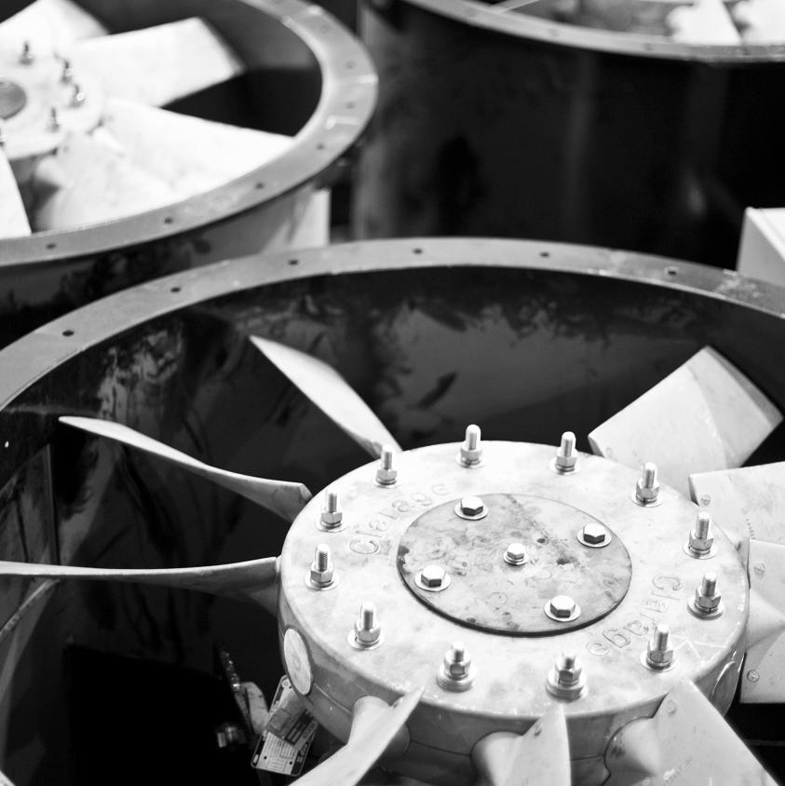
Alloy-Enhanced Fans Maintain Fresh Air in Tunnels
Marshall Space Flight Center
Twin City Fan Companies Ltd.
Minneapolis, Minnesota
NASA Technology
As part of the Partnership for Next Generation Vehicles, a NASA scientist developed an aluminum alloy for high temperature applications
The alloy, three to four times stronger than conventional aluminum, could be used in combustion engine, marine, and aerospace applications
Partnership
NASA patented the technology and over the last decade has successfully licensed it to private firms
The alloy has received an “Excellence in Technology Transfer” award for its commercial success
In 2010 Twin City Fan licensed the technology in order to manufacture tunnel safety fans that would meet European safety standards
Benefits
Twin City Fan now sells tunnel fans capable of operating in 752 °F that are three times lighter than their steel-made equivalents
It now produces fans in 3 sizes, and plans on 12
The compact design will allow the tunnels in which the fan is installed to be smaller, saving greatly on construction costs
Spinoff 2011
Public Safety

Slide 19
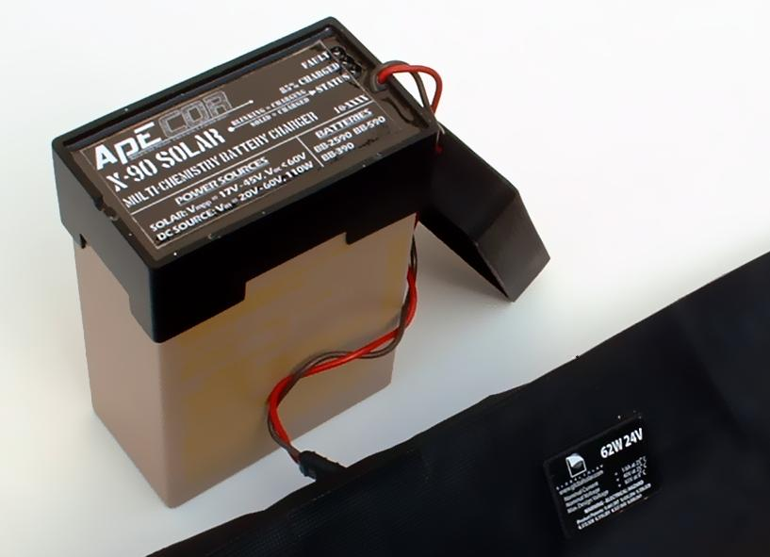
Control Algorithms Charge Batteries Faster
Glenn Research Center
Advanced Power Electronics Corporation (ApECOR)
Orlando, Florida
NASA Technology
Spacecraft on long missions, like NASA’s MESSENGER sent to Mercury, are powered by solar/battery hybrid systems
Weight and size are key considerations: A spacecraft needs enough equipment to power its systems, but every extra pound of weight adds significant costs
Partnership
Through Small Business Innovation Research (SBIR) contracts with Glenn, ApECOR devised a three-port power converter for space systems
The control algorithms that direct energy use and storage help minimize the size and weight of the overall spacecraft power systems
Benefits
ApECOR’s X-90 Solar Charger uses the NASA-derived control algorithms to efficiently charge batteries from solar or other power sources
It charges 30 percent faster than similar devices
Future potential applications include providing power to farms in developing countries and the remote operation of irrigation pumps
Spinoff 2011
Consumer Goods

Slide 20
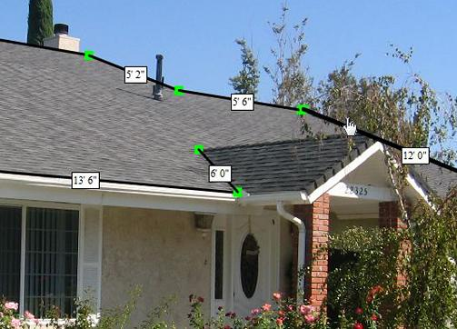
Software Programs Derive Measurements from Photographs
Kennedy Space Center
DigiContractor Corporation
Tarzana, California
NASA Technology
Following the Space Shuttle Columbia tragedy, an investigation board spent 7 months examining the cause of the accident
Part of the evaluation included extensive analysis of the video, including measuring the size of the material that fell and how far it fell
Partnership
A NASA scientist devised the program to measure the debris and, after the investigation, continued to improve the technology before it was made available for licensing
In 2008, DigiContractor licensed the technology from NASA to use in an existing line of software products called uPhotoMeasure
Benefits
uPhotoMeasure takes any photograph and, with a single point of reference, derives the measurements of all other objects in the picture
Using NASA’s improvements to the technology, uPhotoMeasure achieves 95 percent accuracy
Software is ideal for landscapers, plumbers, contractors, law enforcement, designers, et al.
Spinoff 2011
Consumer Goods

Slide 21
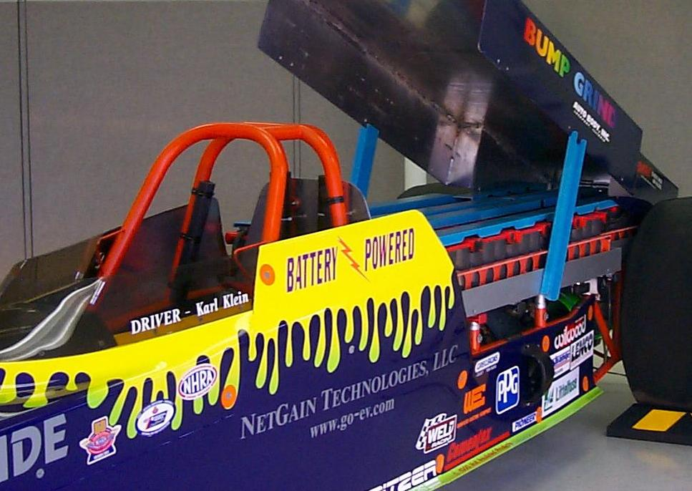
Retrofits Convert Gas Vehicles Into Hybrids
Glenn Research Center
NetGain Technologies LLC
Lockport, Illinois
NASA Technology
Most spacecraft are powered by multiple sources—such as solar, fuel, and battery—working together
One initiative at Glenn focused on combining technologies for optimal power systems
NASA developed supercapacitators to store energy electrostatically and interface with batteries
Partnership
To test the capabilities of supercapacitators, NASA studied their effectiveness in powering a dragster
The NASA Illinois Commercialization Center worked with NetGain to turn a gas-powered dragster into a hybrid using the Hybrid Retrofit System (HRS)
NASA collected significant data from the tests, and NetGain used the technology to develop electric and HRS engines for vehicles
Benefits
The HRS benefits a range of vehicles, but especially short-distance, multiple-stop delivery trucks; these can save 26 percent in fuel costs and see an improvement in performance
NetGain’s sales help keep 150 dealers in business and support 100 manufacturing jobs; engines repay their cost through savings in about 3 years
Spinoff 2011
Consumer Goods

Slide 22
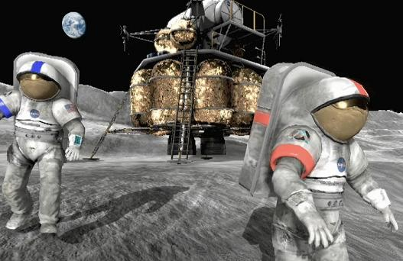
NASA Missions Inspire Online Video Games
Goddard Space Flight Center
Army Game Studio, Redstone Arsenal, Alabama
Virtual Heroes, Raleigh, North Carolina
NASA Technology
NASA’s Learning Technologies program aims to inspire students to pursue careers in the areas of science, technology, engineering, and math (STEM)
As a part of NASA’s effort to increase the number of students engaged in these disciplines, it researched the possibility of an online game to generate interest
Partnership
In 2009, NASA funded the development of a 3D massively multiplayer online game (MMOG)
The success of the game inspired a Space Act Agreement to create a sequel, now in production
The first game uses real NASA lunar architecture plans; its sequel will feature a variety of real NASA engineering and science missions
Benefits
The first game, the award-winning Moonbase Alpha, was downloaded over 300,000 times
Both games reward skills in math, physics, science, and engineering
Curricular support materials are being developed to incorporate Moonbase Alpha and Astronaut: Moon, Mars, and Beyond into the classroom
Spinoff 2011
Consumer Goods

Slide 23
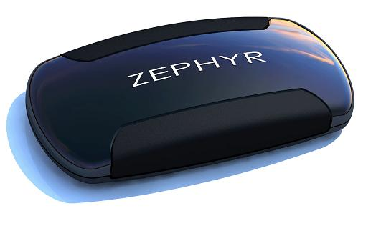
Monitors Track Vital Signs for Fitness and Safety
Ames Research Center
Zephyr Technology
Annapolis, Maryland
NASA Technology
The unique conditions of microgravity can be debilitating to astronauts, causing everything from mild disorientation to nausea to severe vomiting
In order to combat these symptoms, NASA has devised a variety of equipment to induce and monitor the physiological problems caused by microgravity
Partnership
Under a Space Act Agreement, NASA conducted its study in partnership with Zephyr, an innovator in physiological status monitoring technology
Zephyr’s unique equipment served NASA’s purposes well; and NASA’s expertise benefited Zephyr, which used the experience to improve its product
Work continues with an International Space Act Agreement to study fatigue in flight crews
Benefits
The BioHarness is Zephyr’s primary product for monitoring physiological status
Well-suited for fitness applications, it is used by numerous professional sports teams; Under Armour will soon be making a BioHarness shirt
Zephyr has adapted its technology for use with the military, first responders, and firemen
Spinoff 2011
Consumer Goods

Slide 24
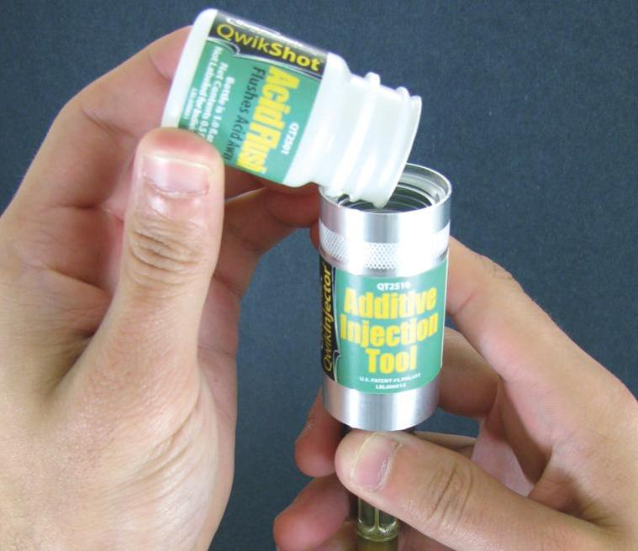
Thermal Components Boost Performance of HVAC Systems
Johnson Space Center
Mainstream Engineering Corporation
Rockledge, Florida
NASA Technology
The International Space Station (ISS) faces extreme temperatures, reaching 250 °F while facing the Sun
The Thermal Control System is a crucial part of temperature regulation, utilizing liquid cooling systems and radiators to collect heat from the ISS and release it into space
Partnership
Since the late 1980s, Mainstream has worked with NASA field centers to develop advanced thermal control technology for spacecraft
Under Small Business Innovation Research (SBIR) contracts, Mainstream developed a nontoxic heat transport fluid, as well as high-performance, low-cost thermal control equipment
Benefits
PuraClean is a liquid spray for air filters; it insulates the fibers and provides a 1,200 percent increase in efficiency without affecting air-flow
PuraClean is under review to become a certified allergy- and asthma-reducing HVAC product
QwikShot is an acid flush that bolsters cooling- system stability without leaving a residue
Spinoff 2011
Consumer Goods

Slide 25
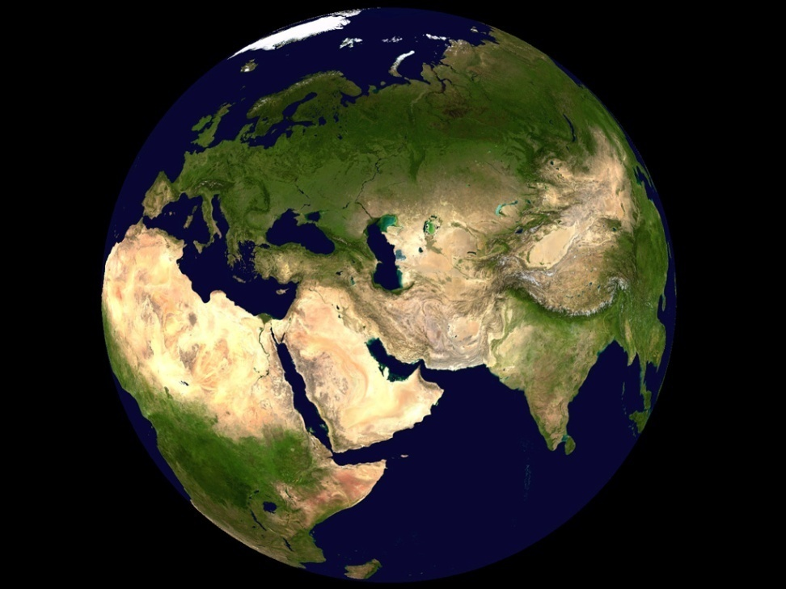
World Wind Tools Reveal Environmental Change
Ames Research Center
Intelesense Technologies
Honolulu, Hawaii
NASA Technology
After decades of utilizing satellites, NASA posses an unmatched store of data on Earth’s surface
To visualize this data in a 3D format, NASA built a software program called World Wind
It further improved the software by making it cross-platform and available to plug in to other software
Partnership
World Wind was released under the NASA Open Source Agreement license, and it received NASA’s “Software of the Year” award for 2009
Intelesense now uses the technology for public health, environmental, and other monitoring applications for governments and nonprofits
Data acquired through World Wind has saved Intelesense about $1 million in development costs
Benefits
Intelesense uses NASA data to support its products: InteleCell (data communication), InteleNet (data integration), and InteleView (data visualization)
The system was deployed to monitor 6,500 acres of intact, native-dominated forest in Hawaii, as well as for creating global heat maps and satellite feeds of maritime domains
Spinoff 2011
Energy and Environment

Slide 26
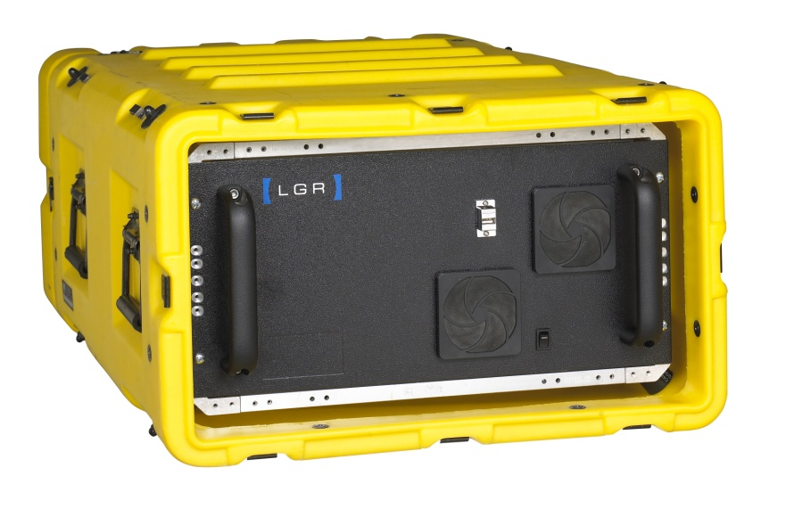
Analyzers Measure Greenhouse Gasses, Airborne Pollutants
Ames Research Center
Los Gatos Research Inc. (LGR)
Mountain View, California
NASA Technology
As a part of the search for other life in the universe, NASA deploys deep-sea sensors on the ocean floor
The sensors collect water from vent eruptions before returning to the surface, where the water is analyzed
NASA is looking for ancient life forms that could take hold in a variety of alien environments
Partnership
To develop instrumentation capable of precisely measuring carbon in deep sea and deep space environments, NASA partnered with LGR through a Small Business Innovation Research (SBIR) contract
The resulting innovation enabled a deep-sea carbon isotope analyzer for NASA’s Medusa project and now forms the basis for LGR’s commercial products
Benefits
LGR’s SBIR-derived technology powers a variety of devices used to measure greenhouse gasses, pollutants, and isotopes
Lasers measure precise amounts of practically any molecule with an absorption spectrum
LGR products were used during the Deepwater Horizon oil spill to record methane distributions
Spinoff 2011
Energy and Environment

Slide 27
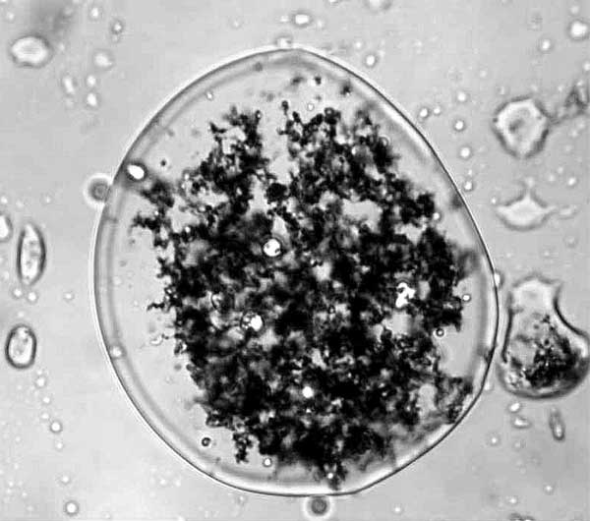
Remediation Technologies Eliminate Contaminants
Kennedy Space Center
Bio Blend Technologies
Cantonment, Florida
NASA Technology
To its surprise, NASA discovered that the launch stand at Kennedy was polluting the ground with polychlorinated biphenyls (PCBs)
Noting the lack of efficient, environmentally friendly options for dealing with PCBs, scientists developed the Activated Metal Treatment System (AMTS)
Partnership
AMTS is a paste containing microscale metal particles, which extract and degrade PCBs (and other toxins) into benign byproducts while leaving the surrounding environment unharmed
The technology won NASA’s “Invention of the Year” award and is in the Space Technology Hall of Fame
Bio Blend licensed the technology to perform remediation on organic chlorides and contaminants
Benefits
At one site, where previous unsuccessful remediation efforts had taken 9 years and cost $1 million, Bio Blend cleared 98.9 percent of contaminants in 77 days at a fraction of the cost
The company will soon open a new blending plant for manufacturing its proprietary and NASA-derived products
Spinoff 2011
Energy and Environment

Slide 28
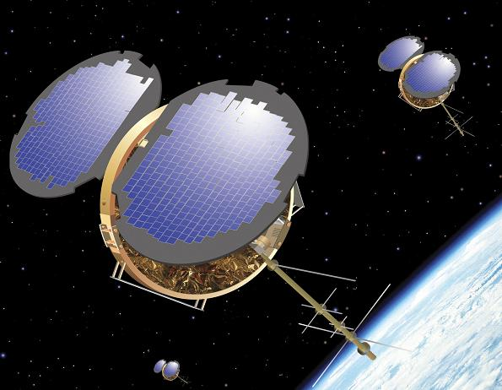
Receivers Gather Data for Climate, Weather Prediction
Jet Propulsion Lab
Broad Reach Engineering Company (BRE)
Tempe, Arizona
NASA Technology
In addition to location, GPS satellites provide data for weather forecasts and climate change; but the signals they send are distorted by the atmosphere
JPL designed the Black Jack receiver to take precise measurements of how GPS signals are distorted, which reveals information on atmospheric conditions
Partnership
To produce the Black Jack receivers, JPL turned to BRE, which then entered a licensing agreement for the technology that extends to 2017
As a result of the agreement, BRE created a new product, the Integrated GPS Occultation Receiver (IGOR), based on NASA’s Black Jack device
Benefits
IGOR’s radio occultation science capability, which provides services for satellites like precise orbit determination, is unique in the industry
IGOR is currently used by NASA, as well as German, Korean, and Brazilian organizations
Other BRE products derived from NASA technology are in use by the Air Force
Spinoff 2011
Energy and Environment

Slide 29

Coating Processes Boost Performance of Solar Cells
Glenn Research Center
Special Materials Research and Technology Inc. (SPECMAT)
North Olmstead, Ohio
NASA Technology
Solar cell technology powers most of the functions performed by NASA’s spacecraft, and improvements to the technology apply directly to its use on Earth
NASA is constantly looking to improve solar cells by making them lighter, more efficient, and less expensive to manufacture
Partnership
Under a Space Act Agreement with NASA, SPECMAT developed a fabrication method using room-temperature wet chemical growth (RTWCG)
SPECMAT has patented and licensed RTWCG within the industry, and it can now be used for solar cell production, microelectronics, and photonic devices
Benefits
RTWCG produces an antireflective layer of silicone oxide without relying on toxins or heat
The coating has lower reflectance than standard coatings, and it cleans the cell’s surface contacts
The resulting cells are high performance and have the lowest cost per Watt in the industry
Spinoff 2011
Energy and Environment

Slide 30
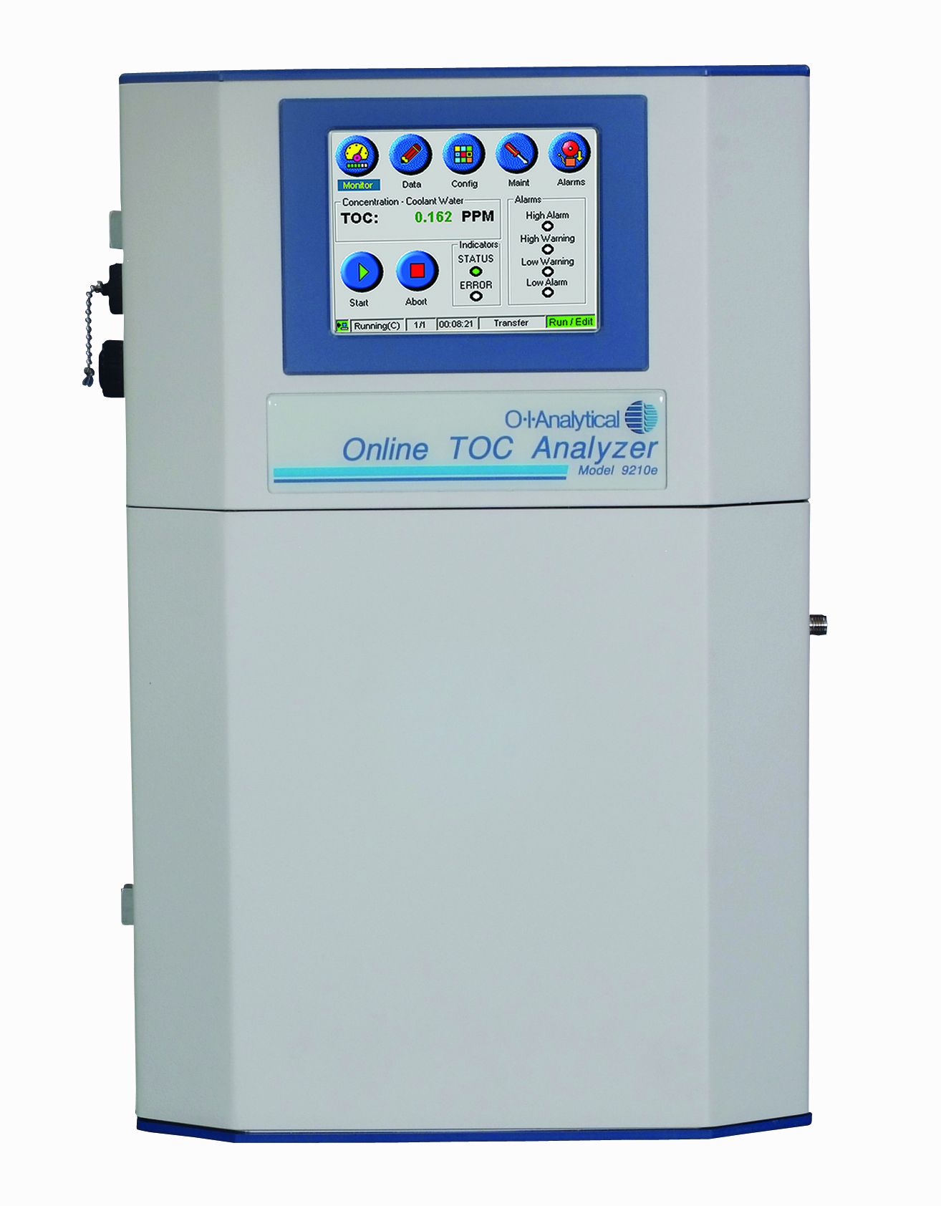
Analyzers Provide Water Security in Space and on Earth
Johnson Space Center
OI Analytical
College Station, Texas
NASA Technology
With no regular access to fresh water, reuse is crucial to the International Space Station (ISS)
Quality remains a concern, as any contamination can place infected crew in a dire situation
NASA was dissatisfied with its current contaminant detection device and looked to industry to improve it
Partnership
NASA contracted OI to build a new total organic carbon analyzer (TOCA), which scans for organic compounds—likely contaminants—in the water
OI already had a prototype from its existing products, which saved NASA two years in development time
The new device reduced the amount of equipment needed to run ISS and made it possible to double the crew to six members, the station’s full capacity
Benefits
OI’s TOCA relies on electricity to measure carbon, instead of chemical processes
Using this system, the typical operator can save 90 percent on installation costs and reduce ongoing expenses by $500 a month
Standard TOCAs are the size of refrigerators; OI’s TOCA’s footprint is a little larger than a piece of paper
Spinoff 2011
Energy and Environment

Slide 31
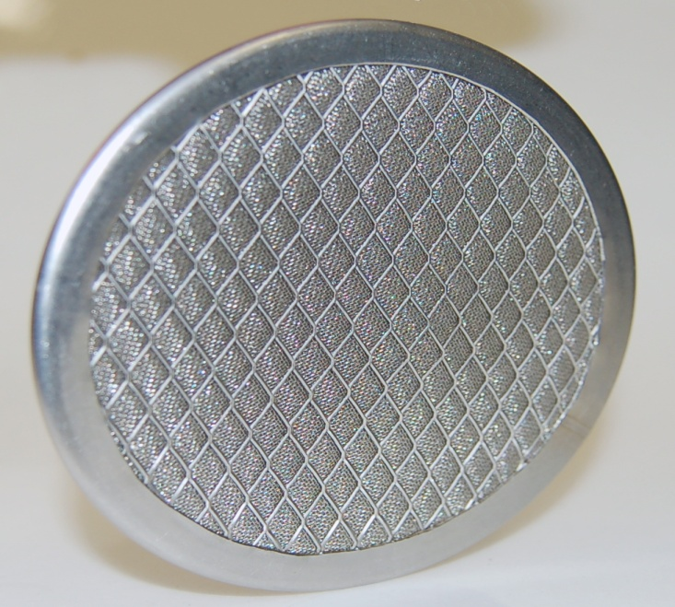
Catalyst Substrates Remove Contaminants, Produce Fuel
Marshall Space Flight Center
Precision Combustion Inc. (PCI)
North Haven, Connecticut
NASA Technology
With no fresh supply of air, there is great potential for contaminants to build up within the International Space Station (ISS)
NASA wanted a regenerable process for ongoing removal of carbon dioxide and contaminants on long-term missions
Partnership
PCI had previously devised spinoff catalytic converters for automotive exhaust applications
Through a Small Business Innovation and Research (SBIR) contract, PCI adapted its technology to provide a trace contaminant removal system
PCI received the “Tibbetts Award” and “Army SBIR Achievement Award,” twice each, for the technology’s many applications
Benefits
PCI devices ensure clean and efficient combustions, provide emissions controls, and are also applied to chemical manufacturing
Its Microlith reactor can convert hydrocarbon into syngas, which can operate fuel cells
Microlith technology is being used as a fuel reformer in the Navy, Army, and Air Force
Spinoff 2011
Energy and Environment

Slide 32
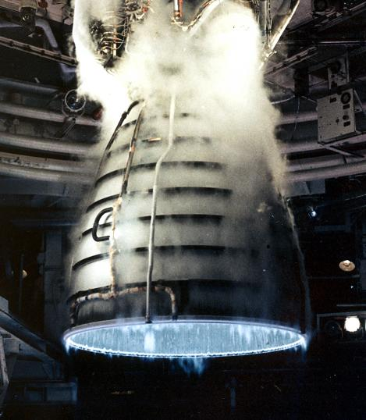
Rocket Engine Innovations Advance Clean Energy
Marshall Space Flight Center
Pratt & Whitney Rocketdyne (PWR)
East Hartford, Connecticut
NASA Technology
The Space Shuttle Main Engines (SSMEs) are an incredible feat of engineering, burning 1.6 million pounds of propellant in 9 minutes, reaching internal temperatures of 6,000 °F
Over 30 years, SSMEs have powered 135 shuttle missions with a 100-percent success rate
Partnership
PWR developed the SSME in the 1970s and soon after began developing efficient gasification systems, which convert carbon-containing materials (e.g., coal, biomass) into syngas, an alternate form of fuel
Its expertise in rocket engines allowed PWR to increase the temperatures and pressures in a gasifier, resulting in a much higher efficiency system
Benefits
PWR began operating a pilot plant in Illinois that has established the gasifier’s successful performance and operation over a range of conditions
Compared to other systems, a PWR gasifier plant can cut the required capital investment by 10–20 percent, and reduce carbon emissions by up to 10 percent
Spinoff 2011
Energy and Environment

Slide 33
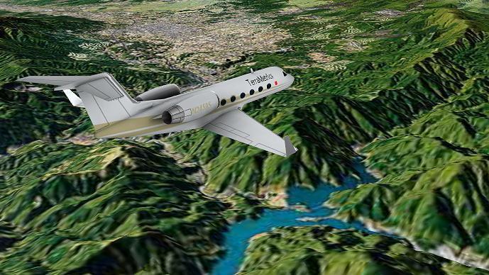
Technologies Render Views of Earth for Virtual Navigation
Stennis Space Center
Langley Research Center
TerraMetrics Inc.
Littleton, Colorado
NASA Technology
Controlled flight into terrain poses a threat to pilots in bad weather, fog, or nighttime flights
To improve aviation safety for pilots in poor visibility, NASA began exploring the possibilities of synthetic vision—creating a realistic graphical display of the terrain outside for use by the pilot
Partnership
Langley partnered with TerraMetrics through the Small Business Innovation Research (SBIR) program to develop 3D terrain rendering technology
To produce its visuals, TerraMetrics relied on Stennis’ Scientific Data Purchase Program
The company created a special graphical representation of the Moon for NASA to test flight simulators and even lunar lander vehicles
Benefits
TerraMetrics commercialized the technology as the TruEarth satellite imagery and terrain data product line
Its imagery powers Google Earth and Google Maps software
The technology is also well suited for online mapping and flight deck display programs
Spinoff 2011
Information Technology

Slide 34

Content Platforms Meet Data Storage, Retrieval Needs
Goddard Space Flight Center
Hitachi Data Systems Corporation
Santa Clara, California
NASA Technology
Earth is under a constant barrage of information from NASA’s probes, spacecraft, and satellites
One of NASA’s data archives now holds 4.5 petabytes of data, or 90 million filing cabinets’ worth
NASA sought to produce a single, consolidated, and scalable repository of digital data
Partnership
In 2004, NASA partnered with Archivas Inc. to preserve and make accessible data repositories
The resulting technology allowed multiple protocols and applications to make use of the same data set
Hitachi Data Systems purchased Archivas and developed the technology into a system that won an “Information Management Innovation Award” from Information Age magazine
Benefits
The Hitachi Content Platform (HCP) is capable of scaling up to a 40-petabyte capacity
HCP also provides secure content management for large companies, in one case achieving an 80-percent increase in administrative efficiency
The system is also ideal for cloud-computing applications
Spinoff 2011
Information Technology

Slide 35
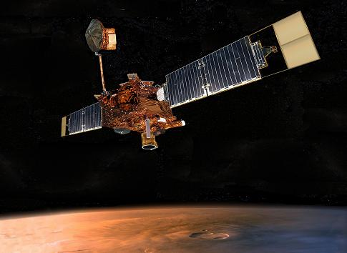
Tools Ensure Reliability of Critical Software
Jet Propulsion Laboratory (JPL)
GrammaTech Inc.
Ithaca, NY
NASA Technology
NASA’s Mars Global Surveyor experienced an unexpected 2-day lapse in communication following a software defect
Since spacecraft have become increasingly reliant on software, a NASA scientist proposed compliance rules to reduce risk and provide consistency
Partnership
JPL had already awarded a Small Business Innovation Research (SBIR) contract to GrammaTech to create a tool that can automatically check software for compliance
GrammaTech adapted its product, CodeSonar, to include verification of “The Power of 10,” NASA’s software compliance standards
Benefits
GrammaTech adapted CodeSonar for commercial use; the software finds problems in a program without executing any part of it
CodeSonar has hundreds of users worldwide, from Fortune 500 companies and startups to cell phone companies and many nonprofit and governmental organizations
Spinoff 2011
Information Technology

Slide 36
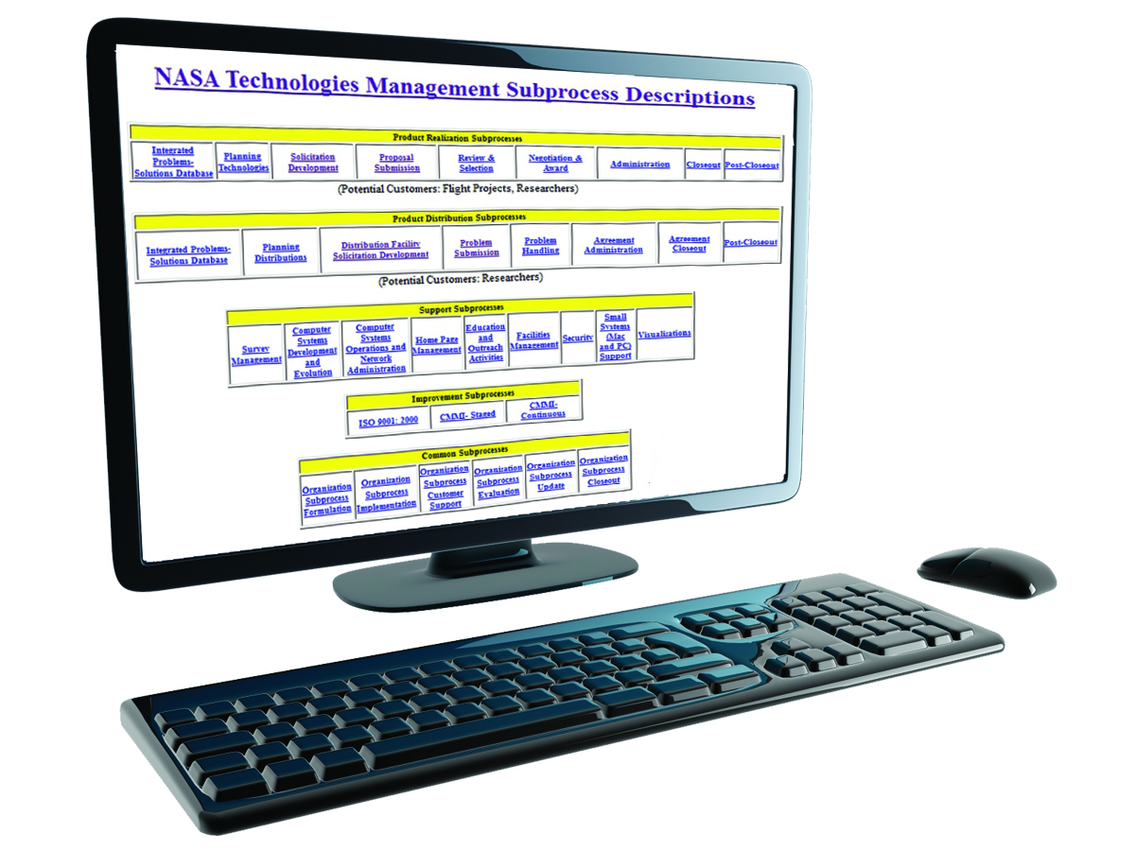
Electronic Handbooks Simplify Process Management
Goddard Space Flight Center
REI Systems
Herndon, Virginia
NASA Technology
To better handle process management on a large scale, NASA developed the Electronic Handbook (EHB) concept
The EHB provides documenting tools for process developers and participants to help them quickly learn, adapt, test, and teach their views
Partnership
Responding to interest from Federal agencies, NASA applied EHB to the Small Business Innovation Research (SBIR) and Small Business Technology Transfer (STTR) programs
NASA partnered with REI to build an integrated, uniform, and extensible framework for storage, retrieval, and update of heterogeneous objects
Benefits
REI extended the EHB concept into applications that manage the grant-making processes for a diverse group of Federal agencies
REI’s program has more than 60,000 users with over $6 billion in financial transactions per year
EHB supports 300 grant programs; 10,000 grantees; and 1,500 employees
Spinoff 2011
Information Technology

Slide 37
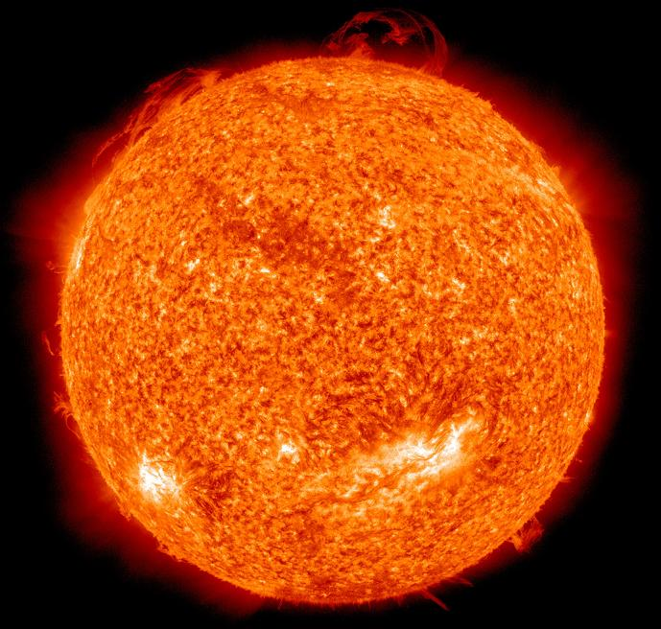
Software Innovations Speed Scientific Computing
Goddard Space Flight Center
Tech-X Corporation
Boulder, Colorado
NASA Technology
The Heliophysics Division of NASA’s Science Mission Directorate pursues a variety of missions to study the Sun
NASA gathers a wealth of data on the Sun every day and deciphers it using a programming language called Interactive Data Language
Partnership
As NASA requires ever greater computing power, it awarded a Small Business Innovation Research (SBIR) contract to Tech-X, which developed applications to run IDL on cluster systems
The new arrangement increased performance in an environment familiar to the scientists while reducing the time needed to analyze large amounts of data
Benefits
Tech-X’s software, FastDL, process up to 40 times faster than previous applications
With 70 employees, Tech-X has earned over $200,000 selling its NASA-derived technology
An additional spinoff technology, GPULib (a library of mathematical functions to facilitate data processing) has been downloaded 10,000 times
Spinoff 2011
Information Technology

Slide 38
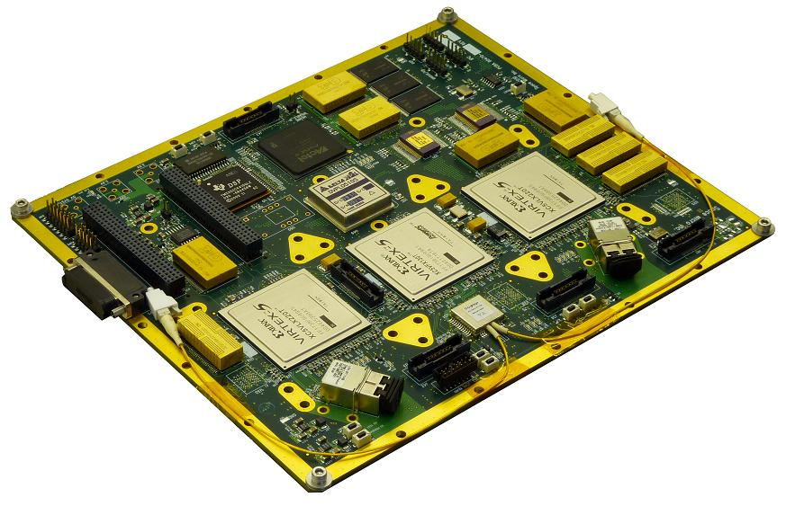
Controller Chips Preserve Microprocessor Function
Marshall Space Flight Center
Space Micro Inc.
San Diego, California
NASA Technology
A dip in the Earth’s magnetic field over the southern Atlantic allows radiation to interfere with satellites
Space radiation can cause physical damage to microchips and even change the software commands in computers, causing them to go into hibernation and become unresponsive
Partnership
Through a Small Business Innovation Research (SBIR) contract, Space Micro developed technology to mitigate radiation-caused interruptions
A Space Micro computer was selected to run medical equipment on the ISS
Space Micro received a “Tibbetts Award” in 2011 for its work and has been recognized by Inc. magazine for its fast growth
Benefits
Hardened-Core (H-Core) technology is a hardware/software combination that lets a system return to operation after interruption
It’s now marketed in space, aerospace, military, and domestic security markets
Space Micro’s revenue has grown from $1 million to $8 million
Spinoff 2011
Information Technology

Slide 39
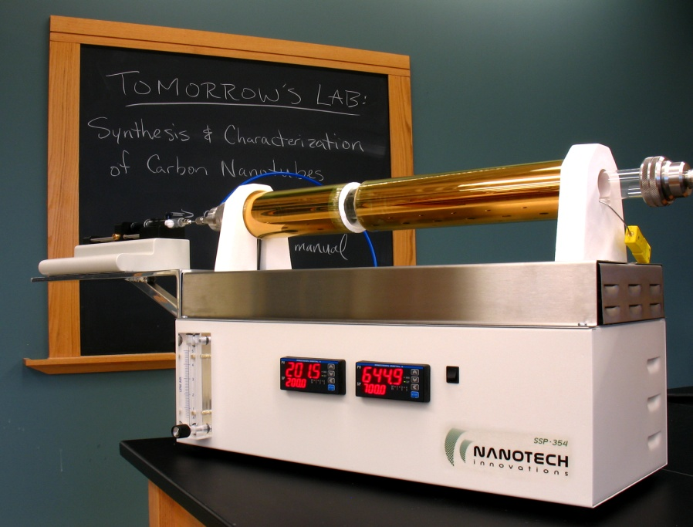
Nanotube Production Devices Expand Research Capabilities
Glenn Research Center
Nanotech Innovations
Oberlin, Ohio
NASA Technology
In order to supply power to deep space probes, NASA developed photovoltaic cells, the building blocks of solar power systems, from nanomaterials
The carbon nanotube has the potential to greatly enhance the reliability of power generation and storage devices in space and on Earth
Partnership
A chemist at Glenn developed a unique process to grow high quality carbon nanotubes
Glenn was more interested in the photovoltaic applications and not the production of the tubes, so it released the technology to the scientist
Nanotech Innovations was born and immediately filed a patent on the technology
Benefits
The SSP-354 is a portable, easy to use, bench-top system for growing high quality carbon nanotubes in a single-step process
The machine is supporting the incorporation of carbon nanotubes into science curricula, research, and product development
Spinoff 2011
Industrial Productivity

Slide 40
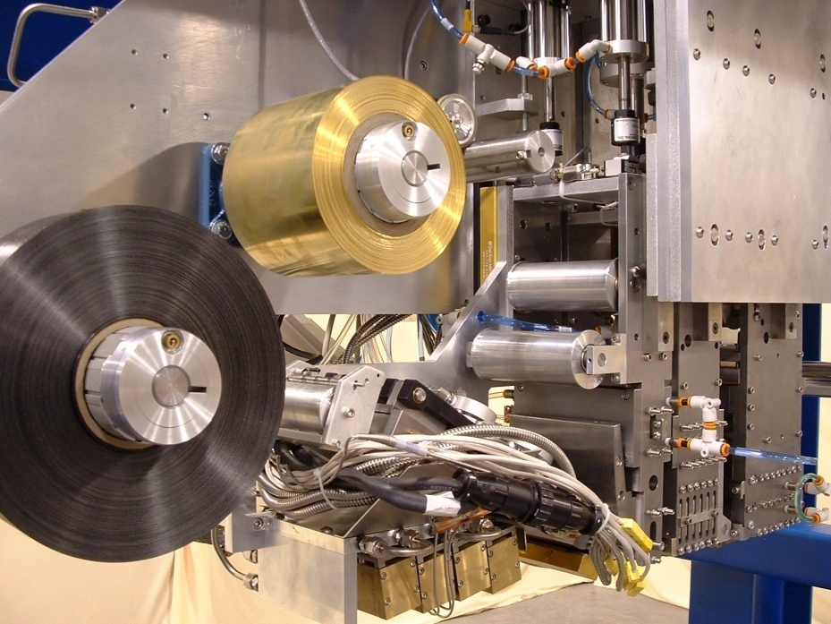
Custom Machines Advance Composite Manufacturing
Langley Research Center
Accudyne Systems Inc.
Newark, Delaware
NASA Technology
Composites provide enhanced mechanical and physical properties and offer promising solutions as a lighter and inexpensive yet strong building material
NASA has recently explored the use of composites for aerospace applications through projects like the Composite Crew Model
Partnership
To help develop manufacturing techniques, Langley partnered with Accudyne through the Small Business Innovation Research (SBIR) program
Accudyne applied its expertise to create a reshapable, reprocessable thermoplastic tape laydown head, and is currently engaged in a Small Business Technology Transfer (STTR) project to improve its properties
Benefits
Accudyne services autoclave-cured thermoset materials, which are still the industry standard
Its automated solutions enable higher quality manufacturing at lower costs
An Accudyne-built machine is currently available at Langley to develop a database of processes and parts made from thermoplastics
Spinoff 2011
Industrial Productivity

Slide 41
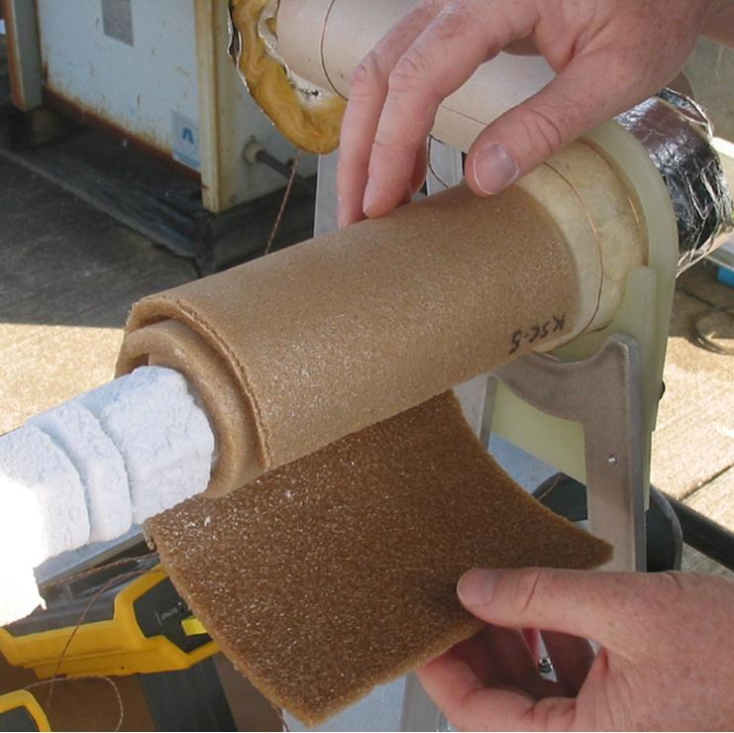
Polyimide Foams Offer Superior Insulation
Langley Research Center
GFT LLC
Pennville, Indiana
NASA Technology
While trying to create a composite solid, NASA scientists accidentally developed a method for creating an insulating foam out of a polyimide (an advanced polymer) material
Named TEEK, the new foam presented a host of advantages over existing insulators
Partnership
The team’s invention won an “R&D 100” award and a later version was named “NASA Invention of the Year” in 2007
NASA licensed TEEK to GFT, which optimized the technology to create the first highly flexible foam from polyimide spheres
Benefits
The PerForma-H and VersaFlex product lines provide flexible insulation that can cover more than a 1,000-degree temperature range
They have a superior performance-to-weight ratio; they do not burn or produce smoke or toxins in a fire
Manufacturing the foam is a wasteless process
Spinoff 2011
Industrial Productivity

Slide 42
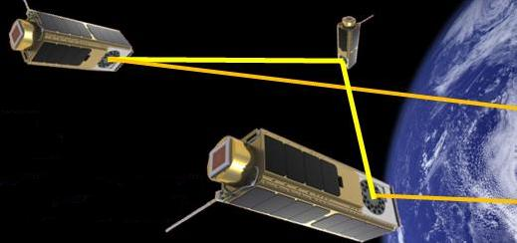
Beam Steering Devices Reduce Payload Weight
Johnson Space Center
Langley Research Center
Boulder Nonlinear Systems Inc. (BNS)
Lafayette, Colorado
NASA Technology
Traditionally, redirecting lasers in space for precision applications requires swinging the entire laser apparatus toward the target
A NASA partner invented a beam steering method that bends and redirects beams using low amounts of power and a reduced footprint
Partnership
Through Small Business Innovation Research (SBIR) contracts with Johnson and Langley, BNS developed a solution to some of the problems of mechanical beam steering
Under a 2002 Phase II SBIR grant, BNS developed high-speed, high-resolution, fully programmable nonmechanical beam steering by using optical phase array (OPA) chips
Benefits
The liquid crystal on silicon OPA chips enable accurate and precise laser beam steering
BNS’s NASA-derived chips are used by all the major aerospace companies and by over 100 research laboratories and universities
OPA chips have applications in forensics, military sensing technology, and laser imaging
Spinoff 2011
Industrial Productivity

Slide 43
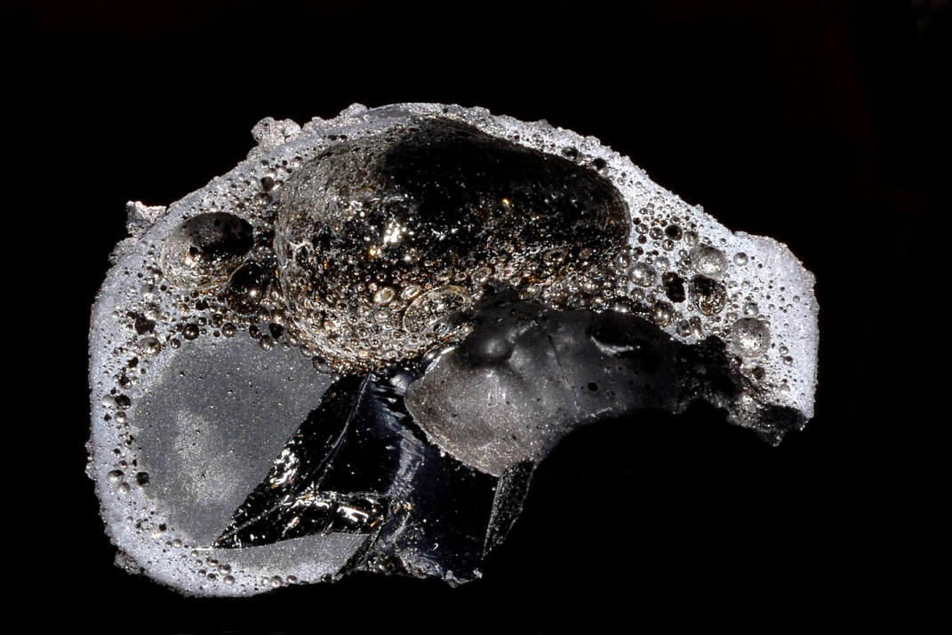
Models Support Energy-Saving Microwave Technologies
Kennedy Space Center
Ceralink
Troy, New York
NASA Technology
Lunar dust—which has sharp, irregular edges and is laden with radiation—poses a threat to equipment and health and safety risks to astronauts
NASA has researched a variety of tools to deal with the dust, and in 2009 investigated a method to harden the dust into a pavement-like surface
Partnership
Kennedy awarded Small Business Innovation Research (SBIR) funding to Ceralink to develop a microwave system for heating lunar soil to 2,000 °F
As a part of the SBIR and in partnership with Rensselaer Polytechnic Institute, Ceralink also developed modeling software to accurately simulate microwave heating on a large scale
Benefits
Ceralink specializes in microwaves, materials, processing, and design; they provide microwave technology for research and manufacturing
Working with the U.S. Department of Energy, the company is using the program to test microwave technology as an energy-saving method for making plastics
Spinoff 2011
Industrial Productivity

Slide 44
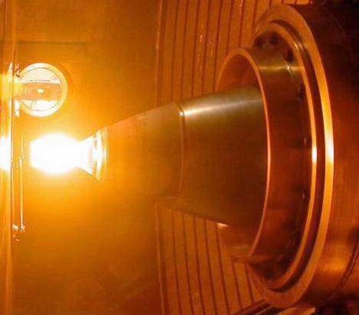
Materials Advance Chemical Propulsion Technology
Glenn Research Center
Marshall Space Flight Center
Plasma Processes Inc. (PPI)
Huntsville, Alabama
NASA Technology
In the future, NASA hopes to utilize lower-cost propulsion systems for satellites, probes, and rovers
Glenn developed the Advanced Materials Bipropellant Rocket (AMBR), an advanced chemical propulsion system that runs at extremely high temperatures
Partnership
NASA contracted PPI to modify a state-of-the-art engine design so that the combustion chamber could operate at high temperatures
PPI continues to develop AMBR technology through a Small Business Innovation Research (SBIR) contract to improve the room-temperature yield strength of the combustion chambers
Benefits
PPI’s method reduces fabrication costs for iridium-coated rhenium material systems
The new chamber set a record for efficiency, which means a reduction in the propellant required to perform spacecraft maneuvers
PPI has sold the technology in the commercial aerospace community
Spinoff 2011
Industrial Productivity

Slide 45
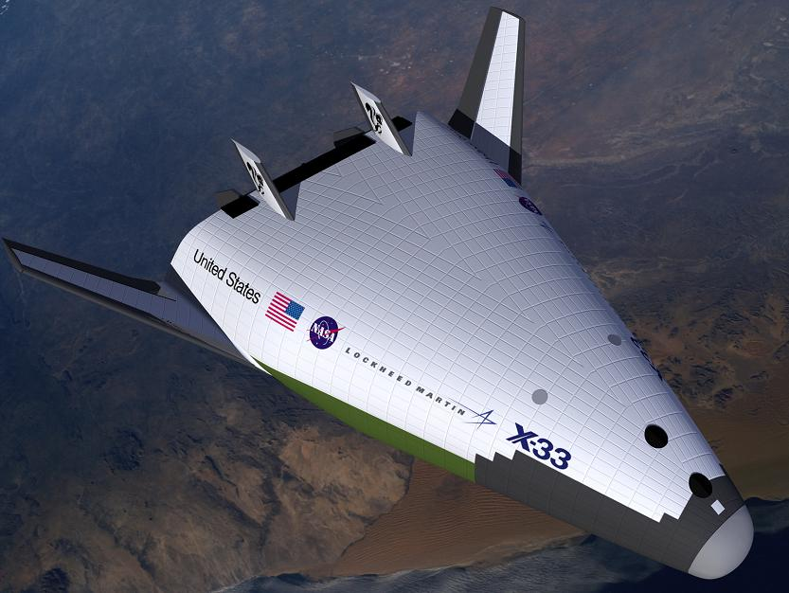
High-Temperature Coatings Offer Energy Savings
Ames Research Center
Emisshield
Blacksburg, Virginia
NASA Technology
As the U.S. X-Plane Program continued to break new boundaries, NASA researched new thermal protection materials for reusable spacecraft
This research resulted in the Protective Ceramic Coating Material (PCCM), a thin and lightweight coating that protects against extreme temperatures
Partnership
When NASA made PCCM available, Emisshield licensed the coating for research and development
After testing its capabilities, Emisshield licensed PCCM to include all applications except space and space vehicles
From the base license the company developed two new patents, including technology to apply PCCM more easily to metal surfaces with a spray gun
Benefits
Emisshield (the company’s main product line) works to protect and increase the efficiency of any place that requires heat for production
Emisshield saves up to 15 percent on energy and boosts productivity by up to 15 percent
Furnaces that have been improved include those making windshields, bread, and wine bottles
Spinoff 2011
Industrial Productivity

